Slide 1

WP5 Review
USE CASE 1: Crowdsourced video broadcasts

Slide 2
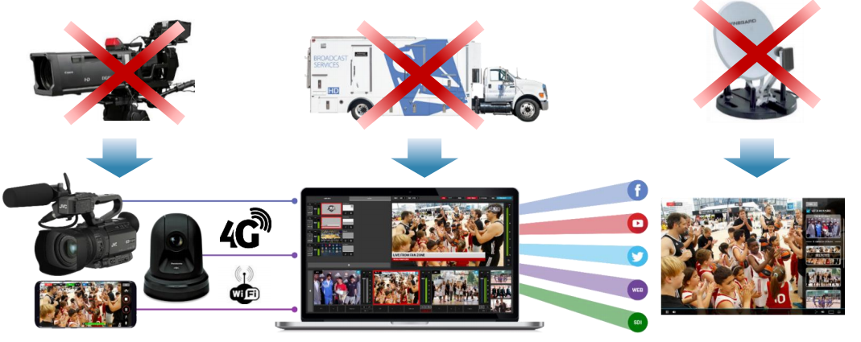
Use Case Features
Crowd sourced video streaming
  Enable crowd sourced live video streaming services to scale over large numbers (>1000 users)
Challenges
  Currently all user generated videos are encoded and streamed to a centralised data centre where the video streams are processed.
  Network bandwidth and latencies affect scaling to large user numbers
  Increase in cost(BW), latency(encoding, processing, decoding) and computing resources at DC
Goal
  Not all videos are useful e.g: spectators from the same area pointing cameras at same locations (location aware streaming). So need a system to decode video stream metadata and decide which streams are useful
  Reduce cost and delays by providing computing capability as close as possible to the video streams
  Orchestrate network resources with virtual network/video functions
  Provide a slice for video streaming application owner to manage access control to video streams

Slide 3


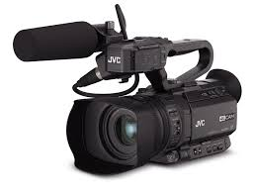
Crowdsourced video streaming
Orchestration (OSM)
VIM
WIM
VIM
Access SDN controller
Transport SDN controller
Metro & Core
DC SDN controller
DC1
Stadia 1
OpenConfig
Metro Network
Core Network
DPI, Firewall
Access Network
Video Function
DC2
Stadia 2
video data
The use case requires following network orchestrator capabilities to host the service:
Computing capability on the fly to aggregate and form clusters of crowd videos at the access network
Provide dynamic high capacity paths to upload clustered video streams
Platform to monitor and gather video application requirements and provide network services. E.g. as the number of video clusters allocate more paths to different cloud locations
Platform to provide virtual load balancers. Capabilities include layer4/7 load balancing, content caching and compression, TCP/IP multiplexing.

Slide 4
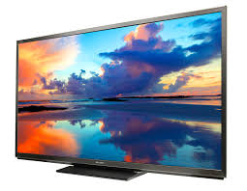
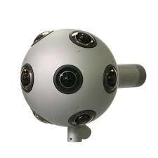
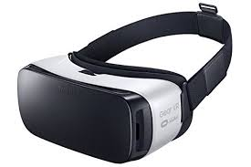
Planned demo scenario
OSM (Orchestration)
OpenStack
Access SDN controller
Transport SDN controller
Metro & Core
DC SDN controller
Stadium 1
University of Bristol
Dark Fibre Infrastructure(NDFIS)
BT Adastral
MCEN
AMEN
Video Clustering
Video encoding/ NAC
Reading
AMEN
Video encoding/ NAC
Simulated Stadium 2
Access/DC SDN control
Transport SDN control
Openstack control

Slide 5
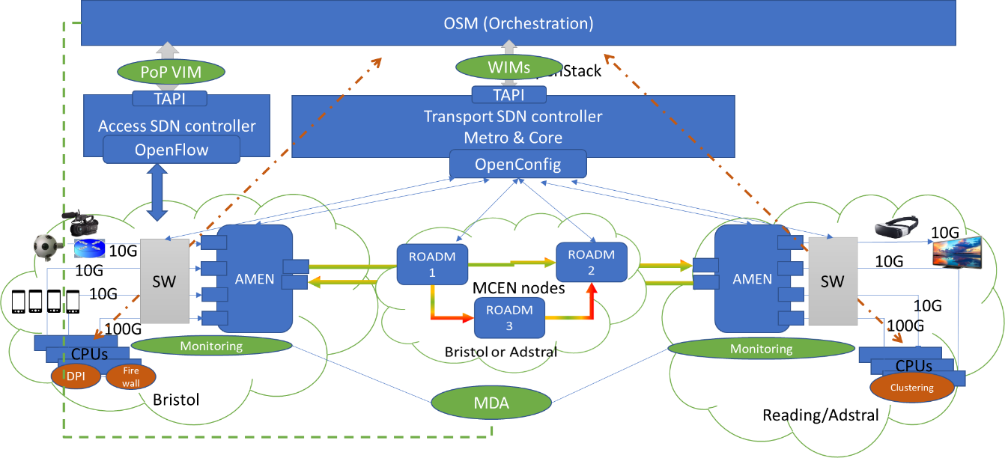
UC1 Demo elements

Slide 6
First crowdsource demo @ TIP conference

Slide 7
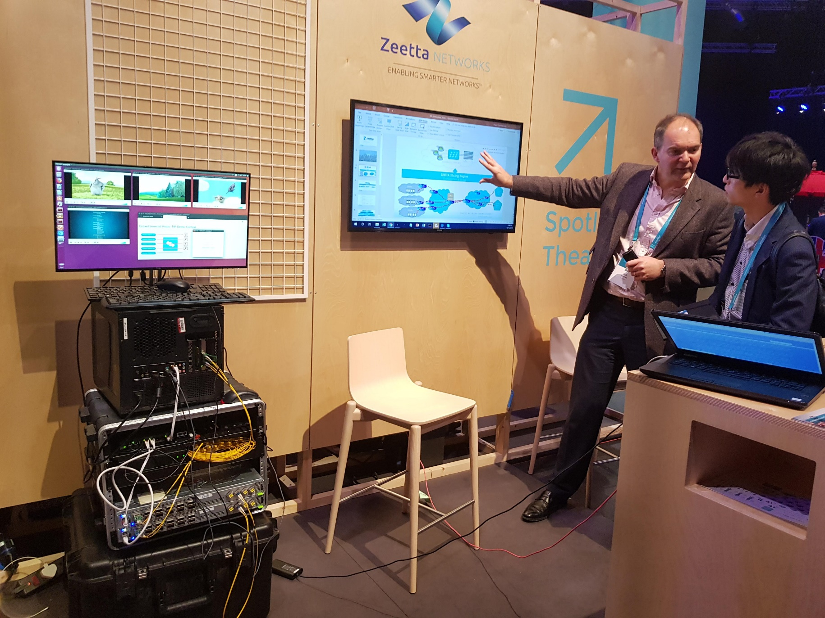
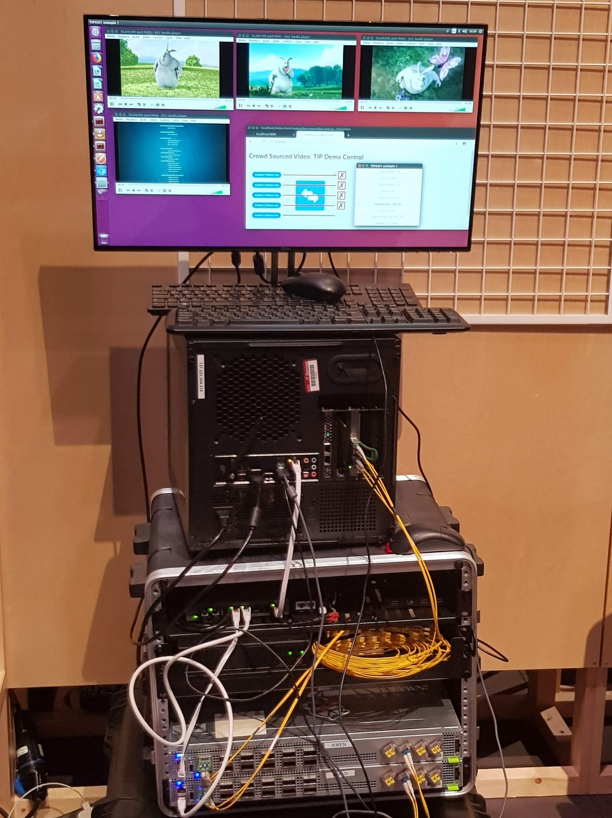
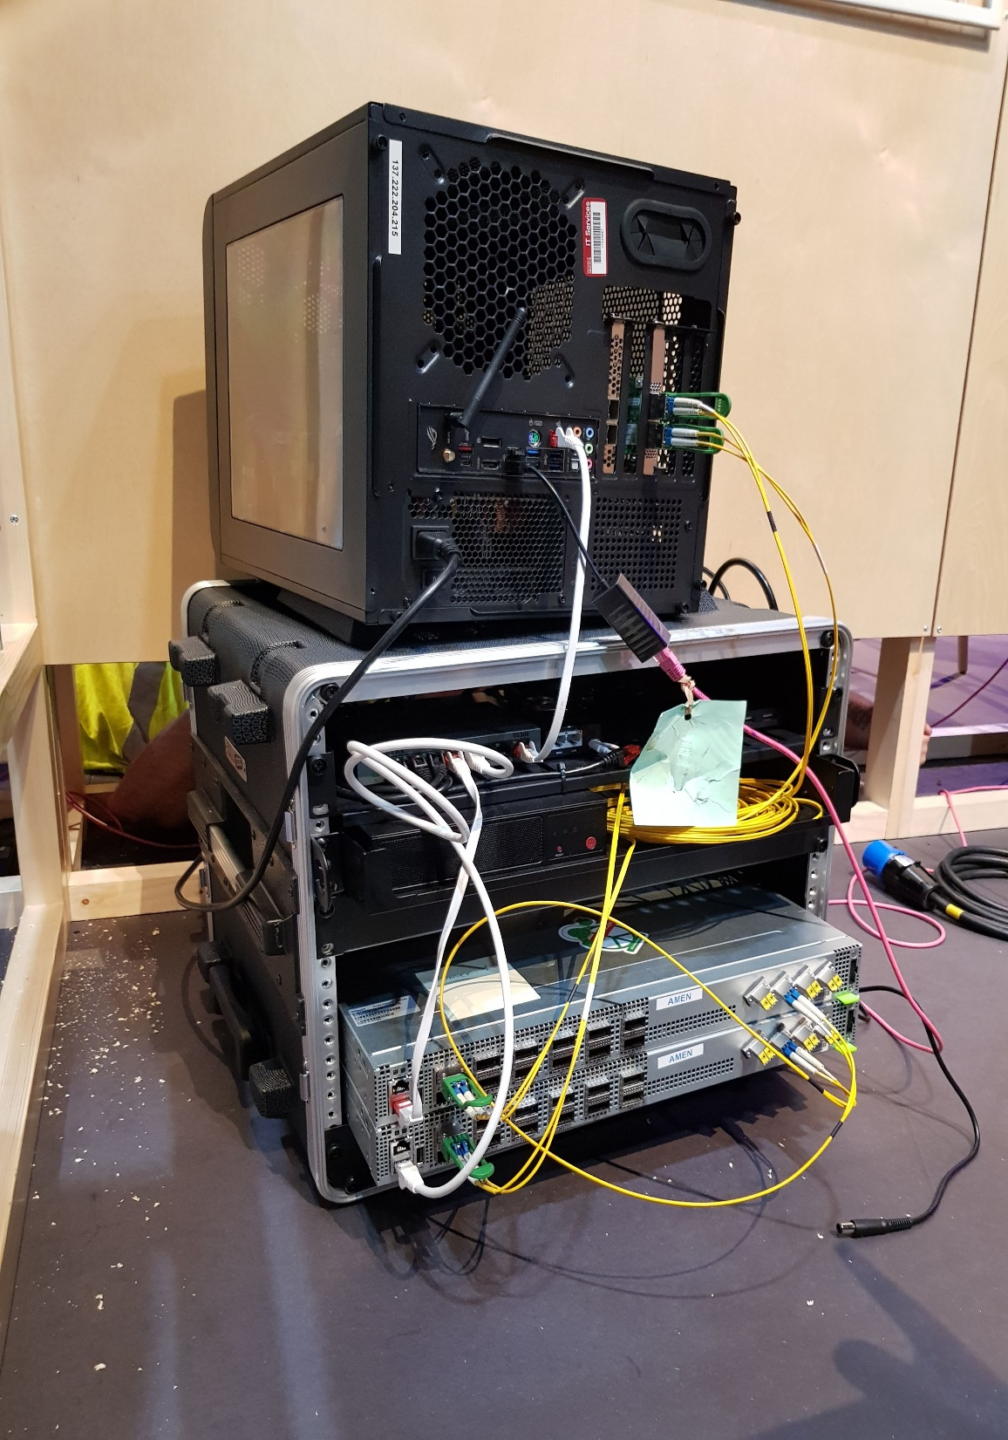
First Metrohaul UC1 demo @ TIPSummit18

Slide 8



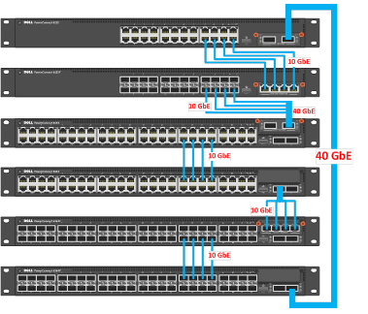
Crowdsource Video Slice
video data
NAC
NAC: Network Access Control
DC
Orchestration & Slicing
Crowd source DC
Stadia 1
Metro Network
Core Network
DPI
Access Network
Firewall
Crowd source DC
Stadia 2

Slide 9
Demo highlights
Service(Video streams) orchestration over dis-aggregated networks
Service orchestration using OSM (VIM and WIM enablers)
  Spawn VNFs (DPI, Firewall & Video function)
  Stitch VNFs with network resources(access←→transport←→DC)
Slice based service over dis-aggregated networks
MH1,2,3 &8 optical, E2E path connection time with reduced capex

Slide 10
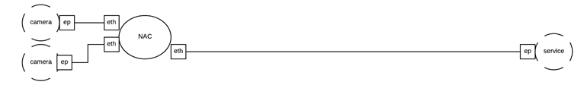
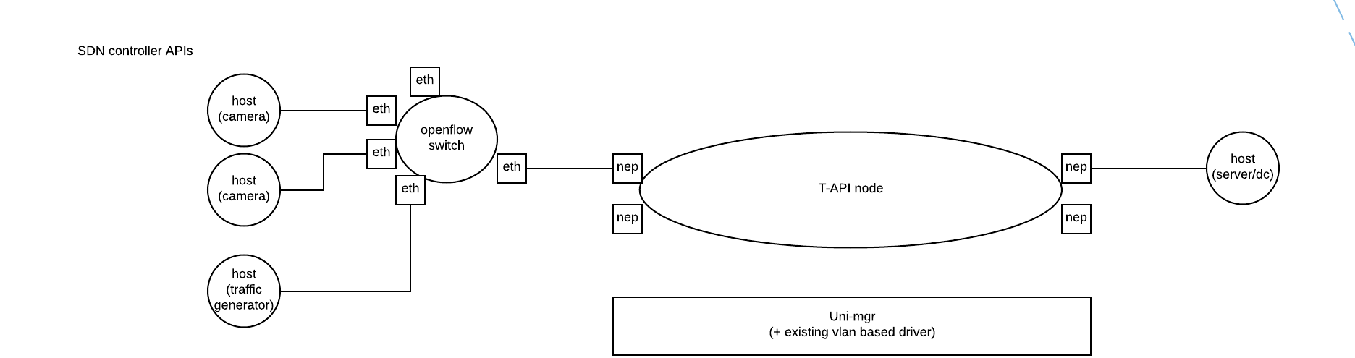
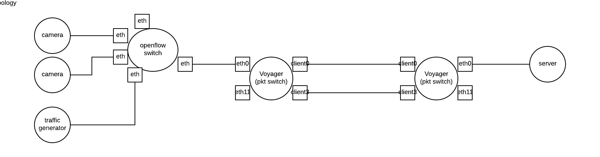
Slice View
Orchestration View: Connectivity services
Physical Topology View

Slide 11
Camera Port
Node V1
Node V2
Camera Port
VR port
Port, Transport
Port, Transport
VR port
VLAN A/B/C…
VLAN A/B/C…
OSM & Slicing
OpenStack
WIM
Transport SDN controller
Metro & Core
OpenConfig/ NCLU
Reading/Adstral
Bristol
Voyager1
2*200G
Voyager2
10G
10G
OXC
OXC
10G
10G
10G
10G
100G
100G
VNFs
VNFs

Slide 12
Demo Architecture
OSM
L2-SM
Zeetta Controller
T-API
T-API
Zeetta
Acc. Contr.
Zeetta
Transp. Contr.
ONOS
Contr.
Zeetta
Acc. Contr.
Edge video analysis
Transmission performance monitoring? (Nokia)
OpenConfig
OpenROADM
stadium
OpenROADM Agent
OpenROADM Agent
ROADM
(WSS)
Ericsson/CNIT
λ-sw
BT
SW
voyager
voyager

Slide 13
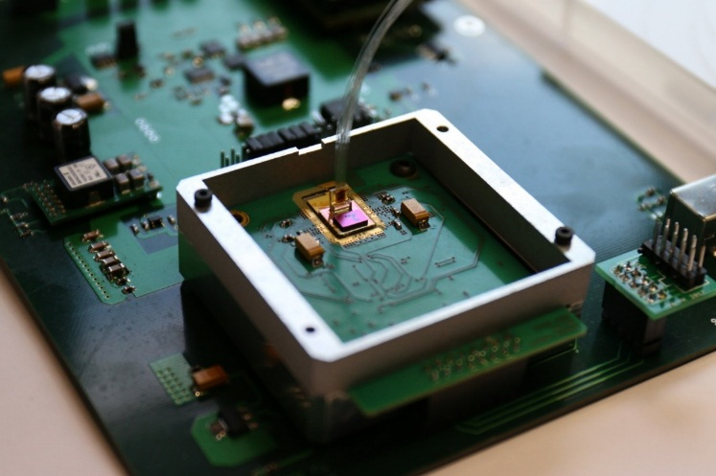



Hardware Details WP3
Component ID | Components | Lead Partner
D4 | Innovative photonic integrated optical switching solution for add/drop module of ROADM | TEI/CNIT
D12 | Programmable packet switching solution for interconnection of access and core segments | Bristol
D19 | Voyager Muxponder | BT/ Bristol
D21 | Bristol ROADM | Bristol
MDA | Agents for Monitoring and Data Analytics | UPC

Slide 14
Software Details WP4
Component ID | Components | Lead Partner
5.1.1 | Parent SDN Controller | TID
5.1.2 | ONOS Optical Controller | CTTC
5.1.3 | ONOS TAPI 2.1 SBI Driver | TID
5.1.4 | ONOS OC Driver | CTTC+CNIT
5.3.1 | Generic OpenConfig Agent | CNIT, CTTC
5.4.3 | OSM with WIM Plugin | Bristol +TID
5.6.1 | MDA Controller | UPC
5.6.2 | MDA Agent | UPC
5.7.1 | Front-end Net2Plan interfaces | UPCT

Slide 15
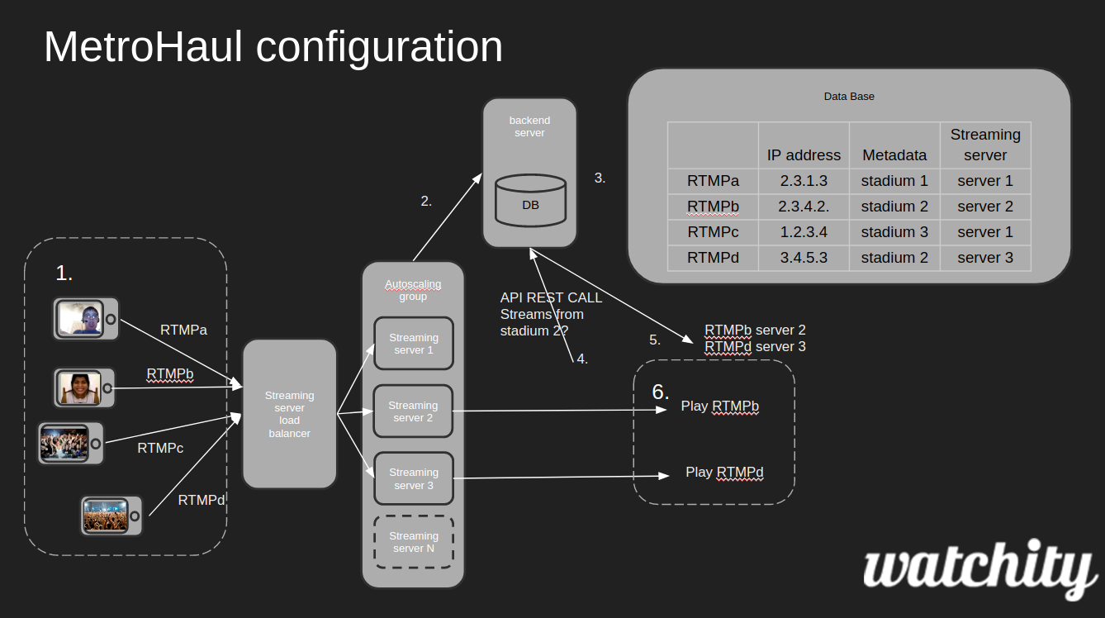
Crowdsource application

Slide 16

University of Bristol – BT Connection (Dark Fibre)
University of Bristol – BT (Ipswich) Link:
  530km of dark fibre
  Amplified link with optical filters in Cambridge.
  Performance:
    PM-QPSK (100Gb/s): 3.2E-9 (BER BT-Bristol), 8.2E-8 (BER Bristol-Ipswich) @Wavelength 1554.94nm.
    Measured Latency 5.5ms (RTT)
University of Bristol
HPN
Adastral Park
BT
Bradley Stoke
University of Cambridge
Bury St. Edmunds
Froxfield
Reading
Powergate
Telehouse
Duxford
Newmarket
Ipswich
23.6km
94.6km
51.3km
77km
35.2km
98.1km
30.5km
36.24km
24.1km
45.5km
14.2km

Slide 17
UC1 Challenges
Using Stadium WiFi a big hurdle
  Radio Spectrum utilization
  Scale: simultaneous connections
Crowd source application work
  https streaming: Work required from video app vendor to allow us to identify streams
BT to UoB link

Slide 18
Next Steps
Preparation for Bristol demo in collaboration with UoB/BT/TIM involving work on the following tasks:
  Openstack and Packet Switch for DC configuration; NFV deployment with openstack.
  NetOS SDN controller and packet switch integration
  OSM and WIMconnector development.
  DC compute node at BT site to provide; Configured by Zeetta and UoB
  NetOS and voyager integration and testing
  ONOS and ROADM integration and testing in NDFIS network
  NetOS and ONOS integration and implementation with OPENCONFIG
  Network service definition and NFV setup
  Crowdsourcing video streaming development efforts

Slide 19
BACKUP SLIDES

Slide 20
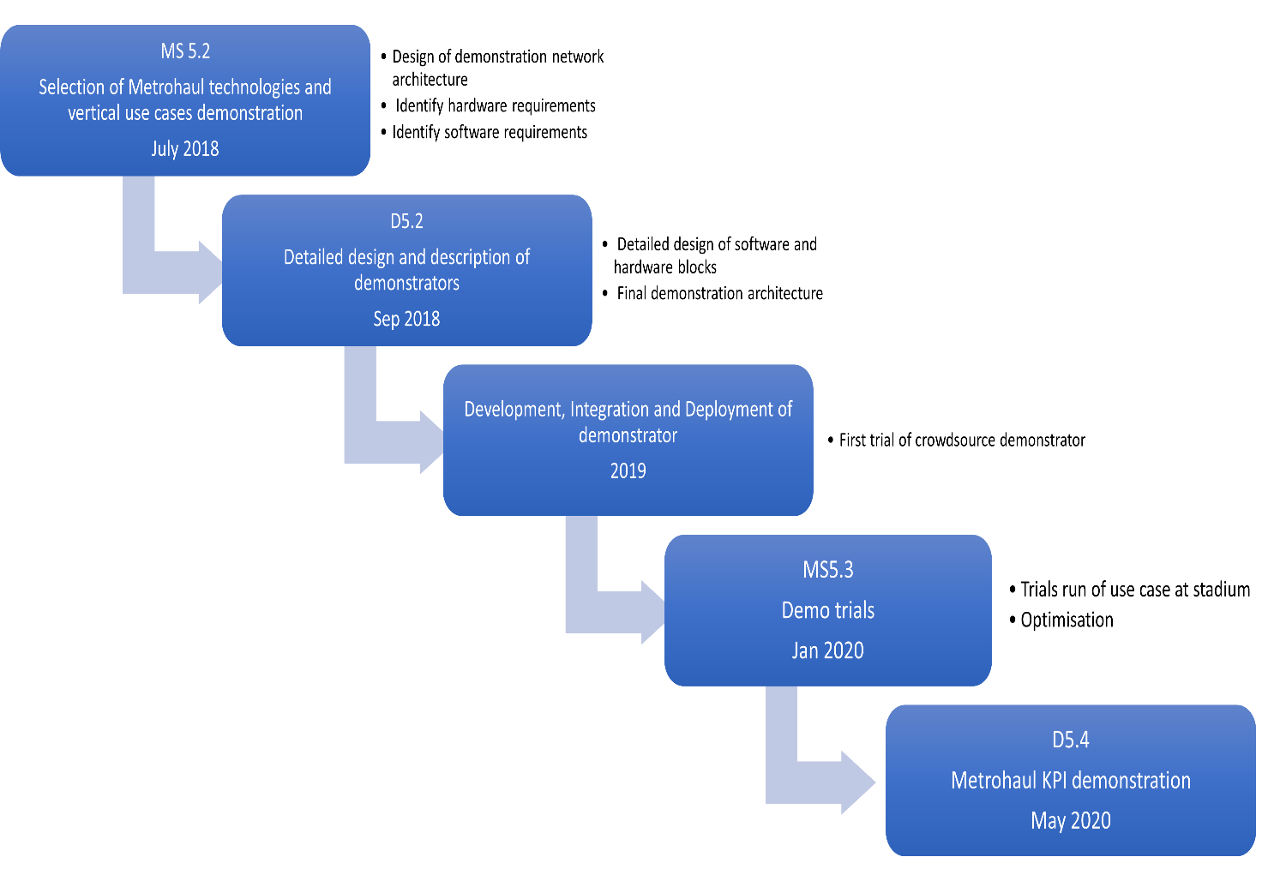
High Level Plan for demo submission
OFC submission

Slide 21
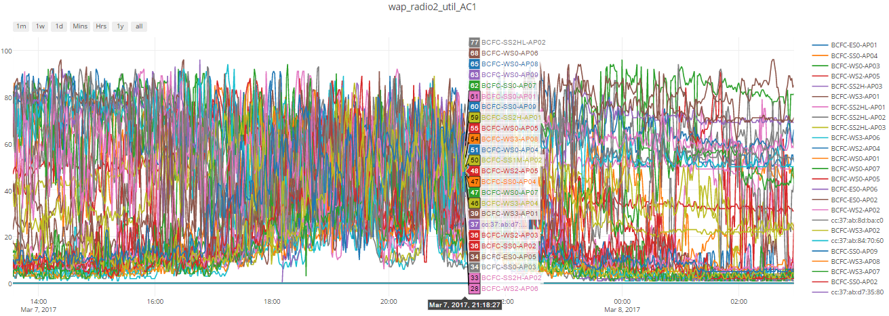
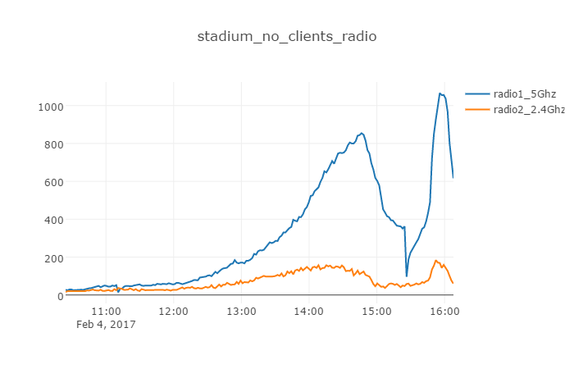
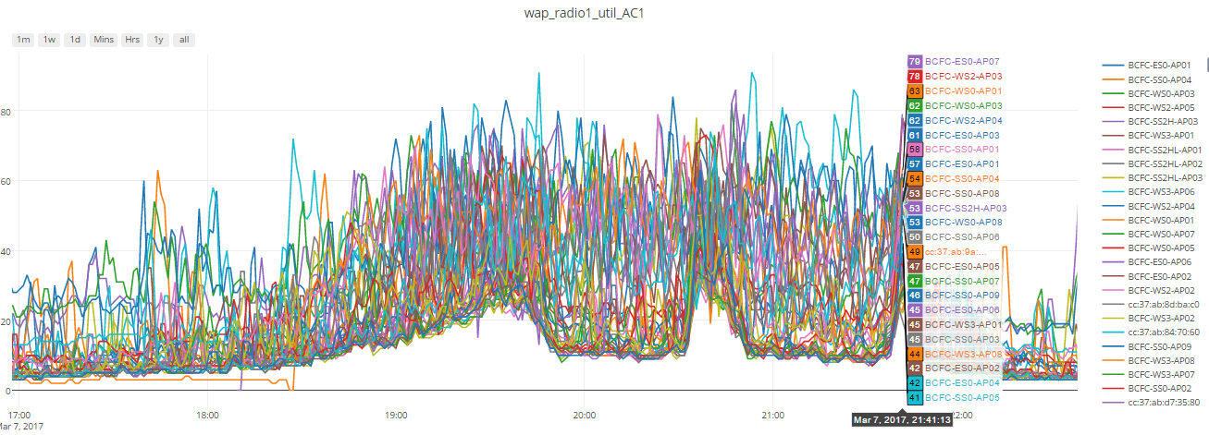
2.4G vs 5G spectrum utilization at Stadium

Slide 22
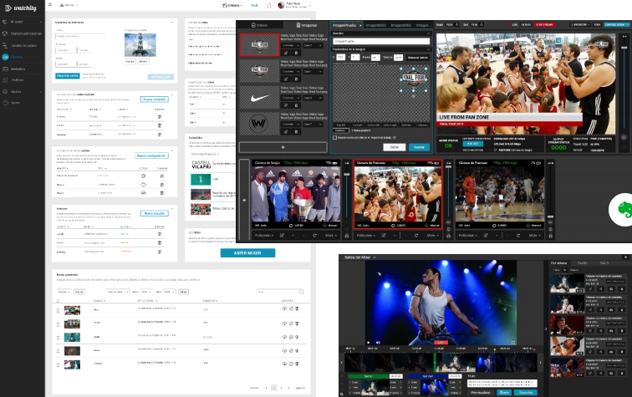
Crowd source app GUI

Slide 23
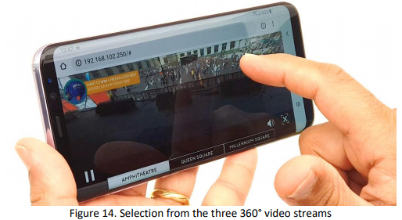
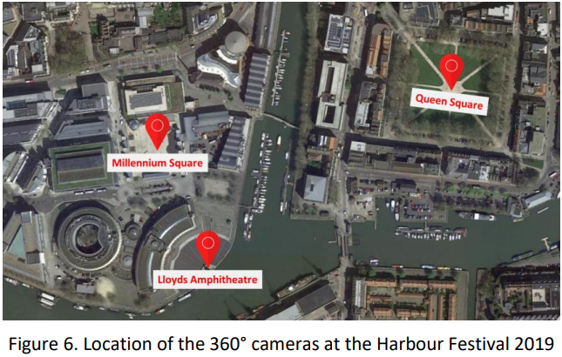
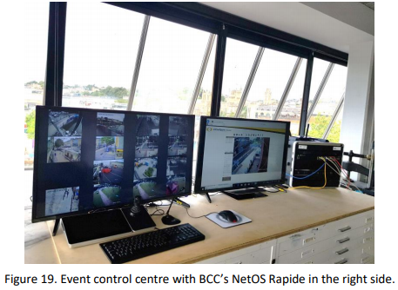
Plan B: Demo extension to Live 360’ cameras

