Slide 1
Metro-Haul Project Second Review WP1
Andrew Lord Andrew.lord@bt.com
Brussels, October 2nd , 2019
33 Avenue de Beaulieu - 1160 Brussels - Room BU33 0/54.

Slide 2
Introductions
Introduce the team
Andrew Lord (PM, WP1 lead), Albert Rafel (TM, WP2 lead) – BT
Emilio Riccardi (WP3 lead) - TIM
Ramon Casellas (WP4 lead) – CTTC
Oscar Gonzalez de Dios (WP5 lead)- TID
Adrian Farrel (WP6 lead) - OLD DOG CO
Reza Nejabati - UNIVBRIS
Luis Velasco - UPC
Filippo Cugini - CNIT
Patricia Layec - Nokia France
Antonio D’Errico (Project Innovation coordinator) - Ericsson Italia
Johannes Fischer - HHI
Annika Dochhan - ADVA
Nicola Calabretta - TU/e
Joao Pedro – Infinera / Coriant PT
Bodo Lent – Qognify / SeeTEC
Mayur Channegowda – Zeetta
Reviewers and PO introductions (apologies from Mario Scillia – Ari Sorsaniemi)
Other partners - Open Light Communications, Lexden Technologies, Nokia Italy, UC3M, Naudit, Polimi, UPCT (Pablo Pavon has long term vocal sickness – Andrew will present his slides)
Partner name changes
SeeTec – Qognify
Coriant - Infinera

Slide 3
Review Agenda
METRO-HAUL REVIEW – MORNING
9am Introductions. Overall project summary and progress inc. WP1 Andrew Lord (BT)
9.45am Innovation summary – Antonio d’Errico (Ericsson)
10am WP2. Albert Rafel (BT)
10.45am – 11am coffee break
11am WP3 Emilio Riccardi (TIM)
11.45am – WP4 Ramon Casellas (CTTC)
12.30 – 1.45pm lunch
METRO-HAUL REVIEW – AFTERNOON
1.45pm – 3pm WP5 Oscar Gonzales (TID)
3pm – 3.45pm WP6 Adrian Farrel (ODC)
3.45pm – coffee break
4pm – reviewers discussion
4.45pm feedback
QUESTIONS AD HOC AS WE GO THROUGH THE DAY – PLEASE INTERRUPT!
MIGHT REVERSE THE ORDER OF THESE

Slide 4
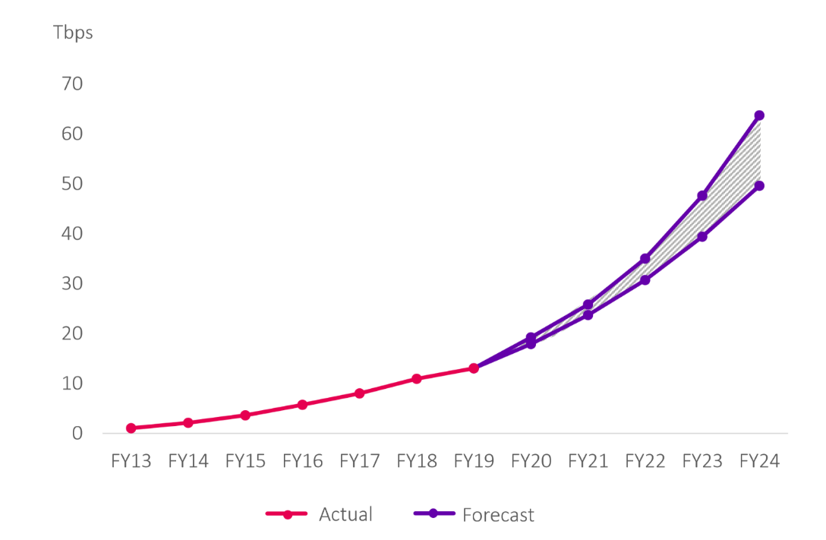
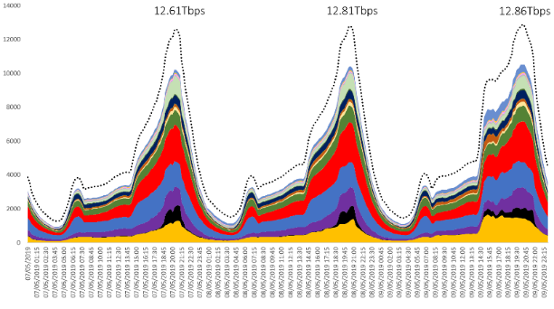
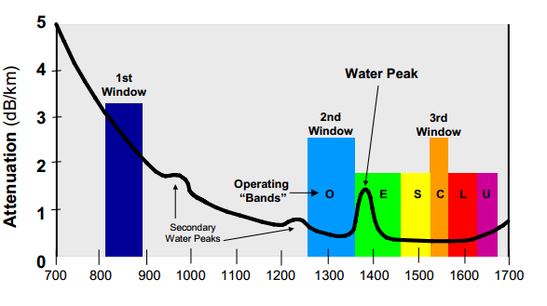
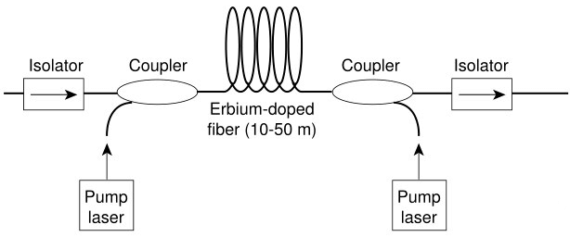
Optical networks are facing huge challenges
Network traffic growth set to continue
The UK will continue to see massive traffic growth
We need options beyond “more of the same fibre”
Slide presented by Tim Whitley (Head of BT Applied Research) at ECOC 2019 last week
May-13: 1 Tbps
May-19: 12 Tbps
Increased peak volatility linked to popular events/releases
200 Tb/s is plausible by 2030
Yet to see impact of 5G, AR/VR or IoT
200 Tb/s implies 10 ‘C’ bands in our biggest nodes
Simply stack fibres
Multi-band operation – new Amplifiers?
Multi Core Fibre?

Slide 5
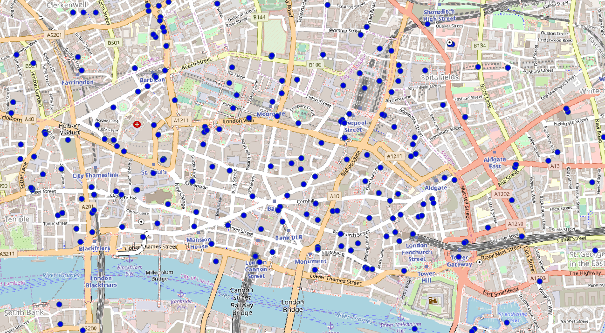
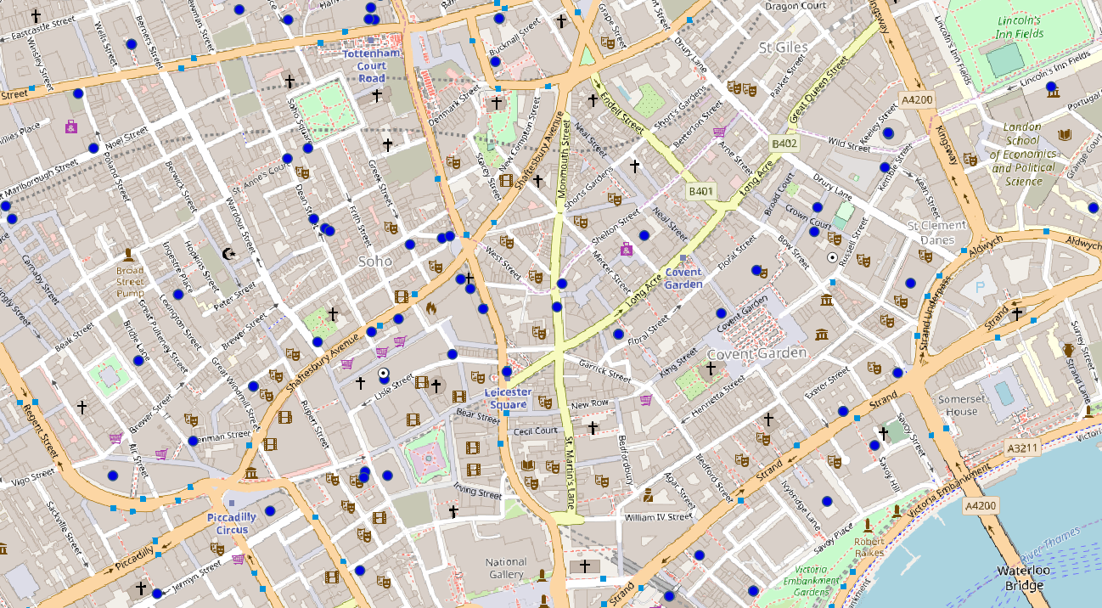
The scale of the 5G access network
Cell sites typically make use of
public infrastructure, e.g. lamp posts
high buildings
CITY OF LONDON
Macro-Cells
Central Office = AMEN
Central Offices
LONDON WEST-END
Next 2 slides presented by Albert Rafel at an ECOC 2019 workshop on future access last week
500m
Central Offices / AMEN
500m
WP1 Status - Metro-Haul Second Report Period Review Meeting (Brussels)

Slide 6
Transport Capacity Requirements Estimates from 5G terminals
MIMO | Peak data rate for F1 I/F from a single DU serving one RU (Mbit/s)
16 | 718 | 1436 | 2872 | 7180* | 19008 | 38016 | 76032
8 | 359 | 718 | 1436 | 3590 | 9504 | 19008 | 38016
4 | 180 | 359 | 718 | 1795 | 4752 | 9504 | 19008
2 | 90 | 180 | 359 | 898 | 2376 | 4752 | 9504
1 | 45 | 90 | 180 | 449 | 1188 | 2376 | 4752
 | 10 | 20 | 40 | 100 | 200 | 400 | 800
ITU-T
Table 10.1/ G.Sup66
Example of Transport Traffic at the F1 interface between DU (serving ONE RU) and CU
RF Bandwidth (MHz)
ITU-T
Table 10.2/ G.Sup66
Example of Transport Traffic at the F1 interface between DU (serving TEN RUs) and CU
MIMO | Aggregated F1 I/F data rate from a single DU serving 10 RUs (Mbit/s)
16 | 1465 | 2930 | 5859 | 14648 | 38777 | 77553 | 155106
8 | 733 | 1465 | 2930 | 7324* | 19389 | 38777 | 77553
4 | 368 | 733 | 1465 | 3662 | 9695 | 19389 | 38777
2 | 184 | 368 | 733 | 1832 | 4848 | 9695 | 19389
1 | 92 | 184 | 368 | 916 | 2424 | 4848 | 9695
 | 10 | 20 | 40 | 100 | 200 | 400 | 800
RF Bandwidth (MHz)
*Note: figures for 100MHz B/W in the air interface assume 64-QAM, but it may be possible to use 256-QAM thus requiring 25G-PON or higher

Slide 7
Metro Network Bottle-neck
Vast numbers of cell sites needed to provide future 5G bandwidth
Backhaul = deep fibre
Potentially hundreds of 10G + circuits over shortish range (20km typical)
Requirements will be
Ultra cost effective optical transport
Short reach DWDM
Some dynamic / optical switching capability
Without a dynamic Control Plane to orchestrate distributed DC and photonic resources, many 5G apps will be impossible
Metro-Haul focusing on these critical areas
Optical whitebox
Novel optical filters and transceivers
Filtered and filterless (and hybrid) networks
Edge compute resources
Edge-edge Control Plane

Slide 8
A world without Metro-Haul…
Danger that optical transport too expensive / too inflexible – causing a bandwidth bottle-neck
Whitebox is the avenue to introduce novel, exciting new technologies, avoiding vendor lock-in
Danger that NO DC functionality will be built at the edge
Too expensive without the ability to dynamically control it
Latency critical 5G applications might be impossible
Harder for EU innovation to be taken up
Innovation in Control-Plane
Innovation in novel optical solutions for EU-sized networks
Without Metro-Haul, true 5G (with all the exciting applications that come with it) will be too CAPEX-hungry resulting in much slower roll-out

Slide 9
The Metro-Haul Solution
Control / Orchestration
Metro scope
METRO TRANSPORT
Metro Core
Edge
Metro Node
Metro Node
Photonic Core
5G Access
Access
Metro
Edge
Metro Core
Edge
Metro Node
10-20 km
0.1-0.2ms
50-200 km
0.5-2ms
100-1000 km
1-10ms
Access Metro Edge Node (AMEN) – multiple ubiquitous access technologies, cloud enabled (storage, compute)
Metro Transport Network – metro node: pure transport
Metro Core Edge Node (MCEN) – Larger cloud capabilities
Metro Control Plane – full orchestration

Slide 10
How Metro-Haul works
WP1 Project Management
WP2
Develop Use Cases.
Techno-Economic modelling
WP5
Demos
WP4
Control plane
Telemetry, monitoring
WP3
Physical Layer
WP6 Dissemination

Slide 11
Metro-Haul Main Objectives
Architect and design cost-effective, energy-efficient, agile and programmable metro networks
Scalable for 5G access and future requirements
Design of all-optical metro nodes (including full compute and storage capabilities)
Interface with both 5G access and multi-Tbit/s elastic core networks.
Challenges:
Optical challenge, cost effective and agile, involving both the optical architecture and also innovative new optical component technologies -> disaggregated white boxes
Network management challenge. SDN/NFV control framework supporting 5G operational and both end-user and vertical oriented services, including slicing.
Monitoring challenge. Implementation & AI-based tools for interpreting vast amounts of data
Use Cases
Video Security for Smart Cities - Intelligent video security based on automatic object/person identification and tracking.
Crowdsourced Video Streaming - Simultaneous sourcing of video from different individuals in an event with a large crowd.
Additional demonstrations will be showcased at relevant events

Slide 12
Metro-Haul KPIs derived from 5G PPP KPIs
 | 5G-PPP Performance KPIs
P1 | Providing 1000 times higher wireless area capacity and more varied service capabilities compared to 2010.
P2 | Saving up to 90% of energy per service provided.
P3 | Reducing the average service creation time cycle from 90 hours to 90 minutes.
P4 | Creating a secure, reliable and dependable Internet with a “zero perceived” downtime for services provision.
P5 | Facilitating very dense deployments of wireless communication links to connect over 7 trillion wireless devices serving over 7 billion people.
P6 | Enabling advanced user-controlled privacy.
D2.3 outlines Metro-Haul plans to address all of these including which work Packages are responsible – see WP2 presentation next

Slide 13
Metro-Haul Achievements (1)
WP2
Edge-to-edge fully disaggregated Metro-Haul architecture finalised assimilating physical and control plane aspects
All foundations (tools and methodologies) in place to enable full Metro-Haul evaluation
Techno-economic analysis with well-defined use-cases assessing the physical layer solutions already showing benefits
WP3
Cross-partner prototype development with integrated hardware and software (e.g. transceivers, ROADM, optical whitebox)
Validated three types of complete transmission solutions (ranging from full filterless to full wavelength-switched)
WP4
Implemented and validated the Control Plane for Metro-Haul exploiting service and traffic monitoring and machine learning.
Deploying 5G services over a multilayer infrastructure encompassing computing, storage and disaggregated network resources
Resource allocation algorithms for VNF placement and traffic prediction / optimisation.
Open source contributions

Slide 14
Metro-Haul Achievements (2)
WP5
Two main demonstrators are fully designed
Inter-partner test-bed facilities completed
Metro-Haul EUCNC in June (both Metro-Haul and with 5G-Picture) with integrated software components
WP6
Very extensive, high-impact dissemination in tier-one journals and conferences
Many contributions to standardisation in multiple standards bodies
Established and widely-followed presence across social media platforms
Compelling innovation report with open source software and patent filings
Informing internal discussions within the major EU operators
Other Innovation Actions to be presented following this talk

Slide 15
Where are we? Honest second year assessment
All WPs addressing their aspects of the key problem
All WPs performing strongly
Progress
Project management aspects all running smoothly. Healthy collaboration within the project. One area of improvement would be hitting milestone and deliverable targets more closely – work usually completed on time but write-ups sometimes delayed due to huge dissemination activities / large conference participation
None of the end-project demonstrations / objectives are at risk. In fact lateness of deliverables is to ensure they WILL enable the final results
WP2 techno-economic modelling has made huge strides and already started to quantify Metro-Haul benefits
WP3 and WP4 made huge progress towards developing the physical, control and monitoring technologies
Already a lot of emphasis on major trials / preparation for them (WP5)
Demos needed an additional focus at the start of year two – to include more Metro-Haul technology
Dissemination incredible
Continuing to over-perform with almost 100 dissemination activities in Year 2, and good progress on “stretch goals”
Open Access is still lacking for some disseminations, but massive improvement over Year 1
Metro-Haul as a whole is delivering strongly in all areas. Final year will deliver the planned demos and completed techno-economic studies. Metro-Haul technologies are strongly placed to assist future 5G roll-out

Slide 16
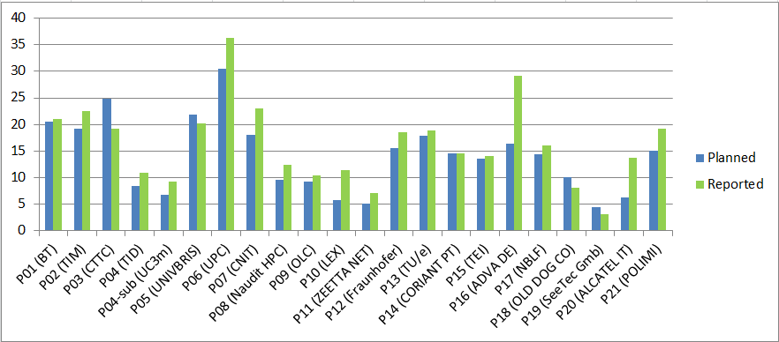
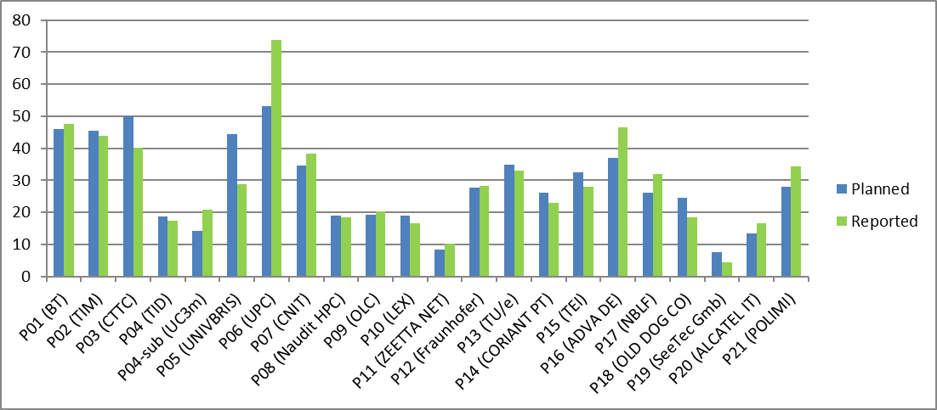
2nd year and Total Metro-Haul Spend
2nd year
Most overspend is catch-up from Y1
Some is increased use of student resource
Individual statements available for all outlier partners
No concern for end of project spend
Total so far

Slide 17
Actions following 1st year review
D1.5 should be revised | All aspects addressed for D1.5 and the deliverable was approved
D7.1 should be re-opened in Y2 | D7.1 has been re-issued after examining the other use case.
Reviewers recommend scheduling an additional review meeting after M24 | Today!
A clear indication should be given in future deliverables in terms of which technologies are being developed by the consortium, which were brought by partners and are being enhanced as part of the work and which are solutions existing already or being developed by other parties. | See Innovation Management Report
In all future deliverables the Executive Summary should be short (one page) and comprehensive highlighting the main findings and conclusions of each section | We have worked hard to improve this year’s deliverables and in particular for our longer deliverables: D2.3, D3.2, D4.2 and D6.2 all have one page exec summaries.
All the required information should be up-to-date in the Web tool. | The web tool has been updated
The gender balance varies drastically between partners. Please provide information what measures were implemented to increase the balance. | Discussion held and encouragement to all partners to do better. Much improved gender balance at the plenary meeting earlier this year (students). e.g. Female summer students liaison between Bristol Uni and BT
In terms of IPR, it would be beneficial to list the patentable results as well as efforts towards the IPR generation | See strong response in Innovation Management Report and talk following this one
The scope of current R&D activities especially in WP3 is very wide, the technological choices should be stabilized to make sure that the project objectives will be achieved. | WP3 presentation will highlight options that have not been pursued.

Slide 18
Review Agenda
METRO-HAUL REVIEW – MORNING
9am Introductions. Overall project summary and progress inc. WP1 Andrew Lord (BT)
9.45am Innovation summary – Antonio d’Errico (Ericsson)
10am WP2. Albert Rafel (BT)
10.45am – 11am coffee break
11am WP3 Emilio Riccardi (TIM)
11.45am – WP4 Ramon Casellas (CTTC)
12.30 – 1.45pm lunch
METRO-HAUL REVIEW – AFTERNOON
1.45pm – 3pm WP5 Oscar Gonzales (TID)
3pm – 3.45pm WP6 Adrian Farrel (ODC)
3.45pm – coffee break
4pm – reviewers discussion
4.45pm feedback
QUESTIONS AD HOC AS WE GO THROUGH THE DAY – PLEASE INTERRUPT!

Slide 19
Thank you. Questions?
Metro-Haul First Report Period Review – WP1
http://metro-haul.eu

