Slide 1
Metro-Haul Project: WP6 Second Period Review
Old Dog Consulting (WP6 Leader)
Adrian Farrel
Old Dog Consulting

Slide 2
Talking about WP6
Reminder
What is WP6?
What are the Deliverables and Goals?
Status and Resource Usage
Open Access : The big topic for WP6 at the moment
What is it and what are we trying to achieve?
What are we tracking?
How are we doing?
Key Achievements in Year 2
Innovation Management – already covered in the morning
Issues and Next Steps

Slide 3
Work Package 6 – Dissemination and Exploitation
Industry Specification and Standards Contributions
Coordinate Involvement in Open Source Projects
Lead on Relationship with 5G-PPP
What is WP6 Responsible for?
Coordinate Dissemination Tasks
Realise Open Knowledge Transfer
Coordinate Publications and Workshops
Coordination of Industry Whitepapers
WP6 KPIs Second Year (Versus Actual)
Conference Contributions (Target was 10 in year two)
Metro-Haul contributed >60 conference publications in the second year
Journals and Papers (Target was 8 Academic journal articles in year two)
Over 16 papers and journals articles have been published in the second year
Contributions to SDOs, Open Source Project and related initiatives (Planned for >5 in year 2)
Metro-Haul contributed to more than 12 specification and standards activities (IETF, ITU-T, BBF and MEF) and OpenSource (ONOS, OSM and OpenROADM)
Industry panels and workshop involvement (Target was 1 in year 2)
Metro-Haul developed and led 2 workshops in year 2 Co-located with NGON and EUCNC
Definition of communication and exploitation plan (Year 2)
Ongoing strategy and year 2 activities documented in “D6.2. METRO-HAUL Year2 report on communication, dissemination and standardisation activities”

Slide 4
WP6 – Tasks, Deliverables and Stretch Goals
WP6 Tasks (All 22 partners are involved in WP6, Lead by ODC)
T6.1. Dissemination and Project Communication (Lead by UoB)
Contributors: BT, TIM, CTTC, TID, UC3M, UNIVBRIS, UPC, CNIT, NAUDIT, OLC, LEX, ZN, HHI, TUE, CORIANT, TEI, ADVA, NBLF, ODC, STEC, NI
T6.2 Exploitation, Standardisation (Lead by ODC), and Innovation Management (Lead by TIM)
Contributors: BT, TIM, CTTC, TID, UNIVBRIS, NAUDIT, OLC, LEX, ZN, CORIANT, TEI, ADVA, NBLF, STEC, NI
WP6 Deliverables
D6.1. Year1 report on communication, dissemination and standardisation activities (Complete in Year 1)
D6.2. Year2 report on communication, dissemination and standardisation activities (Complete in Year 2)
This document continues to summarize WP6 activities and achievements during the first year of the project, including:
Updates to the project knowledge site
Ongoing dissemination strategy plans for initial dissemination and exploitation plans
The communication process amongst across the METRO-HAUL partners
Documenting the standards effort across SDOs for METRO-HAUL work proposals
D6.3. Final report on communication, dissemination and standardisation activities (Target for completion in Year 3)
Project Dissemination “Stretch Goals” before the end of the project:
Development and publication of architecture at key Standards Development Organisation
In progress
See slides later for standardisation work
Chapters in a book covering the Metro-Haul architecture and enabling technologies
In progress
See next slide
Online tutorials for knowledge dissemination of enabling technologies

Slide 5
Metro-Haul Book
Typically, Metro-Haul is over-reaching
Our stretch goal was “chapters in a book”
We’re producing a whole book
Metro Networks: Where optics meet services
Luis Velasco, Filippo Cugini, Ramon Casellas (Eds.)
Table of Contents:
Motivation: Toward 5G-ready optical metro networks
Use cases and 5G-based services
Services and architecture
Metro reference scenarios
Planning and techno-economics
Filtered and filterless Metro networks
Disaggregated optical nodes
Optical transmission for metro networks
Machine Learning for Optical Networks
Control and management
Monitoring and Data Analytics
Autonomic Networking
Service provisioning and slicing
Demonstrations and applications for verticals
WP3
WP2
WP4
WP5

Slide 6
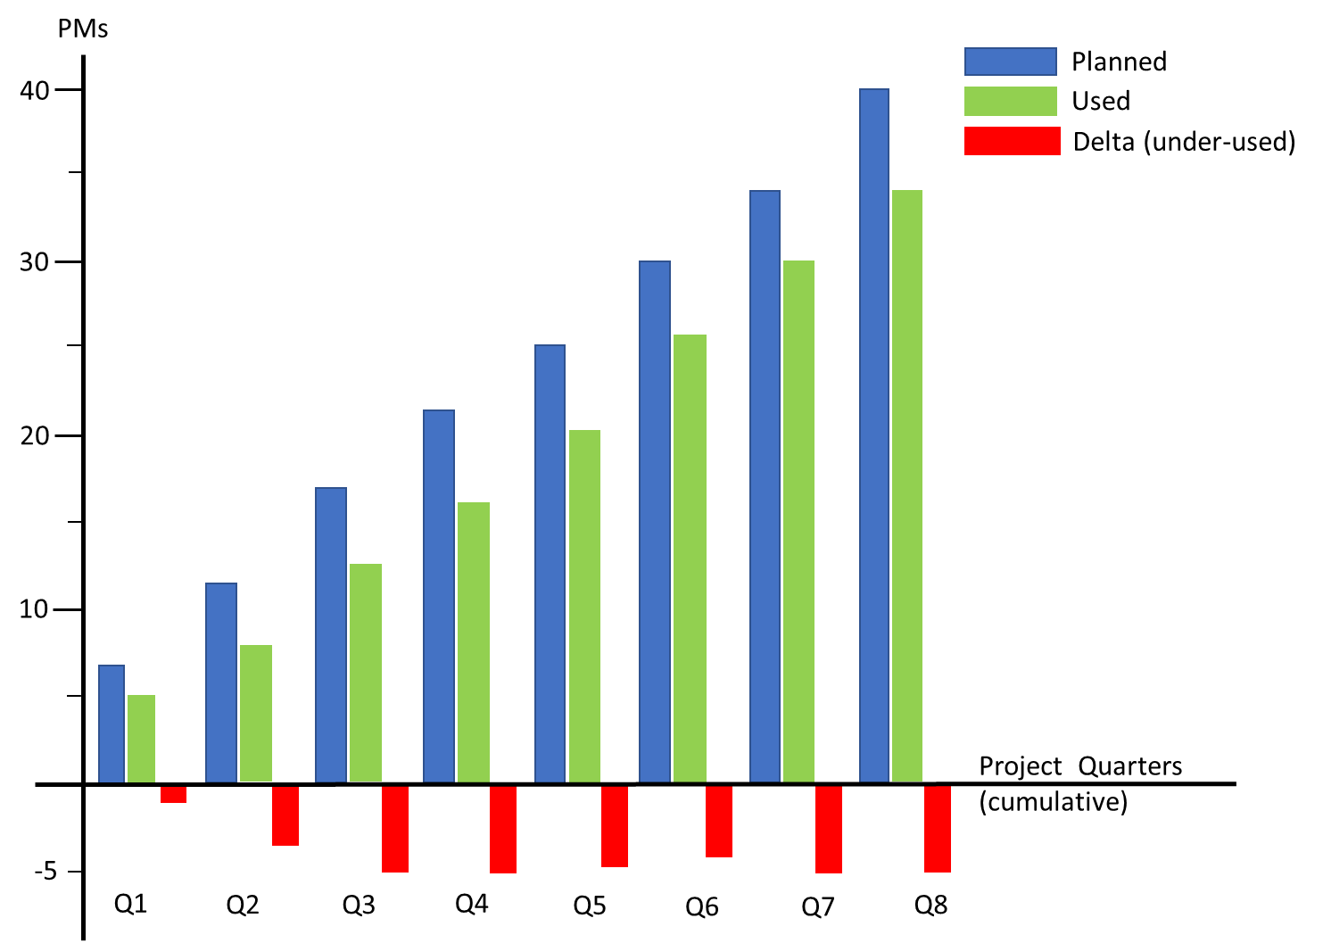
WP6 – Planned and Used Resources in Years 1 & 2
Graph shows cumulative resource usage against planned usage
Year 1 Conclusions
WP6 under-used compared to plan by about 5PMs
Some partners used resources faster than planned
A few partners significantly under-used resources
Year 2 Conclusions
Holding steady
Year two resource usage almost exactly matched the plan
Consequence is that WP6 is still about 5PM under plan
Year 1
Year 2

Slide 7
What is Open Access and How to Track It?
Definitions
Green: the author makes a copy available with some sort of permission from the publisher
Gold: the publisher makes articles available for free (Note we don’t have any Gold OA)
There is a tension between OpenAccess and high-impact publications yielding a range of options…
Open download from the publisher
Open download from a stable public repository (OpenAire, Zenodo, ResearchGate)
Open download from a stable private repository (University, Company, BSCW/pub)
Open download from a transient private repository (Personal web site or personal pages at university)
Copy on request (e.g., via ResearchGate)
Not all Disseminations are published (e.g., conference presentations), but they can still be made available
Eurescom automatically adds Deliverables to Zenodo once they have been approved
Tracking of Open Access is in three places!
SyGMa (was ECAS) shows the formal status of published dissemination
It’s our report to the Commission used to show location of OA copies according to EC definitions
The Eurescom Document Tracker is how we track all documents
Everything from a draft or a proposal, through acceptance/rejection, to publication and supplies links to copies of publications
The Metro-Haul web site provides links to all OA publications
The pages are auto-generated from the Eurescom Document Tracker to allow the public to find our publications

Slide 8
Open Access and Metro-Haul
We take this very seriously
It is a requirement of the Grant Agreement
We personally believe that all publicly funded research should be available
The project had a very bad start
Publications take a long time to become available
Project processes were not working
At Year One review we had only 10 OA articles in Eurescom and none in ECAS
Reviewers and Project Officer rightly highlighted this
Started to pick up at 18 months
Project Officer pointed us at ECAS (we were focused on Eurescom)
ECAS reached 34 papers (c. 30%)
Eurescom reached about 70 papers (c. 60%)
It is hard work for Metro-Haul with roughly 260 disseminations and deliverables to date
Victims of our own success!
Year Two figures follow on a later slide

Slide 9
How we are Tracking Open Access in SyGMa (was ECAS)
Open access venue
Publisher’s site
OpenAire or Zenodo repository
Stable institutional OA site with pointer from OpenAire or Zenodo
ResearchGate with open
download
ResearchGate with “copy-on-request”
BSCW /pub/ open repository
Personal sites, or partner sites
This is the formal tracking of project publications
Only shows published/presented materials
Draft, Submitted, Accepted are not included
DOI is a requirement for all journal articles
DOI not required for…
Conference presentations
Standards contributions
Clickable links present Repository or Open Access versions of the publications
Type of publication
Journal article (must have been published)
Conference proceedings (must have been published)
Conference material (must have been presented)
Standards contribution (includes opensource)
Project deliverable (must have been approved)
N/A
N/A
N/A
N/A
N/A
N/A
N/A
N/A
N/A
N/A
N/A
N/A

Slide 10
Tracking Open Access in Eurescom Document Tracker
Open access venue
Publisher’s site
OpenAire or Zenodo repository
Stable institutional OA site with pointer from OpenAire or Zenodo
ResearchGate with open
download
ResearchGate with “copy-on-request”
BSCW /pub/ open repository
Personal sites, or partner sites
Items entered into Eurescom Document Tracker show up automatically on the project web site
https://metro-haul.eu/publications/research-papers/
Clickable links present Open Access versions of the publications
Our objectives…
Make as much material as possible visible
Bridge the gap until formal OA is available
Type of publication
Journal article (must have been published)
Conference proceedings (must have been published)
Conference material (must have been presented)
Standards contribution (includes opensource)
Project deliverable (must have been approved)
N/A
N/A
N/A
N/A
N/A
N/A
N/A
N/A
N/A
N/A
N/A
N/A

Slide 11
Open Access Numbers
Numbers can be confused by many disseminations in Draft, Submitted, Accepted, and Rejected states
Qualifying publications are those in “published” state
Qualifying deliverables are those that are approved by the Commission and “public”
Qualifying standards are contributions to an open SDO
Qualifying conference contributions have been delivered (presented)
Numbers will improve as more publications become available
 | Total in any state | Total qualifying | Eurescom/Website OA | SyGMa OA
Publications and Proceedings | 69 | 62 | 61 (98%) | 42 (68%)
Deliverables | 26 | 5 | 5 (100%) | 5 (100%)
Standards | 18 | 9 | 9 (100%) | 9 (100%)
Conference presentations | 149 | 97 | 84 (87%) | 55 (57%)
Totals | 262 | 173 | 159 (92%) | 111 (64%)

Slide 12
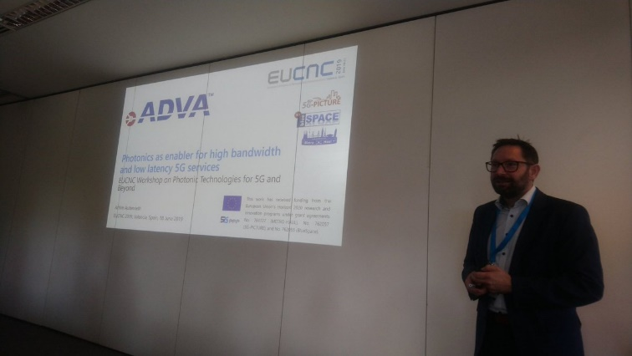
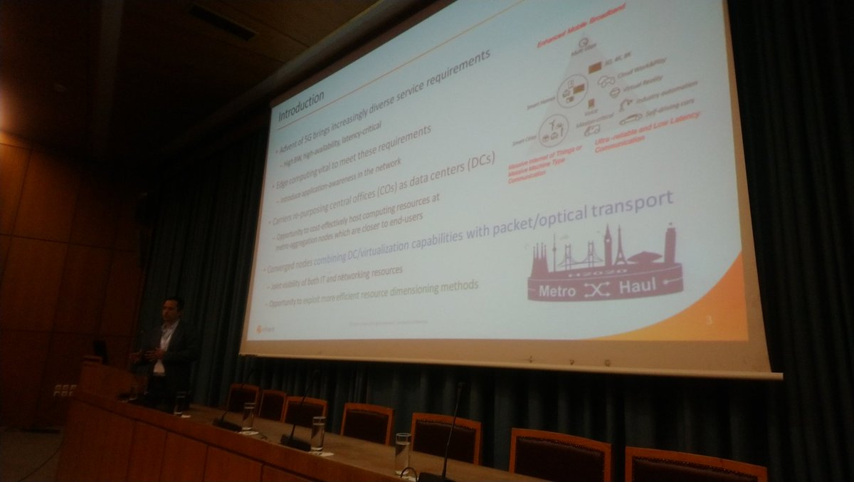
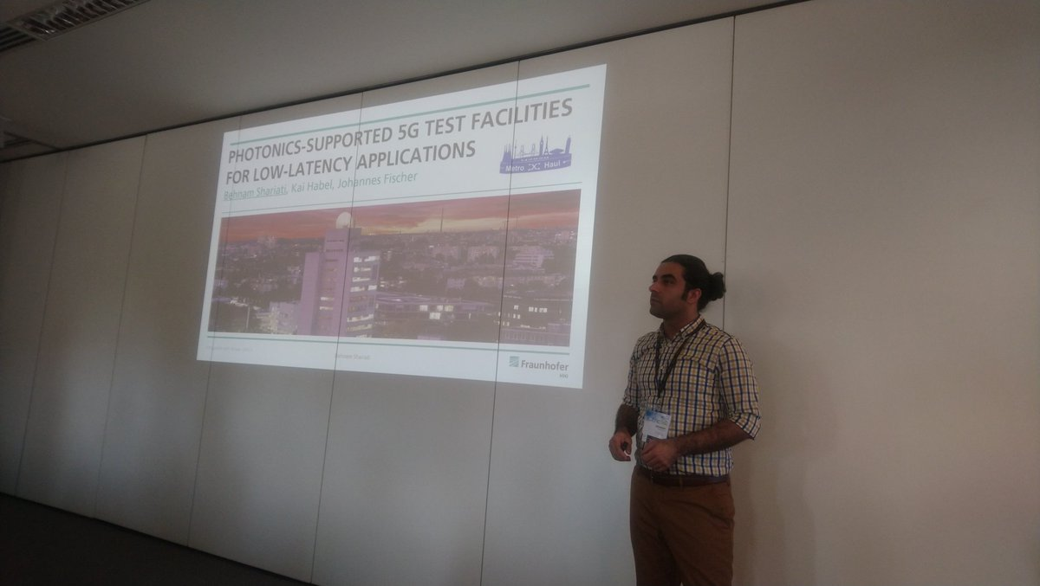
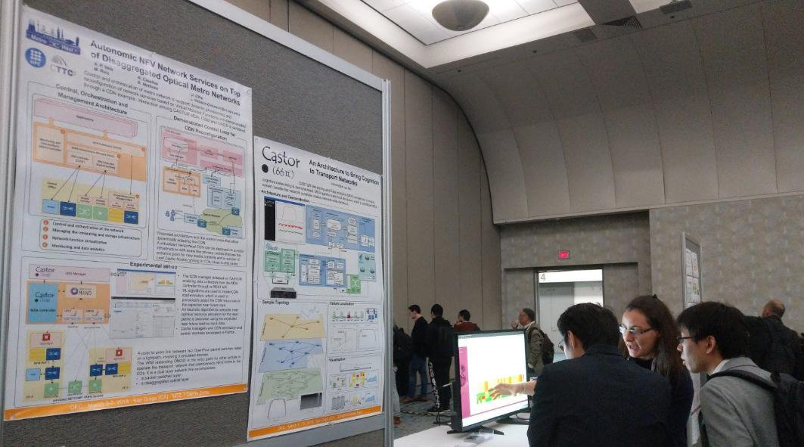
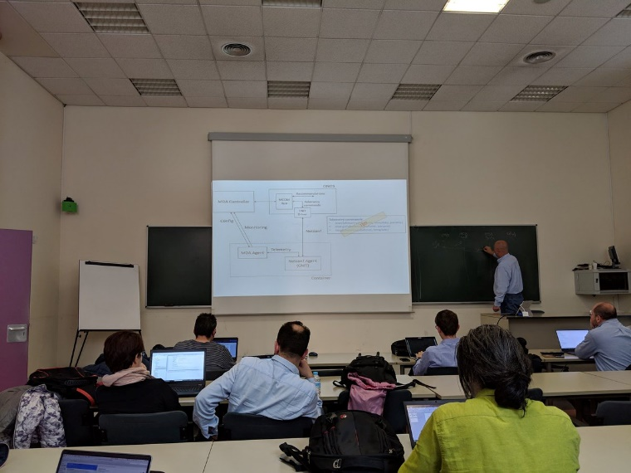
WP6 – Key Achievements in Year 2 (1 of 5)
Notable WP6 success in Year 2 includes:
Disseminations
During the second year of the Project, METRO-HAUL has produced more than 100 dissemination activities.
These are a combination of peer-reviewed papers and journals, articles, standards, and OpenSource contributions
Journal Publications
16 Highly ranked publications
Conferences & Workshop Participation
Participated at 12 industry and academic events
Produced more than 70 contributions (see table)
Conference Participation | Year 1 | Year 2 | Total
EUCNC | 1 | 1 | 2
European Conference on Optical Communications (ECOC) | 10 | 12 | 22
International Conference on Transparent Optical Networks (ICTON) | 11 | 28 | 39
Layer123 - Zero Touch and Carrier Automation Conference 2018 |  | 1 | 1
Layer123 SDN NFV World Congress | 1 | 1 | 2
Optical Fiber Communications Conference and Exhibition (OFC) 2019 |  | 20 | 20
OSA Advanced Photonics Congress 2018 |  | 1 | 1
IEEE International Multidisciplinary Conference on Engineering Technology, IMCET 2018 |  | 1 | 1
IEEE NFV-SDN 2018 |  | 1 | 1
Conference on Optical Network Design and Modelling (ONDM) |  | 4 | 4
Other conferences | 7 | 2 | 9
TOTAL | 30 | 72 | 102

Slide 13
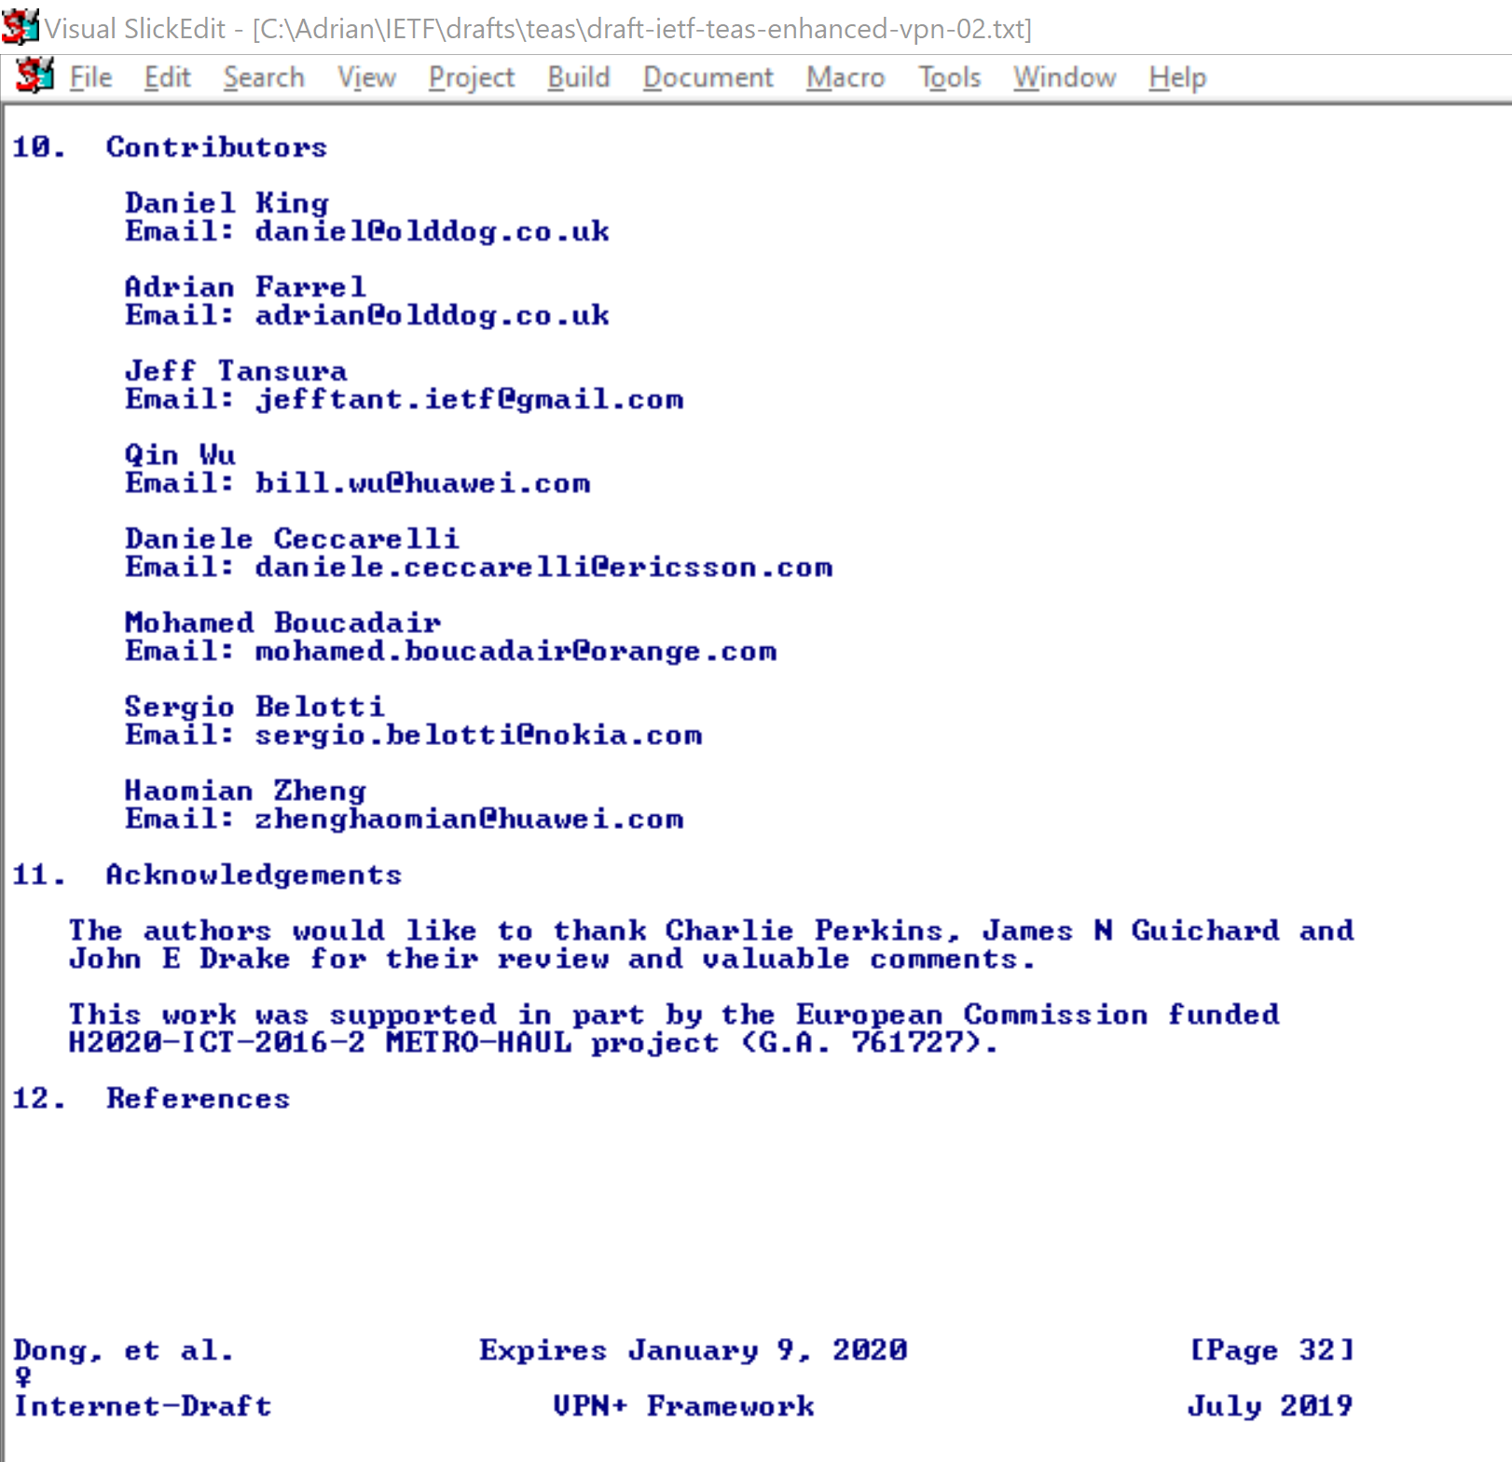
WP6 – Key Achievements in Year 2 (2 of 5)
Why is Standardisation and OpenSource Important?
Impact extends to vendors and operators outside the project in Europe and around the world
It is open and publicly visible
Standard architectures
Enable all vendors to work with same objectives
Allow operators to build coherent systems
Standard data models
Allow vendor implementations to interwork
Free operators from “vendor lock-in”
OpenSource implementations
Provide staring point for consistent implementations
Offer proof-of-concept
Enable validation of implementations as “standard”
Recognition of Metro-Haul (and thus European Commission) as leaders
Benefits for Metro-Haul partners (i.e., European companies)
Shape the standards/OpenSource to fit needs of partners
Early view (pre-standard implementation)
Metro-Haul Standardisation and OpenSource Impact
12 Active SDO Specification and Standards Contributions
Multiple Open Source code contributions (WP4 and WP5 discussions earlier)

Slide 14
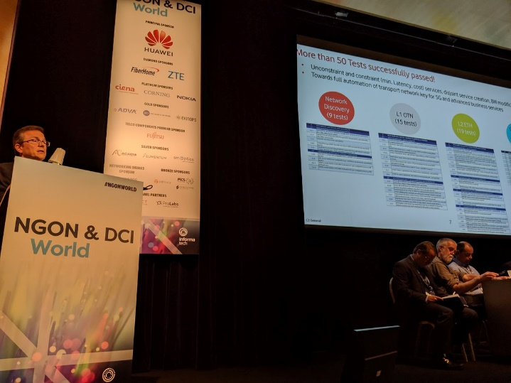
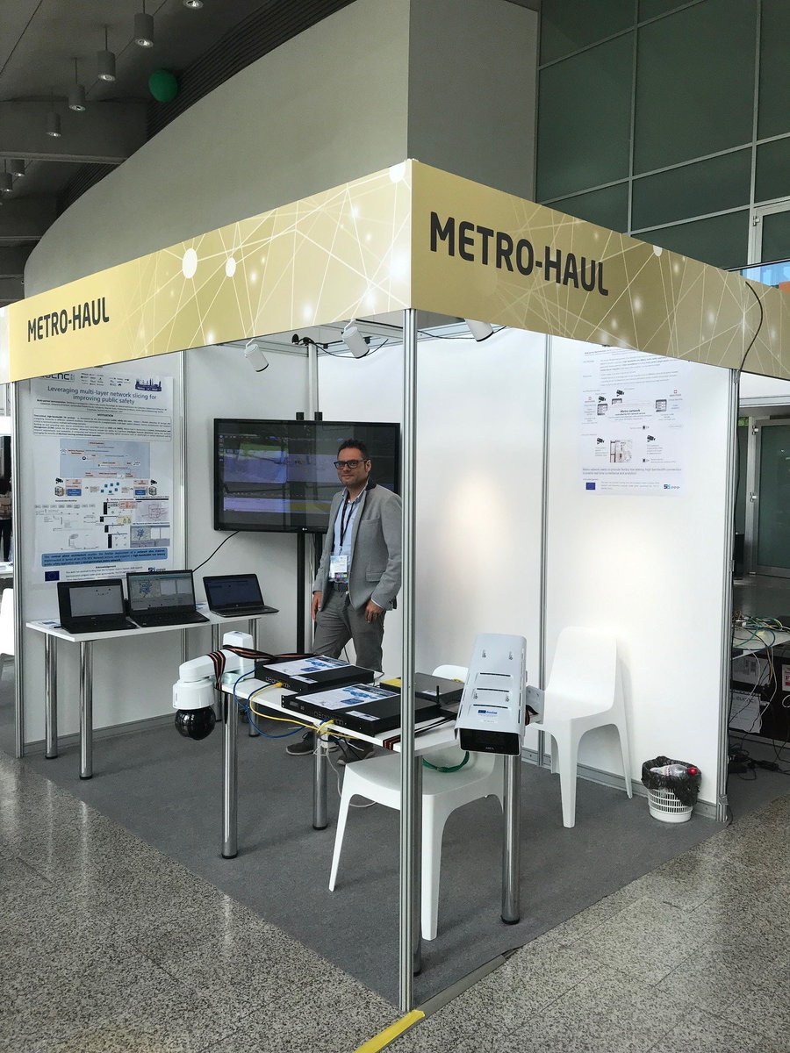
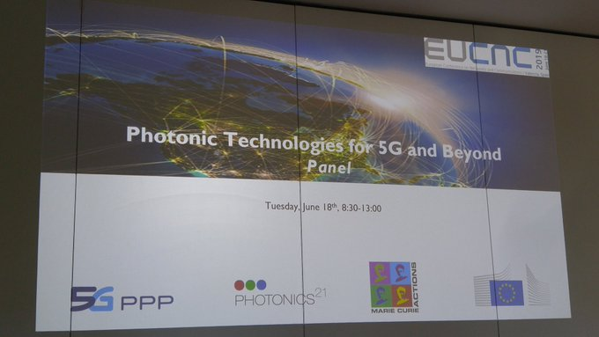
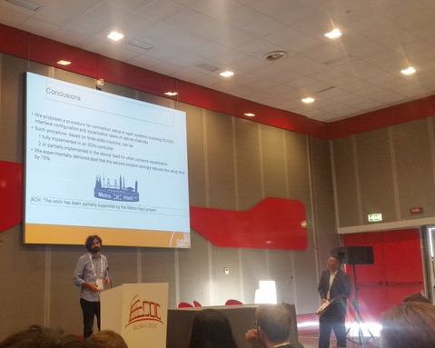
WP6 – Key Achievements in Year 2 (3 of 5)
Two External Project Workshops led by Metro-Haul
May 2019 - NGON Workshop
“The Optical Masterclass Series – METRO-HAUL”
Reached out beyond H2020 projects
Speakers from operators, equipment vendors, standards experts, and YANG implementers to explain how key technologies can provide everything needed to manage and operate packet and optical transport networks for 5G.
June 2019 - EUCNC Workshop
“Photonic Technologies in 5G and Beyond”
Highlighted of Metro-Haul research and the impact of photonic integrated devices and optical for 5G.
Numerous, Keynotes, Invited & Accepted Speakers, Panels, Tutorials, Demonstrations and Exhibitions
ECOC 2018
PSC2018
5GPPP KPI 2018
OFC2019
ICTON 2019
ONDM 2019

Slide 15
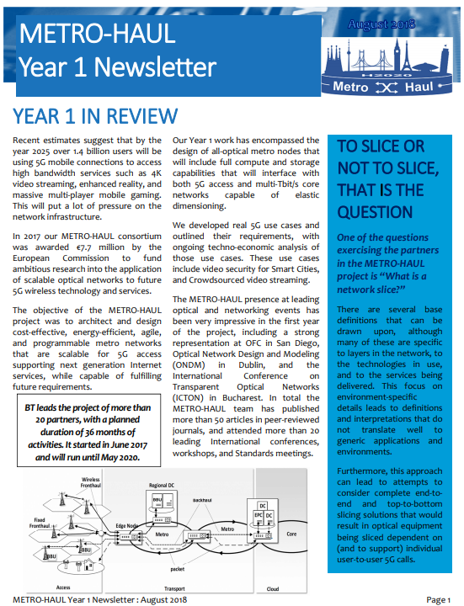
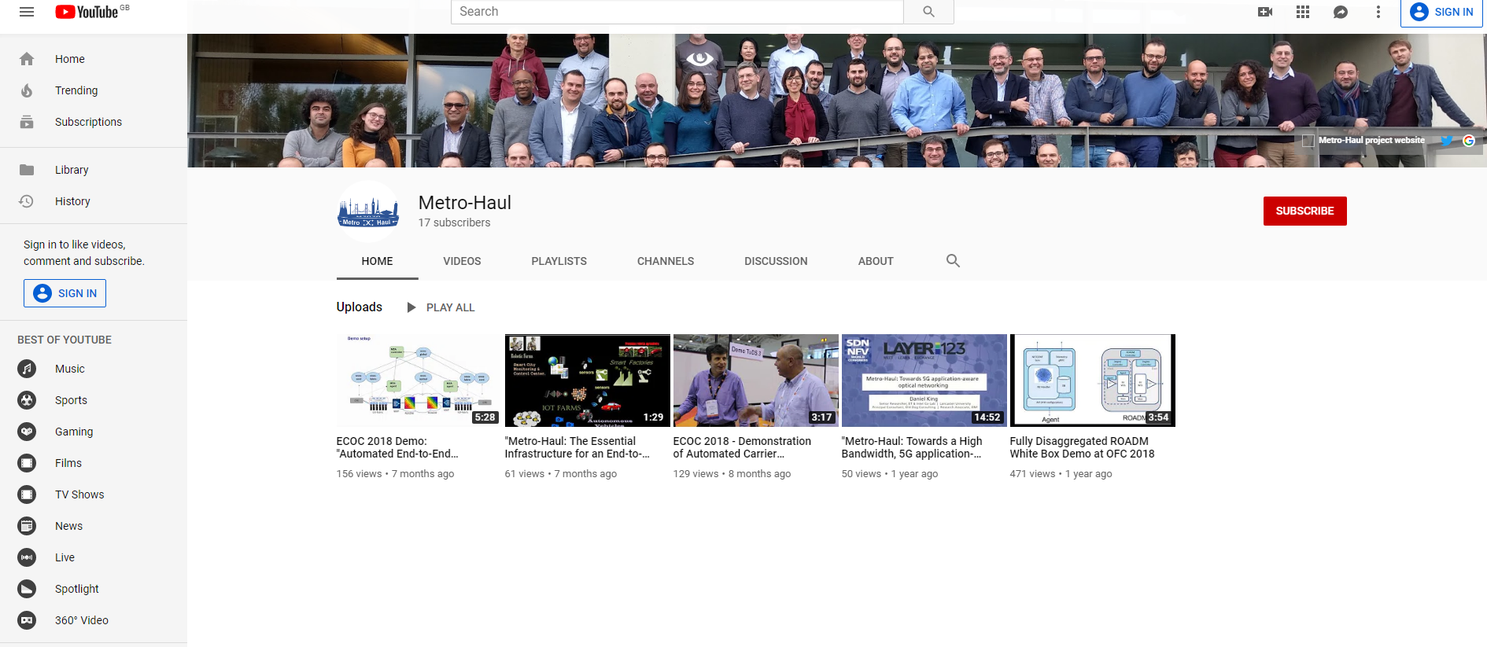
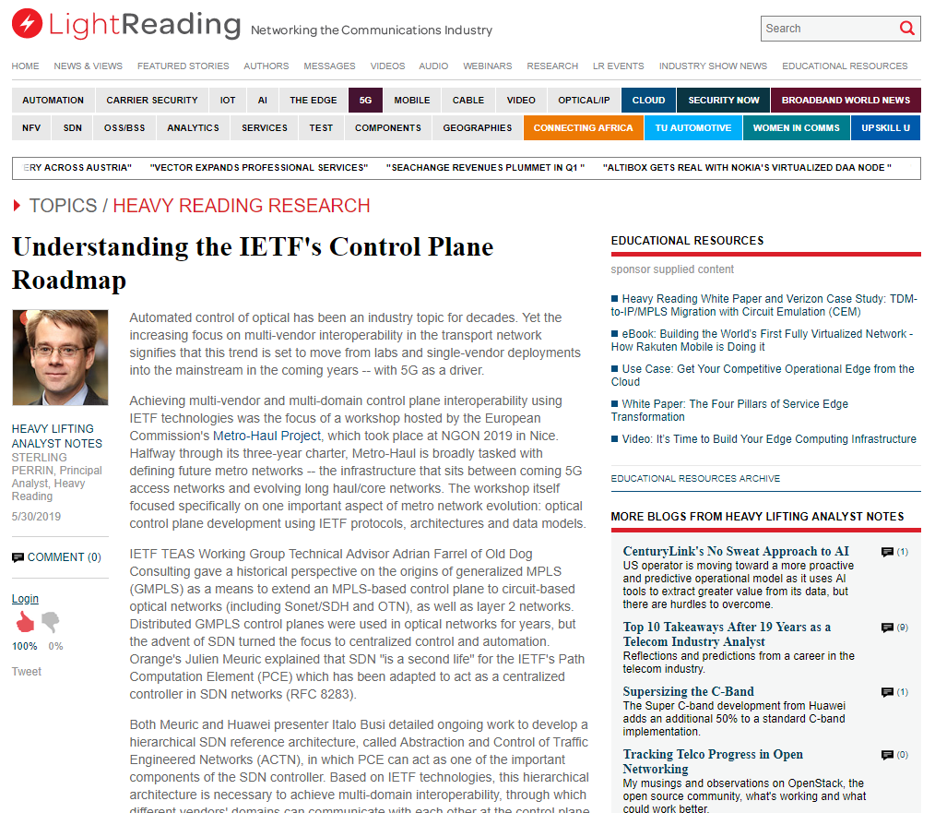
WP6 – Key Achievements in Year 2 (4 of 5)
OFC Participation
At OFC 2019 we had over 20 contributions and speaking slots
Publication of project Newsletters
Two Published
Press Releases
Four Released
Blogs
17 Technical and Project Blogs published on our website
Industry Dissemination
Light Reading Website Article
Light Reading Video Interview
YouTube Channel
ECOC 2018 Demo on Automated End-to-End Carrier Ethernet Provisioning over a Disaggregated WDM (156 views)
ECOC 2018 - Demonstration of Automated Carrier Ethernet across Disaggregated WDM Metro Network (130 views)
METRO-HAUL: The Essential Infrastructure for an End-to-End Viable 5G Solution" at ITU Forum (61 views)
Fully Disaggregated ROADM White Box Demo (471 views)

Slide 16
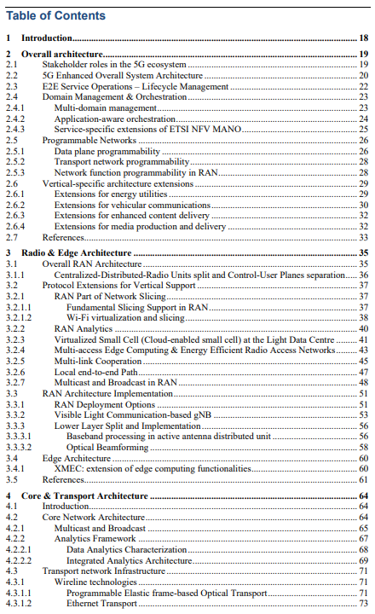
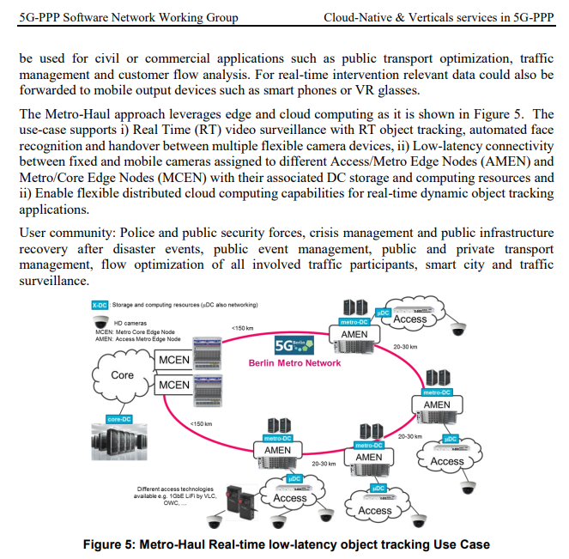
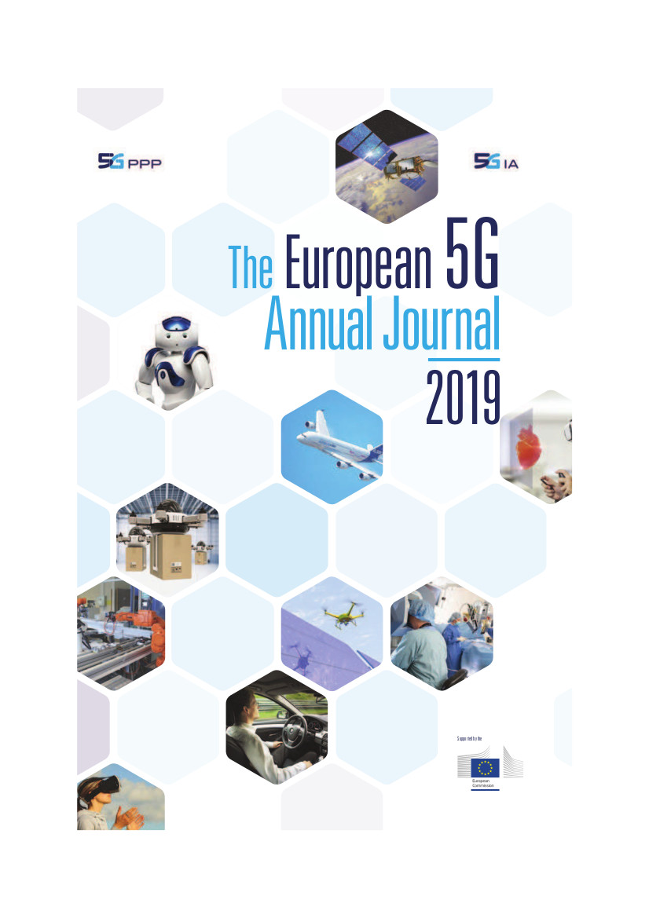
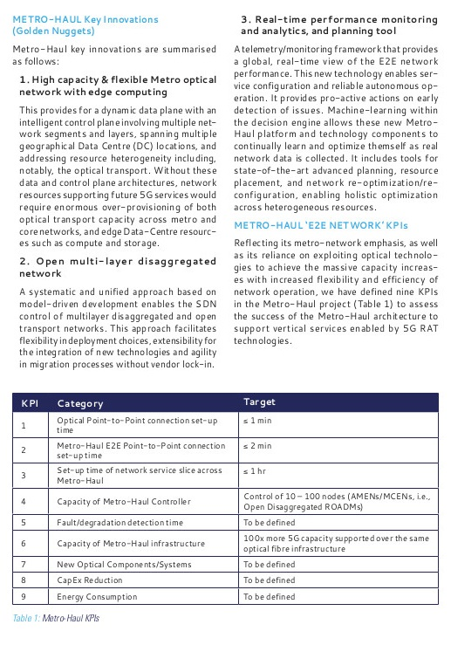
WP6 – Key Achievements in Year 2 (5 of 5)
5G-PPP Participation
Architecture Working Group
Metro-Haul Champions: Infinera, Bristol Uni, CTTC Barcelona
Software (was SDN & NFV)
Champions: CTTC Barcelona, Bristol Uni, ODC
5G Trials
Champions: Telefonica TID, Bristol Uni, ADVA Germany
Pre-standards
Champions: ODC
Automotive
Champions: Eindhoven TU/e, OLC
5G-PPP Participation Output
Cloud-Native and Verticals’ Services Whitepaper (drafted in Year 2, published September 2019)
Revised Architecture Whitepaper ver3.0 (June 2019)
were developed in Year 1, and reviewed and published in Year 2 in the Euro 5G-PPP Annual Journal (May 2019)
Golden Nuggets

Slide 17
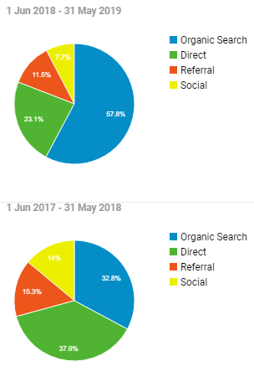
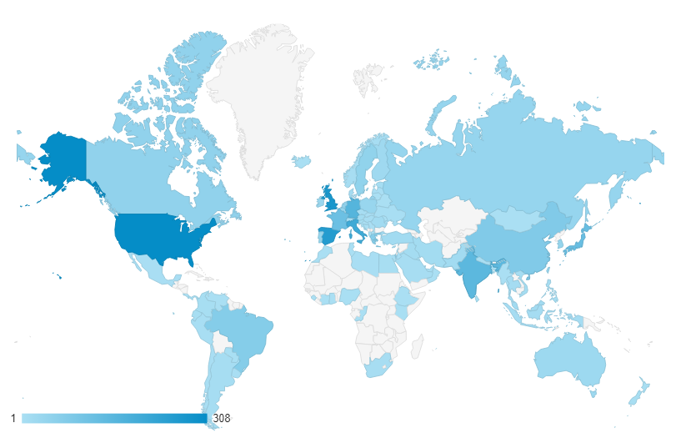
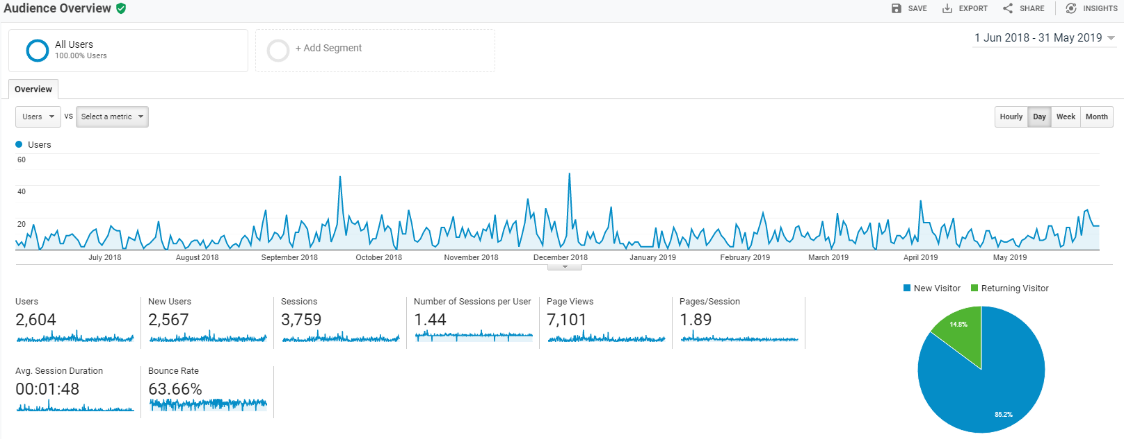
WP6 – Website & Social Statistics
Top content pages in year 2 included:
https://metro-haul.eu/2018/08/23/network-slicing-at-the-ietf/
https://metro-haul.eu/2018/09/11/net2plan-hackathon-report/
https://metro-haul.eu/2018/08/30/what-is-actn/
https://metro-haul.eu/event/ecoc-2018/
The /Publications/ pages are ranked in top 10, including “Research papers” page
This continues to underline that visitors check METRO-HAUL research outcomes
The Blog, Events, and News areas also gain good visibility
Website visitors from around the world
Europe, then USA, Canada, South America and Asia. India also features a high access
Website Statistics, Year 2 versus Year 1
Users up 140% - 2,604 users in Year 2, versus 1,085 Users in Year 1
Organic search for website up 317% in Year 2
Direct traffic up 44% in Year 2

Slide 18
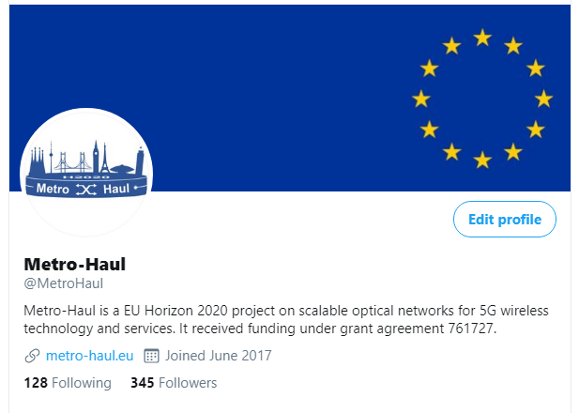
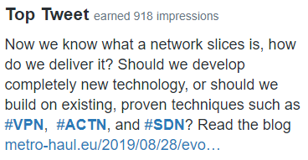
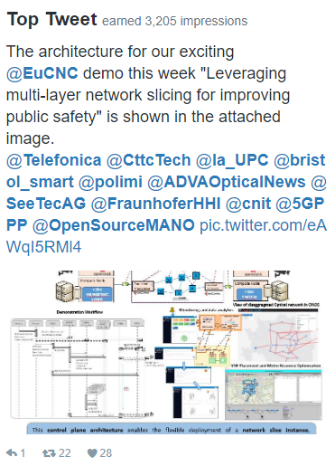
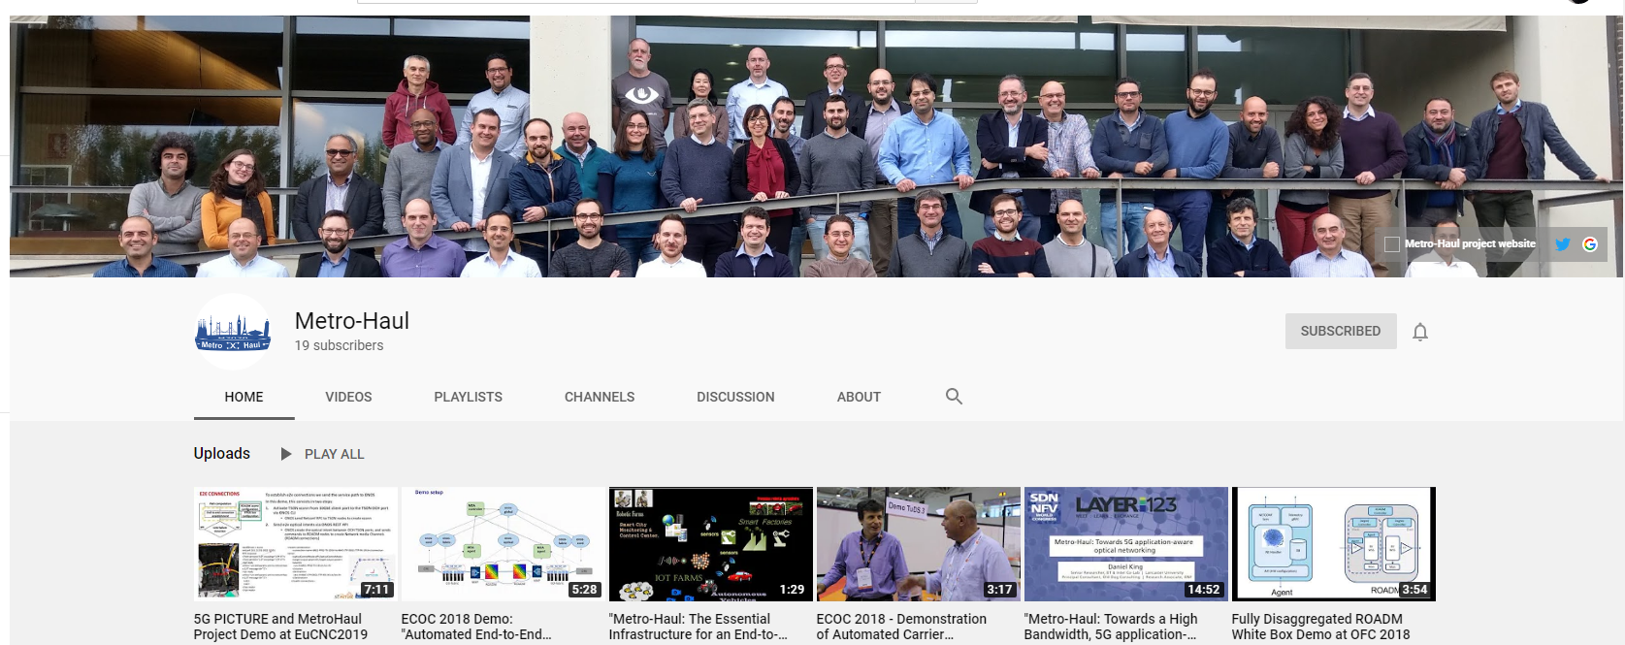
Social Media
Social Media Statistics
Twitter
303 Followers in Year 2, versus 142 Followers in Year 1
>500 Tweets in Year 2, versus >200 in Year 1
Research Gate Project Page
>65 Followers
>480 Reads)
LinkedIn
YouTube
6 videos

Slide 19
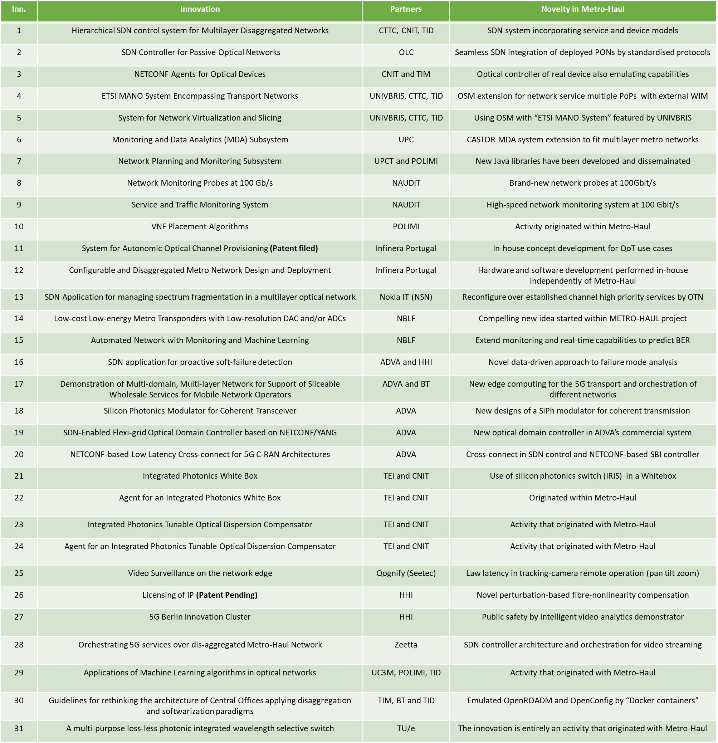
WP6 – Innovation Management
Already discussed this morning
Just a reminder
The innovation results, emerged thus far and disclosed, are extremely compelling and demonstrate an auspicious trend for the project
The Innovation report is public and can be found at:
https://bscw.metro-haul.eu/pub/bscw.cgi/d47157/InnovationManagement_2Audit.pdf
International patent filings have begun, or patent applications are currently pending. Some ideas and patents have been provided to project partners with FRAND terms.
Innovative project software has also been made available within the project partner consortium as “open software”, and in most of the cases loaded in specialised hardware and shared in several demonstrators

Slide 20
WP6 – Issues Identified from Year 1 and Actions Taken in Year 2
Open Access to dissemination very poor
Resolved misunderstanding about requirements
Considerable progress made
More work needed
Novelty of Innovation unknown
Clarifications added to this year’s Innovation Report
No newsletter in Year 1
Two newsletter published in Year 2
Need closer participation with 5G-PPP and H2020 projects
Much greater involvement with 5G-PPP in Year 2
Held joint workshop with other projects at EUCNC
Project blog under-used and poor disseminated
Very successful increase in blogging in Year 2 with many partners involved
Blogs being read quite widely
YouTube channel under-used
Gradual increase in available videos during Year 2
Good number of viewings
Assess publication and conference quality/impact
Want to measure our dissemination better
Action still needed
Academic outreach status unknown
Action still needed

Slide 21
WP6 – Actions for Year 3
Open Access
Good progress in Year 2, but more to be done
Target periodic activities to improve figures:
Chase partners at each plenary for audit of all dissemination activities
Quarterly survey of all Open Access sources by WP6 leadership
Work out how to handle dissemination published after end of project
Assess publication and conference quality/impact
Want to measure our dissemination better
Need to qualify publications and conferences by reputation and size
Academic outreach status unknown
Work with academic partners to determine ways to reach other institutions
Durability of Metro-Haul output
Planning for end of project…
How can the website content persist?
How can we collate and preserve the dissemination material?

Slide 22
Questions or Clarifications?
Old Dog Consulting
Adrian Farrel - adrian@olddog.co.uk
http://metro-haul.eu

