Slide 1
Metro-Haul Project Second Review
WP3
Emilio Riccardi emilio.riccardi@telecomitalia.it
Brussels, October 2th , 2019

Slide 2
Presentation Outline
WP3 Overview
Deliverables and Milestones
Objectives discussion (including technical description of activities)
Conclusions
Next steps

Slide 3
WP3: “Metro Node and Optical Transmission solutions”
The investigation and design of efficient and flexible data plane architectures for Metro Access, Metro Core Nodes and optical metro-wide networks, supporting both filtered and (semi )filterless optical solutions and fully exploiting the Elastic Optical Network paradigm.
  Optical DWDM systems and node architectural aspects (e.g. Central Offices as Data Centers; Optical disaggregation…)
    In collaboration with WP2
  Prototypes (HW + control SW): Switching Optical Network Elements; flexible interfaces; flexible transponders; SDN OLT…
  and Transmission technological solutions (e. g. Filterless/filtered…. )…
    Design and specifications developed within WP3
    Stand alone testing within WP3
    Testing and system assessment in dedicated transmission test beds within WP3
    Final evaluation and integration with control plane (WP4) in joint experiments in WP5
  Models, SBI specification and local (at node level) agents and analytics to interface with control/management and monitoring systems
    In tight cooperation with WP4
Structured into tasks
  Task T3.1: Metro Node and Optical Infrastructure Elements architecture (TIM)
  Task T3.2: Optical solutions for switching and interconnection of the Access and Core Metro Edge Nodes (TuE, UNIBRIS)
  Task T3.3: Optical Transmission solutions (TEI, CORIANT)
  Task T3.4: Monitoring and Control Interfaces (UPC, CNIT)

Slide 4
Optical Network Elements – HW +SW disaggregation

Slide 5
Filtered vs Filterless
Data Plane. We have 2 opposite paradigms,
Filtered approach (cheap WSS): core-like, bandwidth efficient but more expensive, disaggregation needed
b) Filter-less approach: access-like, bandwidth inefficient, but more cost effective
A compromise (semi-filtered) between the two is an interesting approach
FILTERED: Mini-ROADMs; Flexible Transceivers; S-BVT,…
FILTER-LESS: Rings; Horseshoes; splitters; coherent transceivers,…
FILTERED & SEMI-FILTERED Activity
TIM
TEI
TuE
CNIT
Bristol University
…
FILTER-LESS Activity
ADVA
HHI
CNIT
…
Two teams working on different approaches

Slide 6
WP3 in Year two: Prototyping….
Discontinued: Full disaggregation up to subsystem is not a priority.
Discontinued: more suitable for long haul.

Slide 7
WP3 in year two: prototyping but not only…
21 Prototypes…(D1-D21): not 21 distinct solutions or technologies!
Optical Network Elements (O-NE)s and DWDM Transmission Systems solutions:
Three categories of Systems identified within METRO-HAUL:
  WDM-Sys1: Flexible, high capacity WDM transport System based on MD-ROADMs;
  WDM-Sys2: Low cost, simple topology WDM transport System based on degree-2 ROADMs;
  WDM-Sys3: Low cost, simple topology WDM transport System based on Filterless OADMs.
All O-NEs prototypes are mapped into the three systems:
  Short-term scenarios:
  Focus on of compatibility of O-NEs with each other and with the Systems: both horizontal (optical specification: contribution to OpenROADM MSA) and vertical interoperability: standard APIs for device control (OpenConfig for transceivers; OpenROADM for optical switching elements).
  Integration or upgrades of existing or even commercial solutions with SDN oriented agents or autonomic monitoring systems: ROADM, Filterless, Low Cost Add/Drop: D1,D2,D3; Transceivers: D6,D16, D17, D18, D19, D20, D21.
  Longer term scenarios:
  Selection of efficient optical integrated technologies with expected high technological yield and low costs: D4,D5.
  Innovative transponders: D7,D8,D10,D11.

Slide 8
WP3 in year two: prototyping but not only…
Not only O-NEs…
  Programmable packet switching solution for interconnection of access and core segments (D12);
  PON termination to the metro node and its abstraction (D13);
  Monitoring systems, ranging from the optical layer to the data-link layer. More specifically a passive monitor probe at the data-link layer is developed (D14,D15);
  SW agents for Monitoring and Data Analytics (MDA).

Slide 9


WP3: Milestones list
N. | Milestone Title | Lead Beneficiary | Type | Due Date
MS4 | M3.1 Definition of relevant metro node architectures and preliminary specifications for optical technology options to be assessed by WP3 | 2-TIM | Report | M6 Nov 2017
MS10 | M3.2 Definition of the node architectures and optical solutions to be deployed for WP5 demonstrations | 17-NBLF | Report | M10 March->May 2018
MS15 | M3.3 First release of SW modules for the control and monitoring of infrastructural elements | 6-UPC | Software | M18 Nov 2018
MS18 | M3.4 First release of SDN controllable OIEs prototypes for functional testing and preliminary evaluation in WP5 | 13-TU/e | HW & SW | M22 Mar 2019
MS19 | M3.5 Second release of SW modules for the control and monitoring of infrastructural elements | 7-CNIT | Software | M24 May 2019
MS22 | M3.6 Release of node and optical prototypes solutions to WP5 for integration | 16-ADVA DE | HW & SW | M30

Slide 10
WP3: Deliverables list
N. | Deliverable Title | Lead Beneficiary | Type | Diss. level | Due Date
D3.1 | Assessment of metro node architectures and optical technology options | 2-TIM | Report | Public | M12 May 2018
D3.2 | First validation of the METRO-HAUL node architecture and optical solutions | 13-TU/e | Report | Public | M24 May -> Jul 4Th 2019
D3.3 | The Final METRO-HAUL node architecture and optical solutions | 5-UNIVBRIS | Report | Pubic | M36
D3.4 | Final public release of SW prototype for the control and monitoring of infrastructural elements | 7-CNIT | Software | Public | M36

Slide 11
WP3 Objective Assessment: objective 1
Objective 1 | To identify physical architectures for Metro Nodes supporting flexible 5G access requirements, datacom-telecom convergence and disaggregation of network functionalities with particular attention to the optical layer
Status: Completed | Extensively explored in the first year of the project and consolidated in a reference architecture in collaboration with WP2 during the second year (see D2.3) Task 3.1 concentrated mainly on the optical infrastructure subsystem of both AMEN and MCEN nodes leaving to WP2 an in depth analysis of the options for the intra node L2/L3 and overlay networks. Strong heterogeneity in metro network use cases (D2.3)! short/medium and even long reach (topologies: linear, meshed; both, etc.) Trade-offs: flexibility vs cost vs capacity vs expandability, … ↓ Need to explore several optical transmission and switching technologies! Need for modularity ↓ Disaggregation, white boxes (Objective 2) ↓ Three classes of Optical WDM Transport Systems have been identified by METRO-HAUL

Slide 12
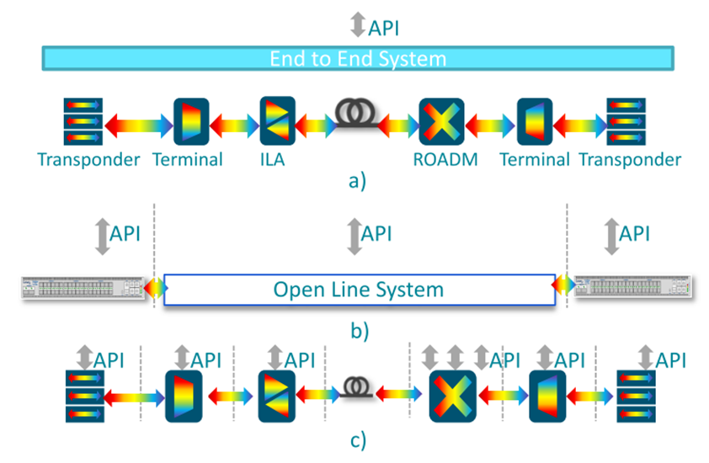
WP3 Objective Assessment: Objective 2
Objective 2 | To explore several multi-vendor and/or disaggregated “whiteboxes” ecosystems
Status: Completed | Already covered in Year one INPUT: Need for modularity in the optical transmission systems INPUT: Need to reduce vendor lock-in: more involvement of Operator in the value chain INPUT: Integration of Optical Network Elements in an automation framework for the whole network Legenda: Optical network architecture alternatives: a) Aggregated, b) Partial disaggregation between transponder and line systems, and c) disaggregation among all optical infrastructural elements
Full disaggregation up to subsystem is not a priority. Discontinued!
Pace of innovation stronger in Transponders:
↓
Need to explore several different solutions!

Slide 13
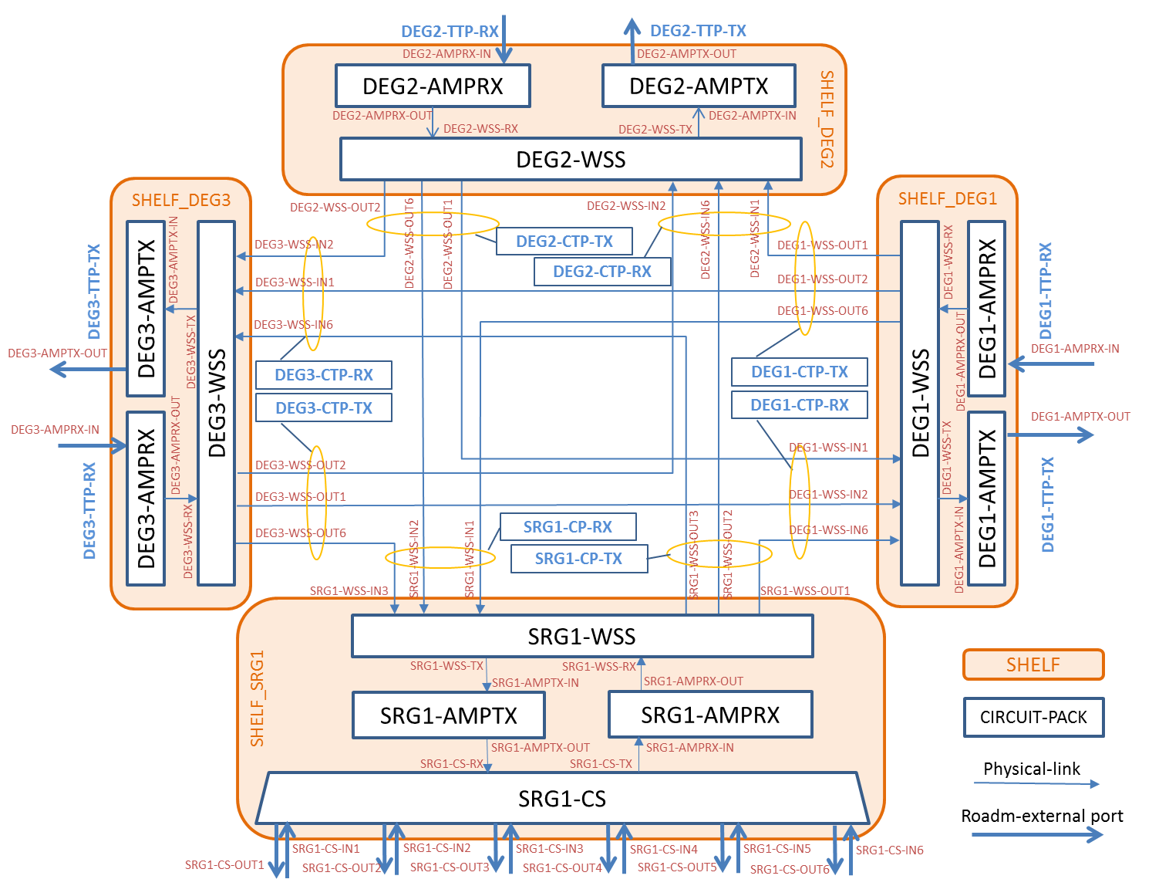
WDM-Sys1: Flexible, high capacity WDM transport System based on MD-ROADMs
Fully flexible optical switching solutions (e.g. MD-ROADM);
Highly efficient flexible coherent transceivers optimized for metro/regional reach (less, or approximately up to 200-450 km);
High traffic node interconnections, including meshed topologies;
Modular chasses with “Data center” form factor or standard “ETSI” telecom form factor;
Targeting either partial or full disaggregation.
Flexible controller needed
MSA and common agents
New technologies for long term solutions
Existing and enhanced solutions for short term

Slide 14
WDM-Sys2: Low cost, simple topology WDM transport System based on degree-2 ROADMs
Low-cost degree 2 Add&Drop system with limited functionalities and lower flexibility and scalability;
Low-cost Coherent or Direct Detection Transceivers optimized for short reach (less, or approximately up to 80-120 km);
Designed for peripheral nodes interconnection with linear or ring topologies, having to handle relatively few optical connections with limited requirements on reconfiguration;
The final implementation will have to be compliant with modular chasses with “Data center” form factor,
Targeting mainly partial disaggregation.
Flexible controller needed
Partial disaggregation: common agents
New technologies for long term solutions
Existing and enhanced solutions for short term

Slide 15
WDM-Sys3: Low cost, simple topology WDM transport System based on Filterless OADMs
Pure filterless architectures (simplifier + couplers and splitters);
Low-cost Coherent or Burst mode interfaces (like in PONs) optimized for even shorter metro distances.
Designed for peripheral areas using linear topologies and relatively few optical connections with limited requirements on reconfiguration.
Implementation with “data center” form factor, for partial or fully disaggregation (possibly reusing existing access technologies (PON) for CO’s interconnection).
Filterless drop & waste express architecture and protection requirements
Low cost
Compatible with exiting Transponders
Innovative Transponders needed for enhanced power and cost reduction
Filterless DuFiNet express architecture and protection requirements

Slide 16
WP3 Objective Assessment: Objectives 3 and 5
Objective 3 Objective 5 | - To design and evaluate low cost optical and energy efficient optical switching elements and high capacity and flexible transmission technologies optimized for one or both filtered and (semi)filterless optical networks - To develop prototypes of nodes, optical switching and transmission solutions as elemental bricks to be integrated in the PoC demonstrators in WP5
Status: Design and HW-SW integration completed ad tested. Final release in November 2019. Integration in demos ongoing | Covered in Tasks 3.2-3.3, 3.4 (Agents) (details in D3.2, D2.3 an Milestones) Classification of the optical devices into the three-identified classes of Optical WDM Transport Systems is completed (WDM-Sys1-2-3), Design process completed; continuous upgrading of existing prototypes ongoing; Integration of HW and control SW completed; Standalone testing and evaluation of integrated devices completed; First prototypes have been released in time for being integrated in preliminary versions of the full METRO-HAUL solution and showcased in major conference and events; Programmable packet switching solution for interconnection of access and core segments and PON termination to the metro node and its abstraction are in an advanced state of realization and have been already evaluated in dedicated demo or experimental assessment sessions; Probes and SW subsystems for the monitoring and dynamic control of the network have been upgraded and tested in several scenarios; Applicability of METRO-HAUL solutions and techno-economic evaluation is ongoing in collaboration with WP2 (see Deliverable D2.3 for the state of the art).

Slide 17
Prototypes (integrated HW+ control SW)
Optical Switching prototypes:
  Multi-degree ROADM targeting the OpenROADM MSA YANG Device model validation and enhancement (Sys 1,Sys 2)
  ROADM solution based on splitter and wavelength blocker architecture for semi-filterless solutions; (Sys 2)
  Innovative photonic integrated optical switching solution for add/drop module of (disaggregated) OADM (Sys 1, Sys 2)
  Multi-purpose modular and loss-less photonic integrated wavelength selective switches for WDM cross-connect switch (N degree) and add/drop node (2 degree) (Sys 1, Sys 2)
At Interface/transmission levels, the following METRO-HAUL prototypes were developed and validated:
  Programmable sliceable transceiver based on multicarrier modulation (MCM) (Sys 1, Sys 2, Sys 3)
  Transceiver solutions for dispersion-tolerant direct detection (Sys 2, Sys 3)
  Spectral-efficiency tunable transmitter with probabilistic-shaping (Sys 1)
  Elastic transponders with low-resolution DAC and ADCs for metro networks (Sys 1, Sys 2, Sys 3)
  Commercial transponder enhanced with specifically designed NETCONF/YANG modules (Sys 1, Sys 2, Sys 3)
  Digital sliceable bandwidth variable transponder for filterless networks (Sys 2, Sys 3)
  Coherent transponders to be used in the filterless architectures (Sys 1, Sys 2, Sys 3)
Additionally, the integration to core and access is specifically addressed by focusing on:
  Programmable packet switching solution for interconnection of access and core segments (Sys 1, Sys 2, Sys 3)
  PON termination to the metro node and its abstraction (Sys 3)

Slide 18
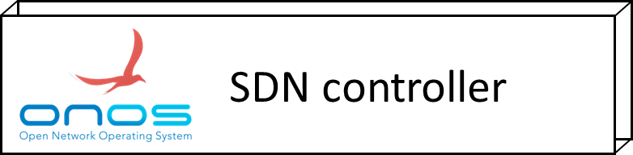

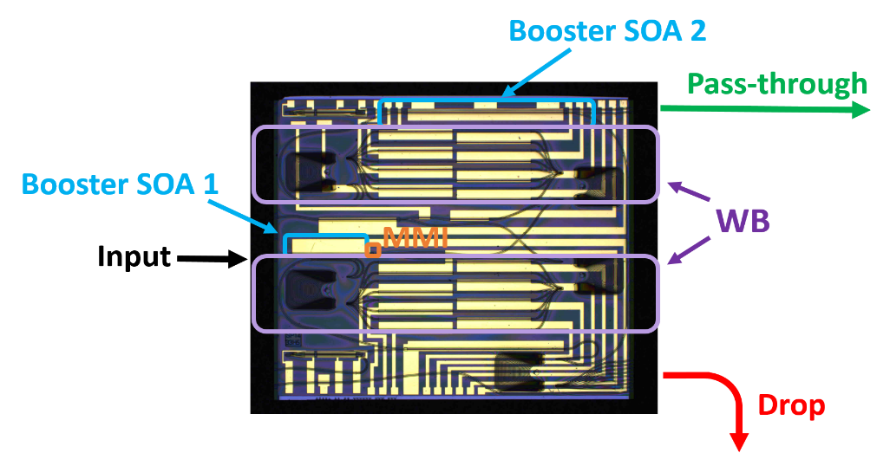
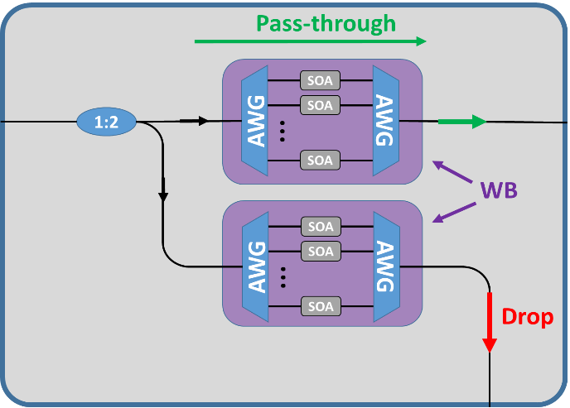
Example 1: TUe: Modular and loss-less photonic integrated wavelength selective switch
Low-cost SOA based 2-degree ROADM with the function of switching and amplification,
The SOA gates inside the ROADM can be turned on and off by the FPGA based O/E/O interface to make each single wavelength pass/stop or drop & continue.,
It will uses an SDN-enabled network solution in conjunction with an OpenROADM agent to drive the metro-access node.
OpenROADM-based agent
FPGA
Key features from the device:
  Programmable;
  Low Crosstalk;
  Lossless;
  Low penalty;
  On-chip monitoring;
Innovation entirely associated with an activity that originated with METRO-HAUL
Schematic of the modular WDM PIC switch (left). Microscope image of the PIC (right).

Slide 19
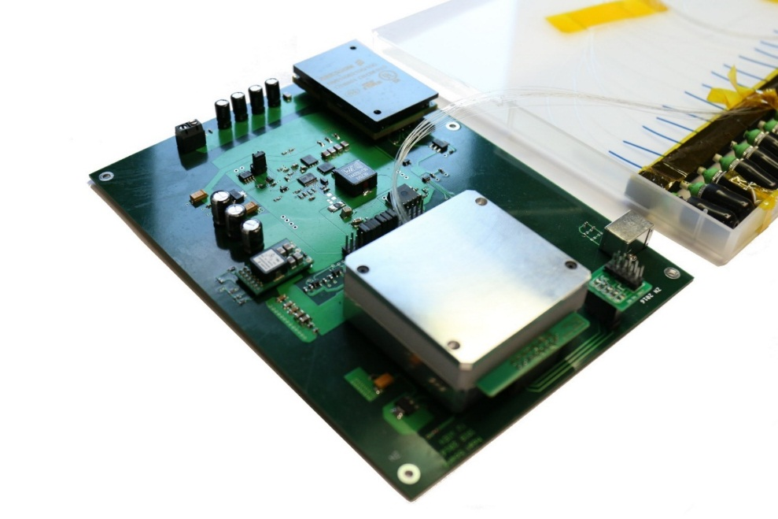
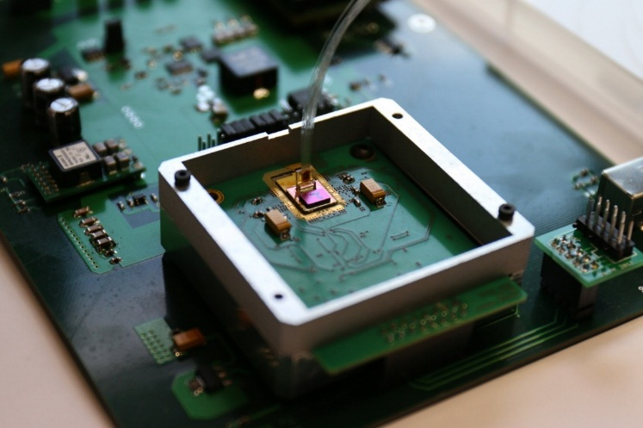
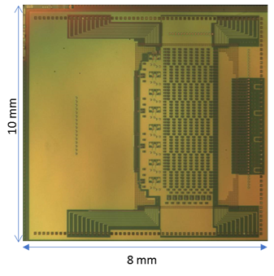



Example 2: TEI and CNIT: Innovative photonic integrated optical switching solution
New node design for low cost, programmable and reconfigurable switching subsystems (ROADM). The enabling element is realized and packaged in IRIS FP7-project and will be adapted to Metro access network node requirements in line with 5G network.
Control and configuration through NETCONF agent compliant with OpenROADM is in phase of testing
Impact on innovation: Integrated Photonics White Box, Agent for an Integrated Photonics White Box
4,5 cm x 4,5 cm packaging
Packaged optical switch for high speed channels in silicon photonics
19

Slide 20
Example 3: CNIT OpenConfig agent
to SDN Controller
NETCONF
edit-config
get-config
Monitoring app
Main functional blocks:
the NETCONF agent, responsible of the communication with the SDN controller, adopting both the OpenConfig and OpenROADM yang models
the device driver, responsible of the communication with the physical devices
the telemetry server, to mange the telemetry subscription and the telemetry data streaming
GRPC collector
Optical node
SDN agent
OpenConfig and OpenROADM
NETCONF agent
(ConfD)
Subscription
GRPC
data stream
DB
Telemetry Server
(Python)
Monitoring socket
Config socket
Device driver
(Python)
Control plane
Proprietary APIs
Data plane
Physical Optical node (Transponders)
Innovation entirely originated within METRO-HAUL
20

Slide 21
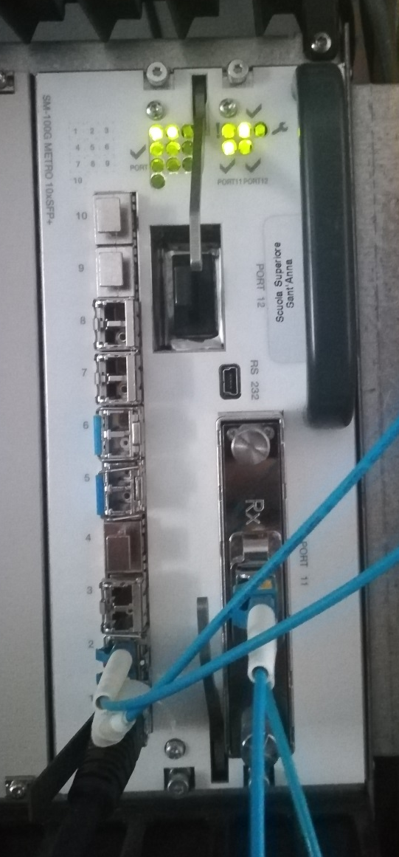
Example 3: CNIT OpenConfig agent + TIM OpenROADM. Devices controlled
OpenConfig
Commercial 100Gbps coherent muxponders (Ericsson)
CNIT Lab coherent transponders
Bristol transponders (Agent provided and ad-hoc extended)
HHI (Agent provided)
OpenROADM
IRIS matrix (Photonic Integrated Whitebox based on silicon photonics chips)
ROADM based on commercial WSSs
Ericsson 100Gbps muxponder
21

Slide 22
Innovative Transponder Solutions
Component | Description
D7 (CCTT) | Programmable S-BVT based on multicarrier modulation A programmable sliceable transceiver based on multicarrier modulation adopting direct detection. The scheme exploits DSP generation and reception of the DMT/OFDM signals with modular architecture providing sliceability, flexibility and adaptability with very fine granularity, trading DSP complexity against advanced functionalities/performance.
D8 (CNIT) | Transceiver solutions for dispersion-tolerant direct detection High bit rate and enhanced tolerance to chromatic dispersion are provided while maintaining cost and complexity comparable with conventional NRZ. Photonic-integrated optical dispersion compensating modules are embedded in the transceiver and operate together with alternative dispersion-tolerant modulation formats.
D10 (NBL) | Elastic transponders with low-resolution DAC and ADCs for metro networks Coherent solutions for Metro transport networks, relying on low-resolution DAC and ADC to reduce DSP power consumption enabling up to 600Gbps/channel.
D11 (HHI) | Digital sliceable bandwidth variable transponder for filterless networks A digital sliceable bandwidth-variable transponders (DS-BVT) for application, e.g. in filterless D&W architectures. Several subcarriers are digitally generated and received in the frequency domain, potentially serving different destinations.

Slide 23
Example 5: UoB Programmable packet switching solution for interconnection to access and core
SDN enabled architecture, programmed on demand to support multiple front/back haul protocols.
Can aggregate/disaggregate any input access traffic to/from a highly synchronous and bandwidth granular optical transport based on time slot switching in a programmable way (Time shared optical network – TSON)
Access to a programmable coherent variable bandwidth transponders (Voyager switch) suitable for spectrally elastic long-haul transmission.
Extended OpenConfig Agent for TSON
METRO-HAUL development
5G-PICTURE
development
23

Slide 24
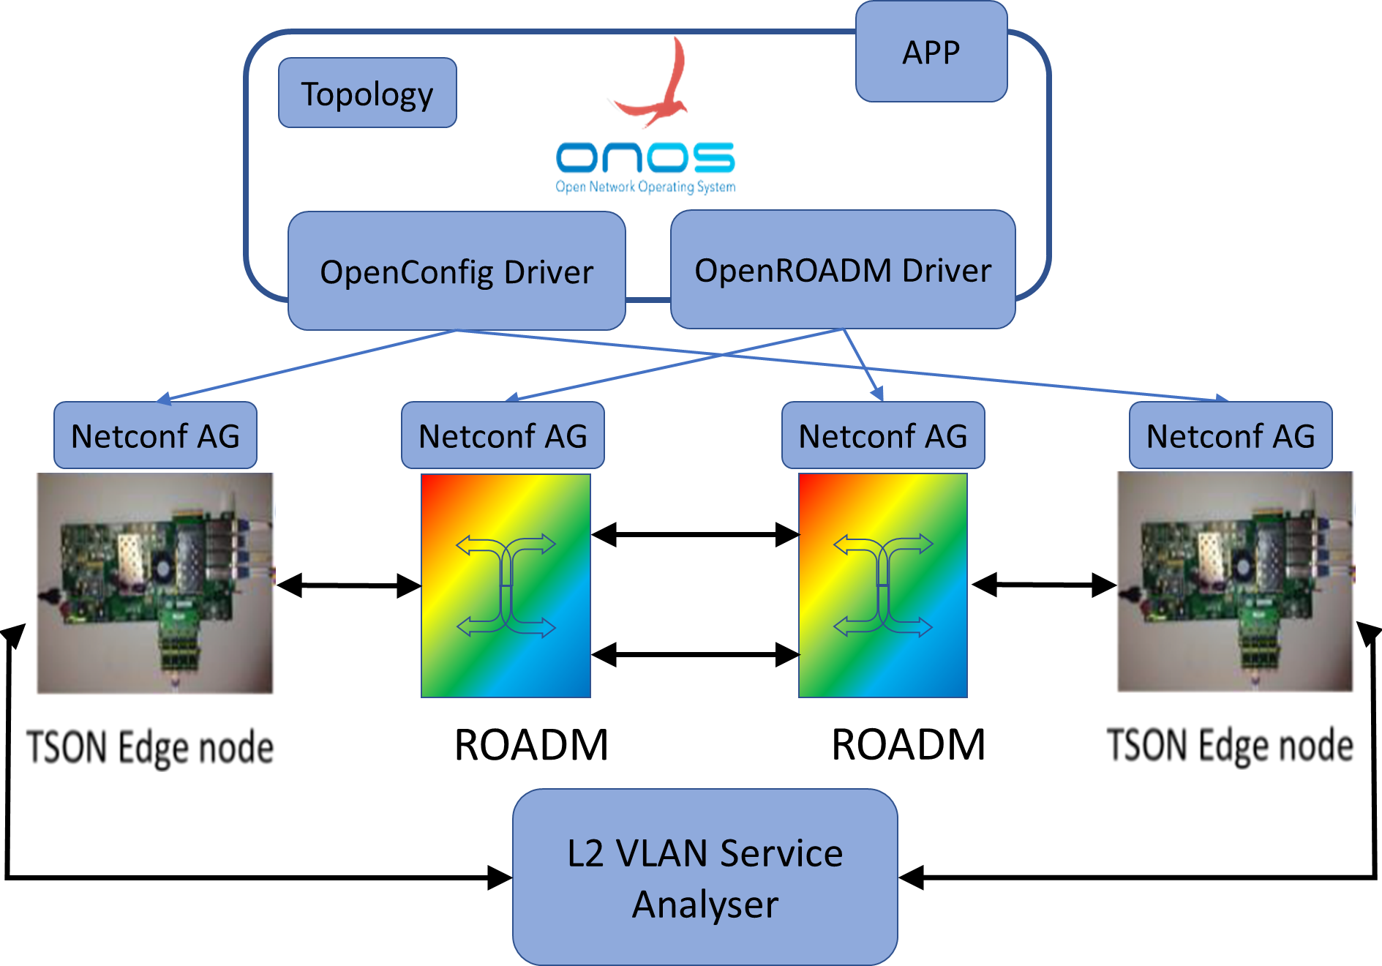






Example 5: EUCNC2019 demo: Active Optical Metro transport solution
NOT PLANNED AT PROJECT START!!
This demo shows the end-to-end provisioning of a L2 VLAN service between two 5G-PICTURE TSON nodes connected through an optical network made by two METRO-HAUL ROADM, managed by ONOS controller.
Testbed setup
Video of the demo is available at : https://youtu.be/6XTlHWwHI64

Slide 25
Objective Assessment: Objective 4
Objective 4 | To investigate and demonstrate an integrated monitoring and control architecture ranging from probes on optical infrastructure elements to Metro Node, packet and service monitoring with local analytics evaluation
Status: Design and second release of SW completed Final release at the end of the project. | Covered in Tasks 3.4 (details in D3.2, M3.3, M3.4, M3.5) Modeling, node Agents and interfaces toward control/ management system Strong collaboration with WP4 Modeling of optical network elements and subsystems addressing transponders, ROADMs, and optical amplifiers (OpenROADM , OpenConfig) Agents for controlling ROADM, X-ponders and amplifies developed and used in several devices and assessed in demos; OpenROADM contribution. Monitoring and Data Analytics (MDA) Strong collaboration with WP4 The specification of the interfaces toward the higher hierarchical order monitoring systems; The definition of the MDA agent architecture; The study and development of methodologies and probes for monitoring at the optical layer; The study and development of methodologies and probes for monitoring at packet layer; Several (often joint) assessment experimental activities of the proposed solutions and developed probe

Slide 26

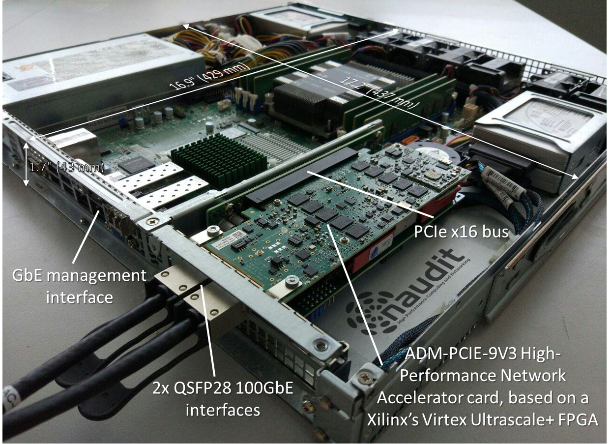
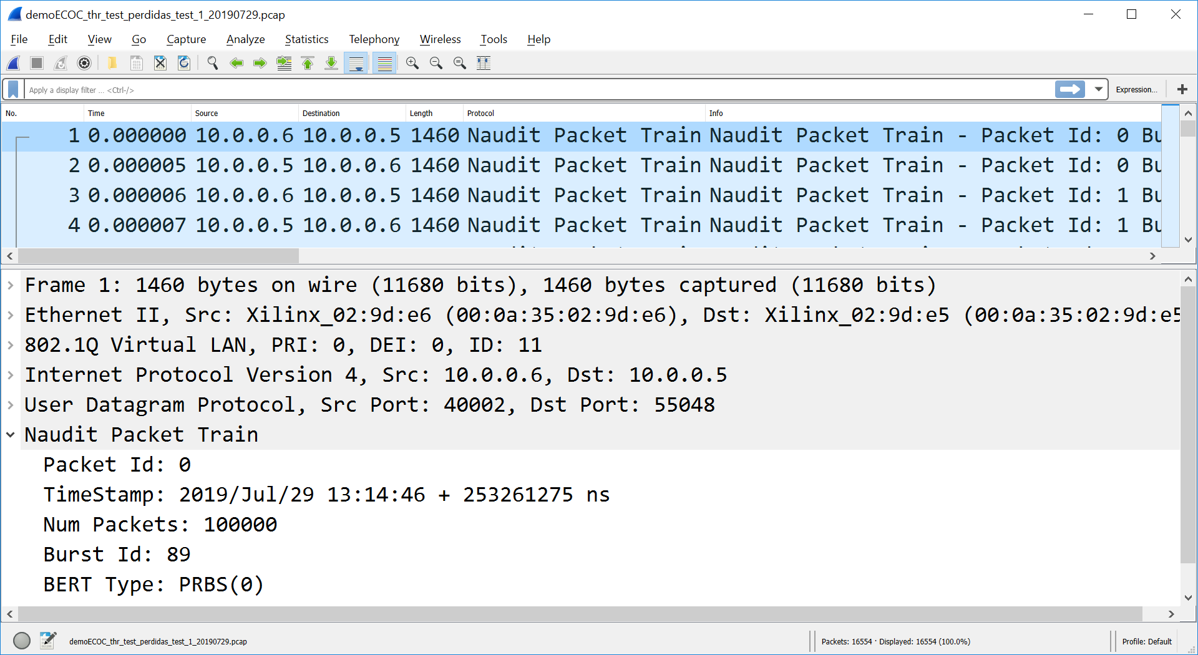
Monitoring at the packet layer (I)
Motivation and Highlights
The Metro-Haul project aims at providing services with very stringent requirements (e.g., such as capacity, delay or packet loss).
This demonstration shows how active measurements at 100 Gbit/s check that the requested KPIs are met before the optical path is put in operation.
NFV Orchestrator (NFVO)
NFVO
Parent Controller
MDA Controller
Active Probe
Monitoring and Data Analytics (MDA) Controller
WAN Infrastructure
Manager (WIM)
Set-up NS
Parent Controller
Create circuit
(enable monitoring)
SDN Controller
(L2/L3)
SDN Controller
(Optical Domain)
Notify New
VPN Created
(VPN Id, Source,
Destination, Path)
Configuration
(RESTAPI)
OK (VPN Id)
100 Gb/s
Active Probe
NS deployed
Run measurement
(VPN Id)
Run measurement
(config params, VLAN ID)
100 Gb/s
Results
Central
Office
Central
Office
VLAN
135
Direct Link
VLAN
135
packets
already
tagged
Virtual Link
packets
already
tagged
Port 100
VLAN 135
Virtual
Port 10
Virtual
Port 11
Virtual
Port 12
Virtual
Port 13
Port 100
VLAN 135
(all ports trunk)
R1
(null:0301)
R2
(null:0302)
R3
(null:0303)
(all ports trunk)
Demonstrated during ECOC 2019
Partners involved: Naudit, UPC, Telefonica

Slide 27
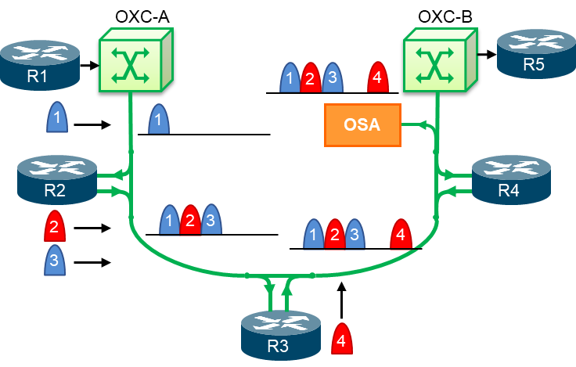
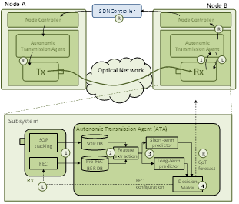
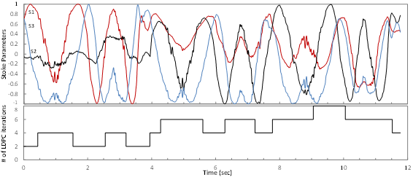
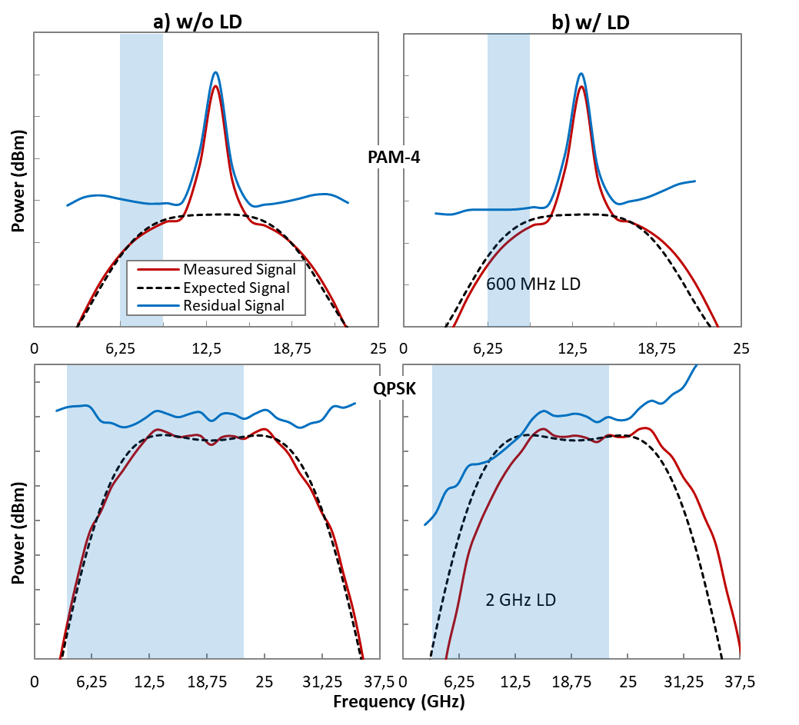
Monitoring at the optical layer (II)
Autonomic Transmission
Low-cost low-margin implementation plays an essential role in upgrading optical metro networks required for future 5G ecosystem.
Low-resolution ADCs can be used in coherent transponders to reduce cost and power consumption.
To guarantee robust operation, soft-decision FEC techniques are required to guarantee zero post-FEC BER transmission, which could increase power consumption.
We aim at minimizing power consumption while keeping zero post-FEC errors by means of a predictive Autonomic Transmission Agent (ATA) based on Machine Learning (ML).
Filterless Optical Metro Networks
Optical signal tracking approaches for FONs are proposed that allow to detect small laser drift problems and enable safely reducing channel spacing.
The most proper resolution for OSA continuously scanning the whole C-band are studied.

Slide 28
Second Report Period Summary and conclusions
WP3 tasks are progressing as expected, addressing all the objectives in the right time and to the expected extent.
  Deviations in terms of effort or time reflects the internal planning of each partner in order to achieve its own objectives and intermediate milestones.
  All milestone released in time. Small delay in D3.2.
  No critical issues are emerged and no corrective actions are needed.
Notable progress of the work done in WP3
  DWDM System classification
  Optical disaggregation
  Advanced Status of prototypes testing and assessment of transmission technologies
  Integration of HW and control SW
  Second release of MDA and probe prototypes
Large number of dissemination actions
  Including High impact joint papers with key aspects of Metro-Haul Technologies
  Demos at key events, ECOC2018 (September 2018), EUCNC 2019 and
  Contribution to OpenSource projects: OpenROADM

Slide 29
Next Steps and ongoing Year 3 work
Completion of the activities of prototyping HW and SW expected by the end of November
Further theoretical and experimental activities:
  Supporting WP5…
  Update per-component specifications (KPIs MH1,2,3,4,7) already addressed in D3.2 and D2.3.
  Address per-component cost savings (KPI MH8) and energy consumption (KPI MH9).
The Final METRO-HAUL node architecture and optical solutions (end of the project)
Final public release of SW prototype for the control and monitoring of infrastructural elements (end of the project)

Slide 30

Grazie
Metro-Haul First Report Period Review – WP3 Status
http://metro-haul.eu

Slide 31
Additional slides

Slide 32
CCTC

Slide 33
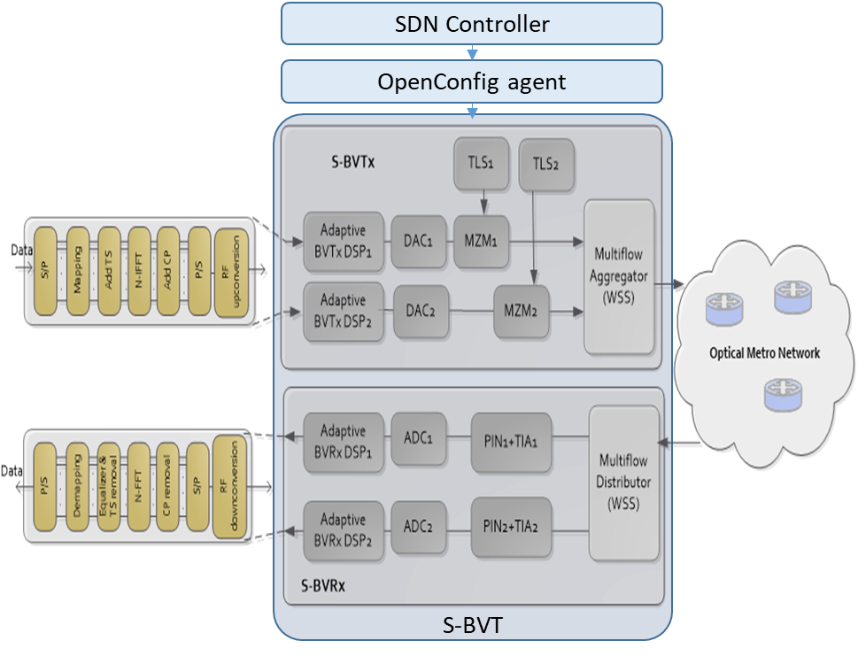
CTTC: Programmable sliceable transceiver based on multicarrier modulation (MCM)
  METRO-HAUL prototype D7: Programmable sliceable transceiver based on multicarrier modulation (MCM)
  Short description:
  Programmable multi-rate/format/reach/flow (SDN-enabled) transceiver based on multicarrier modulation (MCM) with receiver configuration adopting direct detection (DD)
  DSP offline processing
  Number of slices: 2
  Enabling SDN capabilities by the implementation of OpenConfig agents
  Status:
  Design, analysis, implementation and experimental validation
  of the Programmable S-BVT prototype
  Assessment of architectural and functional aspects of modular/programmable
  transceivers
  Development of OpenConfig Agents and integration with the
  sliceable bandwidth variable transceiver (S-BVT)
33

Slide 34
CTTC: Programmable sliceable transceiver based on multicarrier modulation (MCM)
  Related METRO-HAUL Innovation
  4.1 Hierarchical SDN control system for Multilayer Disaggregated Networks
Demos
  S-BVT integration with OpenConfig agents and ONOS SDN controller
  Proof-of-concept validation within the ADRENALINE testbed
Expected use cases
  Application in disaggregated optical networks in order to fully exploit system/network flexibility and programmability
Impact
  Network capacity increase due to the implementation of optimized bit/power loading algorithms at the S-BVT digital signal processing (DSP)
  CAPEX reduction thanks to the adoption of cost-effective optoelectronic subsystems and simplified DSP solutions in the S-BVT
  OPEX reduction thanks to the implementation of SDN agents to configure/program the S-BVT according the network requirements/needs to efficiently use the metro transport resources

Slide 35
ADVA and HHI

Slide 36
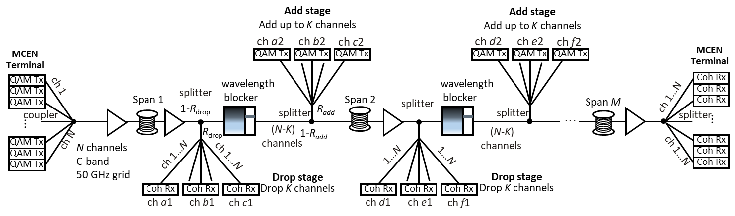
ADVA: Semi-filterless node architecture using wavelength blockers
Node architecture with splitters and wavelength blockers in horseshoe or ring metro network with coherent detection (D3+D18)
  Design rules for splitters and couplers (ratios R_{drop}/R_{add})
  Implication on optical Signal-to-Noise Ratio (OSNR)
  Experimental evaluation with DP-QPSK and DP-16QAM (together with HHI)
$${\frac{P_{min,Rx}∙K∙N}{P_{amp}}<R}_{drop}<\frac{P_{max,Rx}∙K}{P_{amp}}$$
$$R_{add}=\frac{P_{amp}\left(1−R_{drop}\right)}{\frac{P_{Tx}}{K}∙a_{WB}∙N+P_{amp}\left(1−R_{drop}\right)}$$
$${OSNR}_{M,E+A}=\frac{P_{in,EDFA}}{M∙h∙f_{c}∙B_{ref}∙F_{N}+P_{in,EDFA}∙\left(\frac{M}{{OSNR}_{add,K}}+\frac{1}{{OSNR}_{Tx,N}}\right)}$$

Slide 37
ADVA: Semi-filterless node architecture using wavelength blockers
Software interfaces: ADVA OLS: TAPI 2.1 NBI interface will be provided to connect with optical SDN, ADVA coherent transponders: OpenConfig for optical SDN control
ROADM nodes and coherent transponders will be used in real-time low-latency object tracking demo (Berlin)
Final hardware installation and software integration for demo with other partners started
Paper “Flexible metro network architecture based on wavelength blockers and coherent transmission” is accepted for ECOC 2019 as extended talk and Journal paper will be prepared → The results and findings are useful in future system designs by ADVA using wavelength blockers and coherent transmission

Slide 38
OLC

Slide 39
OLC: Validation of PON termination and the abstraction architecture
PON termination to metro node and its abstraction
  Modular architecture
  Supports legacy (installed) PONs
SDN Controller for Passive Optical Networks
  hiding the PON specific details
  Automatic vendor-specific command translation
  PON element configuration:
    VLANs
    VPLS
    Ports
    Bandwidth profiles
    Queues
  PON status monitoring

Slide 40
TIM

Slide 41
Reference ROADM model (OpenRoadm Device 2.2)
ROADM features:
3 degrees
1 SRG
SRG1-CS is a passive coupler-splitter

Slide 42
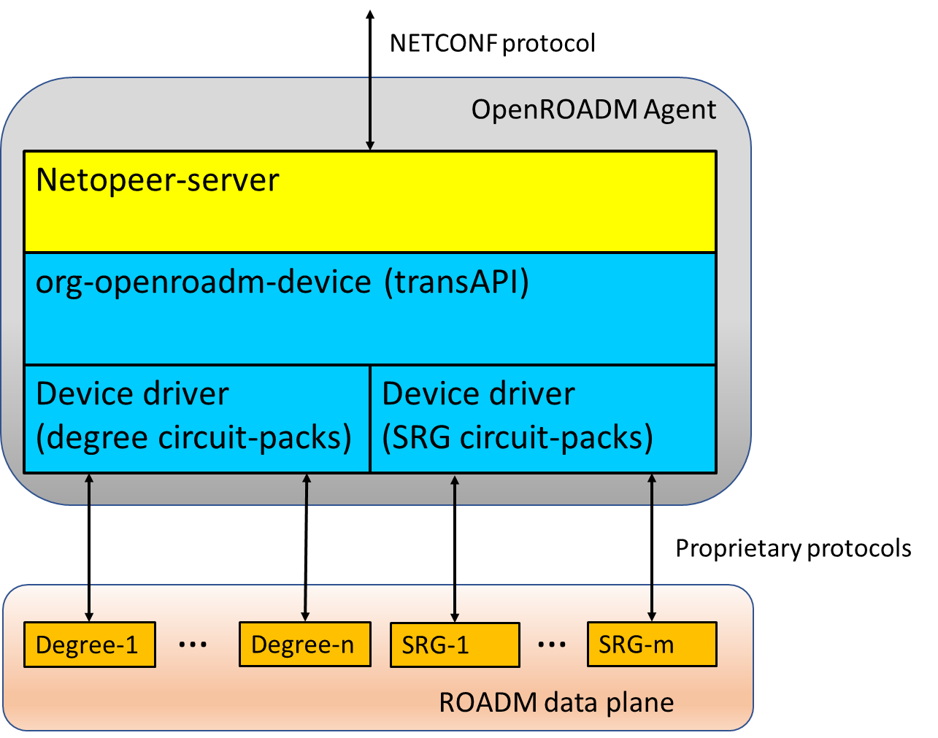
OpenROADM Agent Architecture
NETCONF (server) Agents for Optical Devices
Server based on Netopeer
Running in a Docker Container
Open drivers and customizable to adapt to different devices
Support disaggregation up to sub-systems
Employed and tested in several demos
Innovation entirely originated within METRO-HAUL

Slide 43
TEI/CNIT

Slide 44
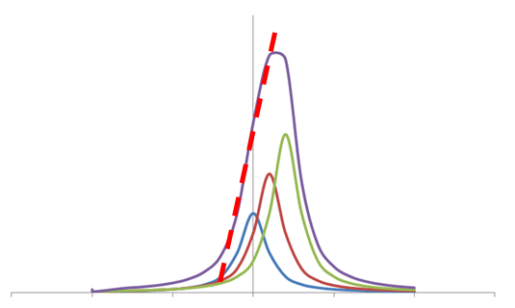
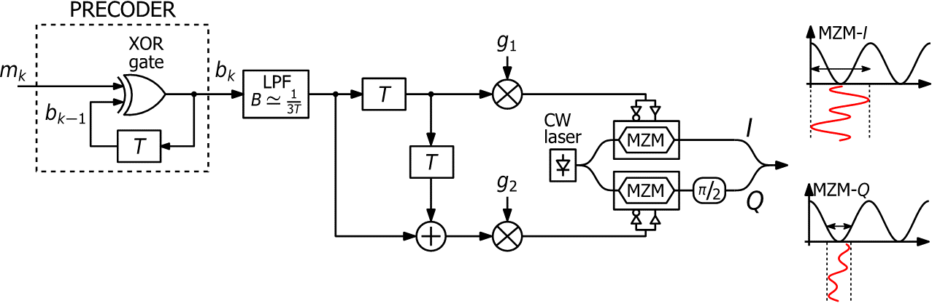
TEI and CNIT: Transceiver solutions for dispersion-tolerant direct detection
Combine novel robust transmission techniques and photonic integrated devices to enhance link performance and robustness to chromatic dispersion.
Control and configuration through NETCONF Agent compliant with OpenConfig
Impact on innovation: Advanced modulation formats, Integrated Photonics Tunable Optical Dispersion Compensator, NETCONF Agents for Optical Devices
Low pass filter
Digital circuit
(Duobinary encoder)
el. DATA
ODC Control
Delays and combiners
Driver amplifiers
IQ modulator
Tx option
λ
IM
ODC (xN)
Dispersion tolerant High speed transmission with CAPS3/IQDuo coding
Chromatic dispersion compensation through cascaded ring resonators
ODC (xN)
NRZ Rx
Rx option
el.
DATA
ODC Control

Slide 45
NETCONF Agents based on ConfD tool
NETCONF agent based on ConfD tool modeling a transponder device compliant with the standard OpenConfig Terminal Device.
- OpenConfig agent has been used in several demonstrations (e.g., OFC2019, EuCNC control plane demo) with both real (e.g., Ericsson commercial transponders) and emulated devices.
OpenConfig agent is in phase of integration with CNIT/TEI transceiver for dispersion-tolerant direct detection
Other partners are using the agent to control several devices (Bristol experimental TSON in collaboration with 5G PICTURE project, Voyager transpoder at Zeetta Networks, Nokia transponder, Adva transponder).
NETCONF agent based on ConfD tool modeling a ROADM device compliant with the OpenROADM standard.
- OpenROADM agent is in phase of testing for controlling a physical ROADM implemented with a photonic integrated switching matrix developed within the IRIS project.

Slide 46
University of Bristol

Slide 47
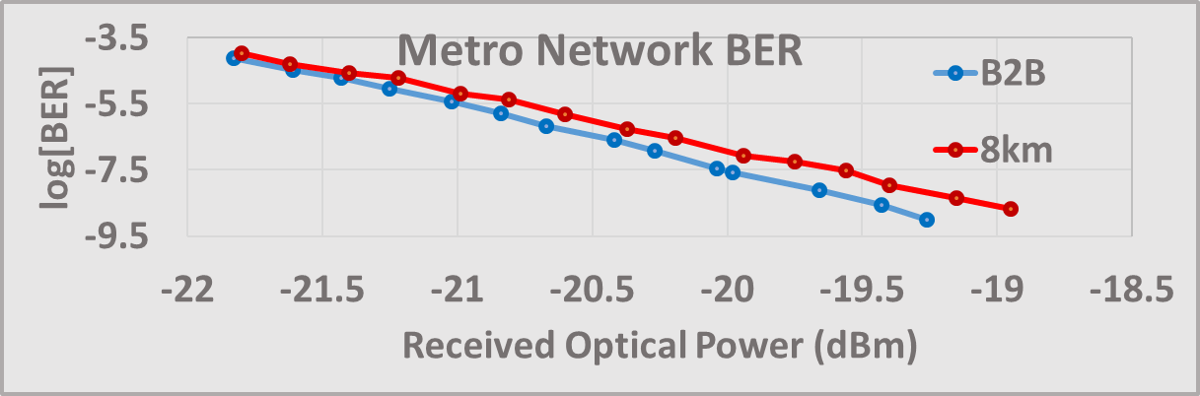
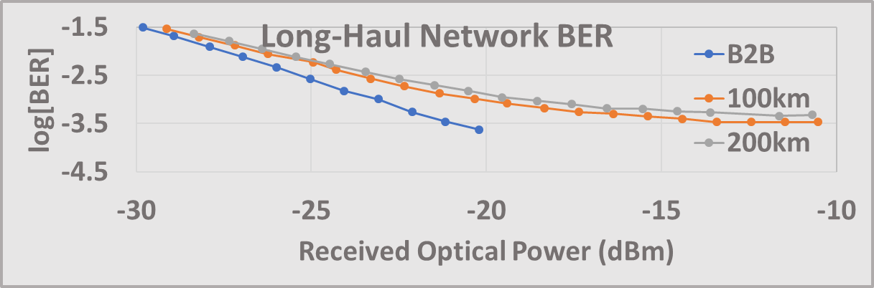
Programmable packet switching solution for interconnection to access and core
Testbed Setup and Experimental Results
Destination | B2B, Metro | B2B, Metro | 8 Km | 8 Km | B2B | 100 Km | 200 Km
Traffic Granularity | Fine | Coarse | Fine | Coarse | - | - | -
Latency (us) | 9.5 | 32.5 | 48.4 | 71.2 | 12.3 | 503.3 | 996.2

Slide 48
Programmable packet switching solution for interconnection to access and core
Solution linked to Hardware components in Metro-Haul
  D12: Programmable packet switching solution for interconnection to access and core
  D19: Voyager muxponder
Usage in Bristol demo
  Used as a transponder to transmit crowdsourced video streams from the AMEN to the remote MCEN

Slide 49
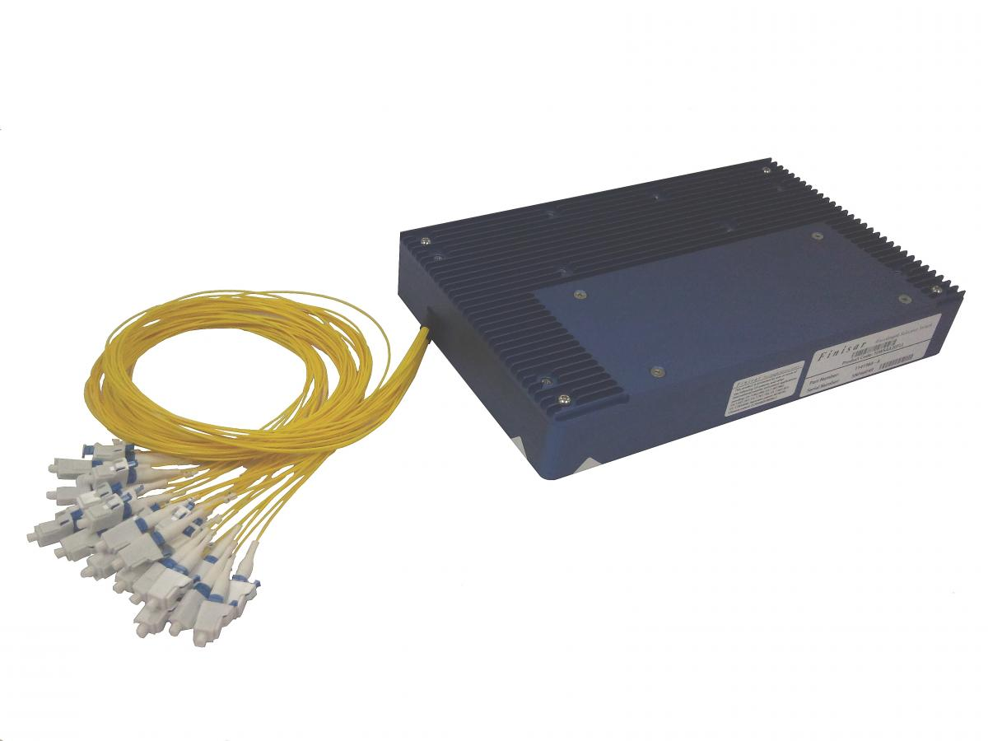
University of Bristol ROADM
Ideal ROADM design:
TrueFlex WSS
Lumentum
(WSS to be emulated)
WSS
WSS
WSS
WSS
WSS available in HPN (UnivBris):
- 1x4 Waveshaper Finisar
- 4x16 Waveshaper Finisar
- 1x20 Flexgrid WSS Finisar
WSS
WSS
WSS
WSS

Slide 50
University of Bristol ROADM Design
OpenROADM Agent
North
WSS
University of Bristol ROADM design with splitters:
3 degrees
4 WSS used instead of 8
Insertion loss comparable to WSS for this type of splitter/configuration (~6dB)
WSS
West
East
WSS
WSS
Add / Drop

Slide 51
University of Bristol ROADM
Solution linked to Hardware components in Metro-Haul
  D21: Bristol ROADM
Usage in Bristol demo
  Used as the ROADM to switch lightpaths carrying crowdsourced video streams from the AMEN to the remote MCEN and vice versa

Slide 52
UPC

Slide 53
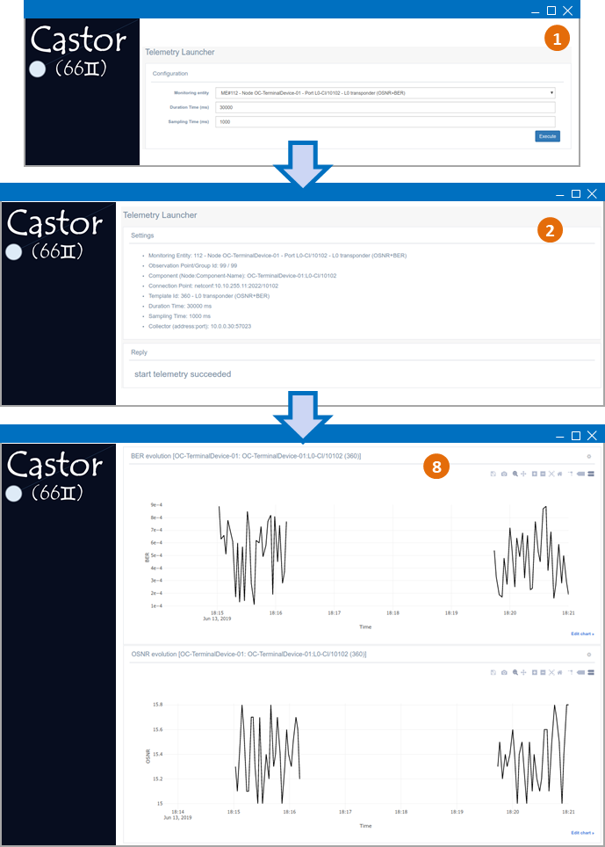
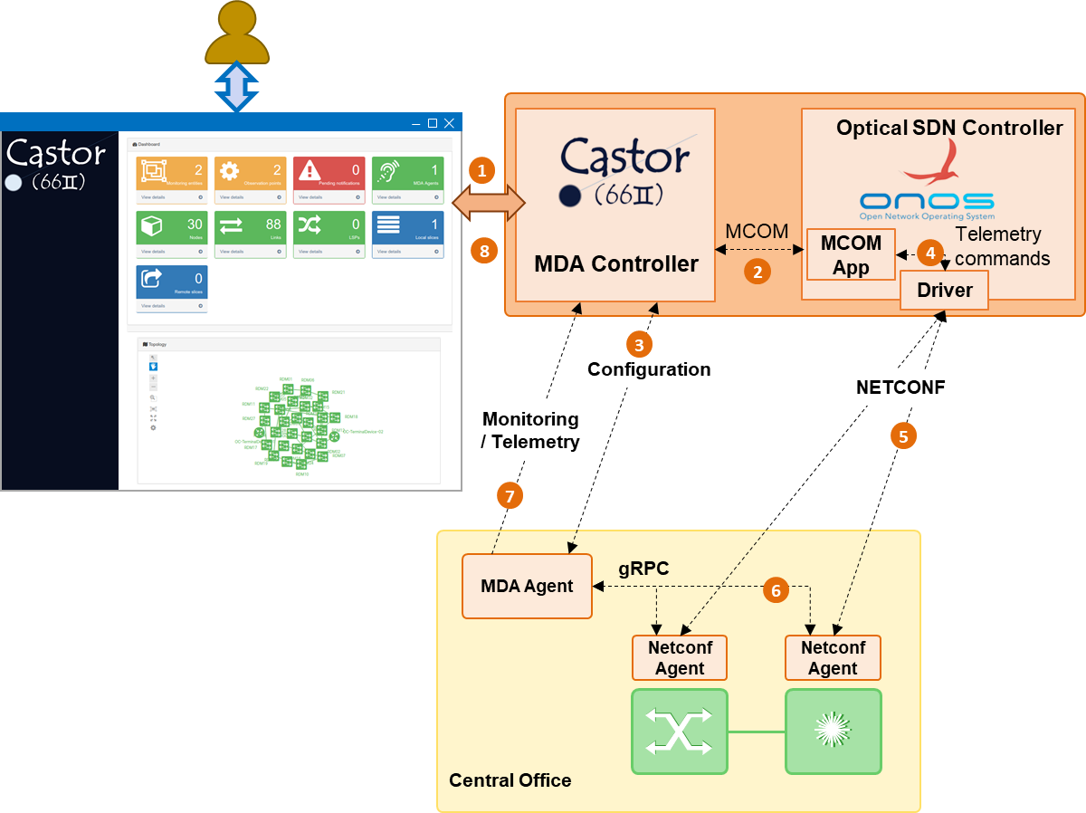
UPC: On-demand Telemetry and Results Visualization
Demonstrated during EuCnC 2019
Partners involved: UPC, CNIT, CTTC

