Slide 1
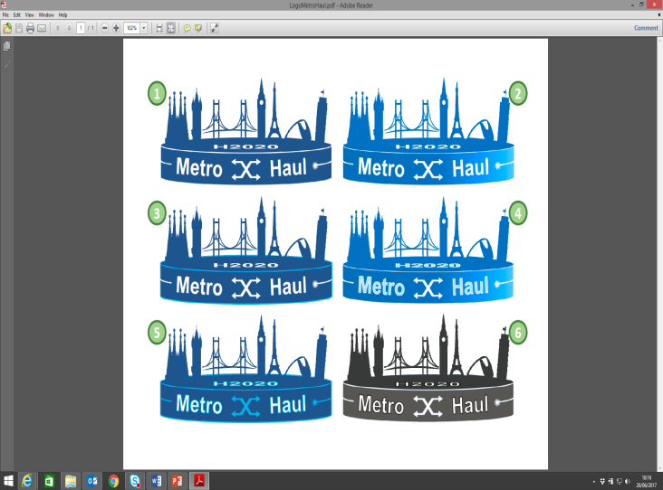
Innovation Management
Antonio D’Errico, TEI

Slide 2

Innovation Leap
Peur?
Antoine de Saint-Exupéry, “Le Petit Prince”

Slide 3

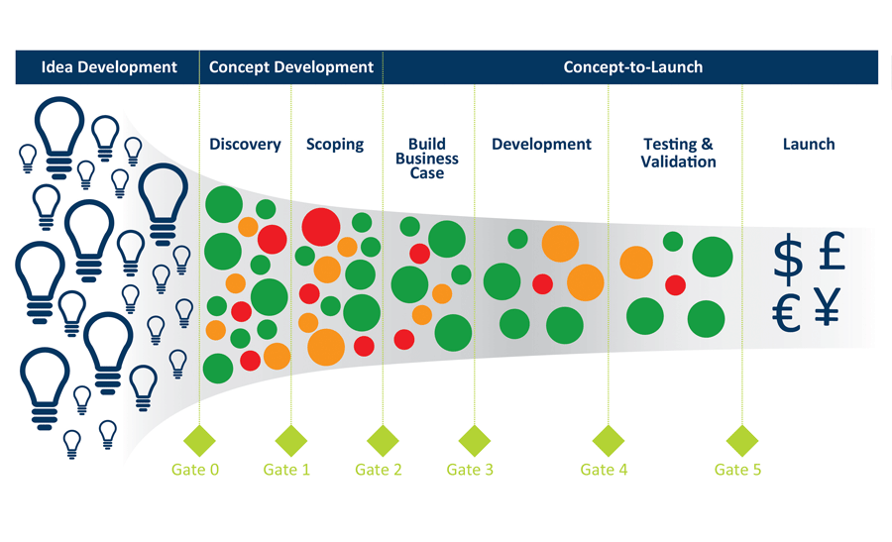
Innovation Cycle
USERS
Business
TECHNOLOGY
Development
Focus
Profitability
Growth
Research
Direct Value
Intermediate Value
Indirect Value
MARKET

Slide 4
Innovation 2nd Year
The Innovation Management activity in the second year focused on analysing the areas of METRO-HAUL project that provide commercial opportunities for innovation and fruitful exploitation in terms of
        novelty
        inventiveness
        intellectual property
Project commercial partners, SMEs as well as large companies, based on different perspectives, are aiming to enhance their product portfolio and reuse the enabling techniques and technologies developed within the project

Slide 5
Innovation 2nd Year Progress
During the first year, a clear separation was established to highlight innovative research, and what represented commercial innovation activity and innovation opportunities, across all WPs of Metro-Haul.
During the second year, two principal attitudes have been used by project partners when discussing and documenting innovation in the project, specifically:
            Ingenuity
            Creativity
            The principal technological approaches utilise two guiding principles: improving both the fast responsiveness and the transparency of the network; furthermore, we are ensuring economic costs are sustainable and minimising power consumption where possible.

Slide 6
Innovation Management Pinpoints
While expressing their innovation impact, the involved partners were asked to comment on three innovation survey questions:
  Clarify key Metro-Haul project developments and innovations
  What are the compelling use cases for identified innovation?
  Declare if and what IPR has been filed per innovation, and per partner

Slide 7
INNOVATION UPDATES
List of Innovations 2019
The innovation results, emerged thus far and disclosed, are extremely compelling and demonstrate an auspicious trend for the project
The Innovation report is public and can be found at
https://bscw.metro-haul.eu/pub/bscw.cgi/d47157/InnovationManagement_2Audit.pdf
International patent filings have begun, or patent applications are currently pending. In critical examples, some inventive ideas and patents have been provided to project partners with fair, reasonable, and non-discriminatory (FRAND) terms.
Innovative project software has also been made available within the project partner consortium as “open software”, and in most of the cases loaded in specialised hardware and shared in several demonstrators

Slide 8
WP4
WP3

Slide 9
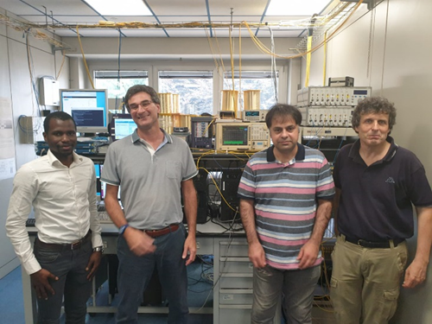
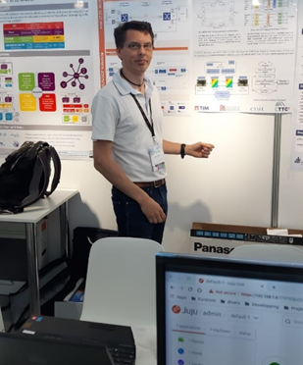
Contributions to Support Innovation
Several demos in support of Metro-Haul innovation has been showcased in the important events around Europe
ECOC 2018
EUCNC 2019
OFC 2019
ECOC 2019
Joint METRO-HAUL 5G-Picture also in laboratories involving real devices and prototypes
For instance the involved ONOS controller is the last version with all new features introduced by Metro-Haul

Slide 10
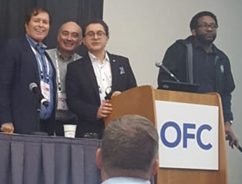
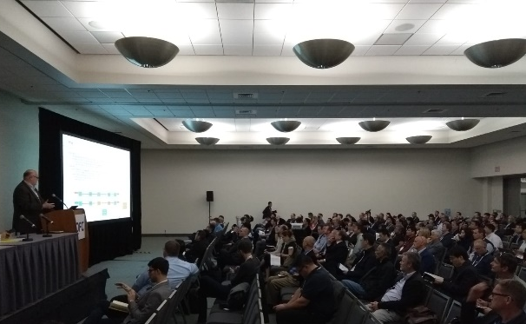
OPEN PLATFORM SUMMIT AT OFC 2019
Antonio D’Errico and Albert Rafel, representing Metro-Haul Project with the collaboration of Stephen Grubb, Facebook Inc., as members of the OFC events organizing committee, chaired the Open Platform Summit on Disaggregated Networks.
The major players in the field were present at the summit:
AT&T, Microsoft, NTT, Facebook, ONF.

