Slide 1

Metro-Haul
WP2: Year 2 Review
Albert Rafel (BT)
Brussels, 2 October 2019
Notes:
1. Single slide headline - v quick summary to grab attention Title of WP.
Main purpose of WP.
Top 3 headlines emerging from the first year
2. What is this WP all about? WP objectives. Tasks. Partners involved. Milestones and Deliverables. (THOUGH I want it to not sound as dry as this somehow)
3. What has been done in the first period, task by task
4. Summary of key outputs inc deliverables, demos etc
5. Anticipated next steps.
6. Any issues, roadblocks? What are the main challenges ahead and how will we meet them?
7. Conclusion slide

Slide 2
WP 2 – Use Cases, Service Requirements, and Network Architecture Definition
WP2 Objectives
  to define Service Use Cases and requirements of the metro network architecture that can support them
  to define the functional architecture of the metro network that can be used by an orchestrator to control the infrastructure in order to provide the defined Service Use Cases
  to design the Metro network architecture and evaluate its performance
WP2 Work Organisation – Tasks
  Task 2.1 Definition of generic use cases and service requirements [June ‘17 – Jan ‘18] Leader: TIM
    Milestone: MS3 “Collection of selected proposals on use cases and services” [finished Sept ‘17]
    Deliverable: D2.1 “Definition of Use Cases, Service Requirements and KPIs” [submitted Feb ‘18]
  Task 2.2 Functional network architecture definition [June ‘17 – Sept ‘18] Leader: University of Bristol
    Milestone: MS14 “Architecture Functional Description” [finished Oct ‘18]
    Deliverable: D2.2 “Functional Architecture Specifications and Functional Architecture” [submitted Oct ‘18]
  Task 2.3 Network architecture design & evaluation [Jan ‘18 – Nov ‘19] Leader: Infinera (formerly Coriant) Portugal
    Deliverable: D2.3 “Network Architecture Definition Design Methods and Performance Evaluation” [submitted May ‘19]
    Deliverable: D2.4 “Techno-Economic Analysis & Network Architecture Refinement” [due Nov ‘19]

Slide 3
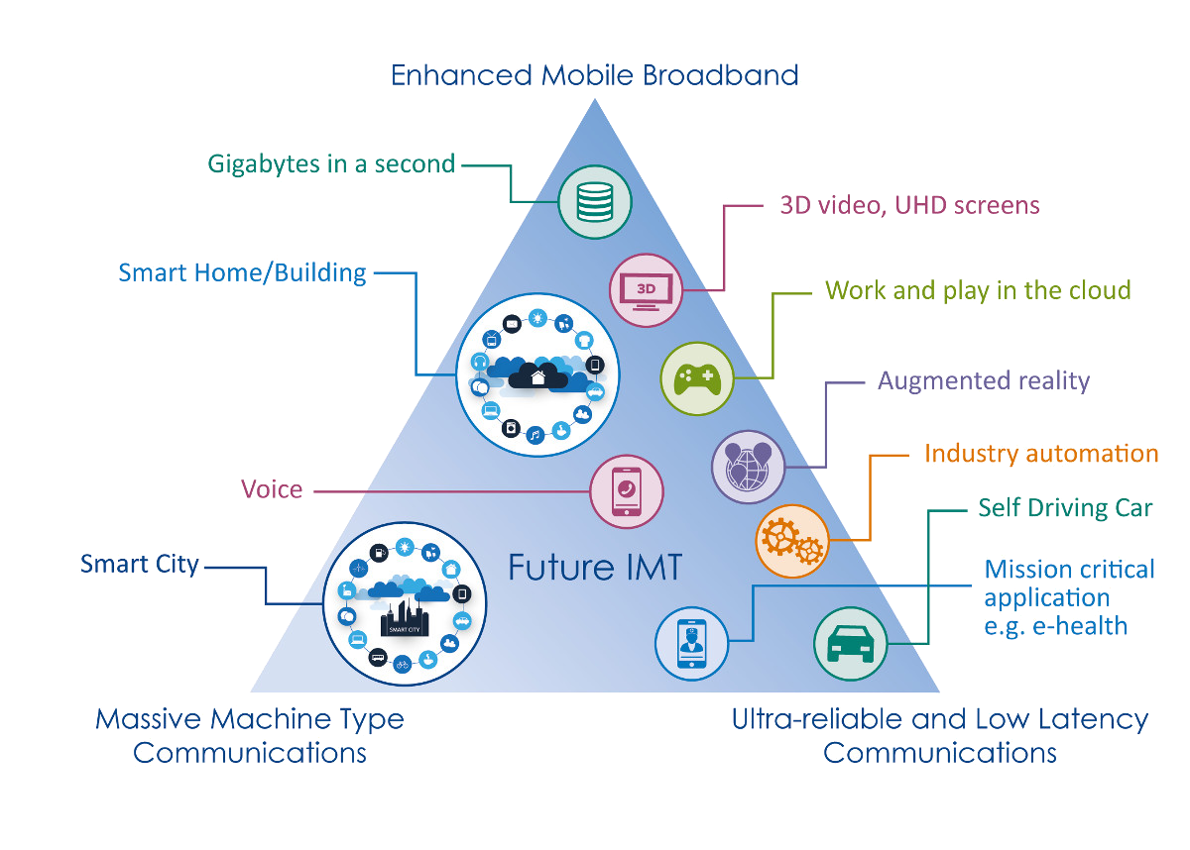
WP2 Approach – 5G Service Classes
Distributing intelligence in the network
a single physical network that is dynamically programmed to deliver not only uRLLC, but also mMTC and eMBB services at the same time.
The network uses the efficiencies and computing/storage scalability of data centres – the cloud – at multiple levels: near the edge, at the aggregation level, near the core.
Software-defined networking (SDN) and network function virtualization (NFV) provision a dynamically-configurable, service-oriented architecture.
Source: http://5gsmarts.com/5g-tech/5g-latency-1-millisecond/
Source: ETSI presentation - Adrian Scrase - URLLC 2017, London, UK, 14 November 2017
Central Offices re-architected as Data Centres

Slide 4





Metro-Haul Architecture
Control / Orchestration
Fixed & Wireless Access
Monitoring
AMEN
Photonic Core
DATA
CENTRE
BBU
MCEN
Metro Node
EPC
BBU
DCN
Metro Node
DC
DC
DC
DC
DC
DC
PBytes?
Gbit/s?
FLOPS?
TBytes?
Tbit/s?
FLOPS?
Metro Node
10-20 km
0.1-0.2 ms
Metro-Haul scope
AMEN: Access Metro Edge Node
MCEN: Metro Core Edge Node
50-200 km
0.5-2 ms
100-1000 km
1-10 ms

Slide 5
Analysed Service Use Cases
Vertical | Use Case | CoS
Media & Entertainment | Content Delivery Network | eMBB
 | Live TV Distribution | eMBB + URLLC
 | 6DoF Virtual Reality | eMBB + URLLC
 | Crowdsourced Video Broadcast | URLLC
Cloud Services | Service Robotics | eMBB + URLLC
 | Enterprise Access with NG Eth | eMBB + URLLC
Utilities | Utility Metering | mIoT
Automotive | Intelligent Transport System & Autonomous Driving | eMBB + URLLC
Industry 4.0 | Smart Factories | eMBB + URLLC + mIoT
Public Safety & Environment | Real Time Low Latency Object Tracking & Security | URLLC
Operator orientated | Secure SDN Control – Video Distribution | BB + URLLC
 | 5G Fronthaul Architectures

Slide 6
D2.2 Functional Architecture Specifications & Functional Definition
D2.2 binds together the work done in D2.1/WP2, D3.1/WP3 and D4.1/WP4 in terms of SDN control and monitoring, AMEN/MCEN nodes, and optical layer, in scope of the objectives of METRO-HAUL and the Service Use Cases
Metro-Haul uses and EXTENDS existing SDN/NFV platforms (Standards) to achieve the overall objectives
  New models, interfaces and agents (e.g. disaggregated optical nodes)
  Advanced Planning & Optimisation Tools
  Monitoring and Data Analytics Subsystem
D2.2 described the functional Workflow and the Performance Analysis for the two field demos and one portable demo as described in D2.1/WP2 & D5.1/WP5
  Crowd-Source Video Streaming
  Real-Time Low-Latency Object Tracking & Security
  It includes other vertical services described in D2.1/WP2
Notes:
have been developed to be used over packet switching elements and the disaggregated optical nodes, used or newly developed, in the project

Slide 7
Deliverable D2.2 on Latency
D2.2 includes an analysis and classification of the latency requirements for the different services defined in D2.1/WP2
It also elaborates on a Latency Model and applies it to the Metro-Haul Architecture
  It includes a detailed analysis of the latency for the different Latency Classes over different 5G Transport Architecture Split Options and their mapping onto the Metro-Haul Architecture

Slide 8
Deliverable D2.2 on Energy Consumption
D2.2 includes an Energy Consumption Analysis applied to the Content Delivery Network (CDN) use case
The model is used to estimate the energy consumed for transporting and storing the service traffic

Slide 9
T2.3 Network architecture design & evaluation
Antonio Eira (Infinera) organised work in T2.3 through main 3 activities: Project KPIs, Support Tasks, and Working Streams
  D2.3 Network Architecture Definition, Design Methods and Performance Evaluation
  D2.4 Techno-Economic Analysis & Network Architecture Refinement
Figure 5 / D2.3
Deliverable D2.3 describes the tools and methodologies to evaluate the Metro-Haul architecture based on the KPIs

Slide 10
Metro-Haul KPIs and T2.3/WP2
 | M-H KPIs
MH1 | Optical PtP connection set-up time
MH2 | Metro-Haul E2E PtP connection set-up time
MH3 | Set-up time of network service slice across M-H
MH4 | Capacity of Metro-Haul controller
MH5 | Fault/degradation detection time
MH6 | Capacity of Metro-Haul infrastructure
MH7 | New optical components/systems
MH8 | CapEx reduction
MH9 | Energy consumption
Project KPIs were defined by Consortium
Evaluation spread across WPs according relevance
MH6, MH8, and MH9 were partly assigned to T2.3/WP2
M-H KPIs | 5G PPP Performance KPIs
 | P1 | P2 | P3 | P4 | P5 | P6
MH1 |  |  | X | X | X | N/A
MH2 |  |  | X | X | X | N/A
MH3 | X |  | X |  | X | N/A
MH4 | X |  |  |  | X | N/A
MH5 |  |  |  | X |  | N/A
MH6 | X |  |  | X | X | N/A
MH7 | X | X | X |  |  | N/A
MH8 | X |  |  |  | X | N/A
MH9 |  | X |  |  |  | N/A
 | 5G-PPP Performance KPIs
P1 | Providing 1000 times higher wireless area capacity and more varied service capabilities compared to 2010.
P2 | Saving up to 90% of energy per service provided.
P3 | Reducing the average service creation time cycle from 90 hours to 90 minutes.
P4 | Creating a secure, reliable and dependable Internet with a “zero perceived” downtime for services provision.
P5 | Facilitating very dense deployments of wireless communication links to connect over 7 trillion wireless devices serving over 7 billion people.
P6 | Enabling advanced user-controlled privacy.

Slide 11
Geo-Types, Reference Topologies and Traffic Characterisation
D2.3 defines a reference topology to be used for the validation of the Metro-Haul KPIs
Topology as the Consolidation of current TIM, Telefónica and BT Metro Networks
Two types of traffic generating methodologies have been developed
- Macro Traffic: maximum traffic generated during busy hour
- Micro Traffic: dynamic traffic being generated within the busy hour
Traffic has been characterised and different methodologies to generate the traffic have been developed.
The traffic matrices resulting from these methodologies will be the Traffic Inputs for the Techno-Economic Studies and evaluation of the M-H KPIs

Slide 12
Evaluation Tools
Net2Plan as a Tool for the network Techno-economic studies and evaluation
  The existing Open Source Planning tool Net2Plan was chosen for the use in WP2
  The necessary tool new interfaces were developed to be used by Metro-Haul
Node Cost and Energy Models
  Models to evaluate the cost and power consumption of the optical, packet-switched and data centre building blocks to be used to design Metro-Haul’s AMEN and MCENs

Slide 13
Candidate Architectures & Evaluation Methods
Data-Centre Nodes at AMEN/MCEN
  Six different architectures have been defined that will be assessed
  ADVA commercial equipment has been adapted and enhanced to be used in the DC Node as computing and switching resource
Disaggregated Optical node architectures for Metro-Aggregation and for Metro-Core Nodes
  Physical Layer Components developed within WP3
  Optical Disaggregation Models
  Edge Computing
Autonomous Networking & E2E Orchestration
Metro-Haul topology and full network topology

Slide 14
D2.4 Techno-economic Analysis and Network Architecture Refinement
D2.4 due November 2019, will show the “Make or Break” of WP2
Frameworks for Techno-Economic Architecture Evaluation
  Traffic Characterization and Service Use-Cases (UPC)
  Planning Tools and Dissemination (UPCT)
  Cost and Energy Model (UC3M)
Architecture and Evaluation Methods Refinement
  Techno-Economic Analysis of DC Node Architectures at Central Offices (TID)
  Physical Network Architectures for Optical Nodes (INFN)
  Economic Impact of Optical Disaggregation Models (TIM)
  Techno-Economic Impact of Edge Computing (PoliMi)
Techno-economic evaluations and KPI analysis (INFN)
Conclusion

Slide 15
Techno-economic analysis. Methodology

Slide 16

Methodology for techno-ecnonomic analysis
Reusable modules / multiple partners
Scenario Definition
Software framework
Algorithms
Reference Topology
NIW
NFV over IP over WDM
Net2Plan Library
Aut. reports
Traffic Model
Excel Template
Benchmark tests scripts
NIW library developed within MH (open-source)
  Based on abstract model of an IP over WDM network with IT resources in the nodes.
  Simplifies development of Net2Plan algorithms, automatic reports etc. for these networks.
  Simplifies import/export from defined Excel-based template.
Publicly available: shipped with Net2Plan (www.net2plan.com)
Notes:
This schema depicts the proposed methodology to accomplished some of the WP2’s objectives.
We can define the scenario (topology and traffic) easily in a specific excel file.
This file is used as an input in Net2plan, the NFV over IP over WDM (NIW) library [developed inside MH –by UPCT- now part of Net2Plan to help its dissemination] provides an information specifically designed to MH WP2 purposes.
Additionally, several partners can deploy their algorithms to evaluate different analysis within different WP2 work streams, such as, capacity planning, resource allocation or cost/energy budget calculations.
IDEA: This methodology is modular and embraces a multi-partner collaboration approach

Slide 17

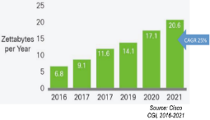
Methodology for techno-economic analysis. Workflow example
IP BOM
Cost model
Multi-hour tests
Capacity Planning alg.
Reference Topology & Traffic
DC BOM
Energy model
Multi-period tests
WDM BOM
Three reference topologies (Telecom Italia)
  Diameter <200 km, [52, 102, 159] nodes
  Anonymized in node position
With traffic information in agreement with Deliverable 2.3
  Background traffic: P2P, regular, cacheable (video)
  Traffic from verticals: VNF & traffic requisites from key vertical services considered (D2.3).
Notes:
Next slides are for a workflow example, in a case of capacity planning => given traffic, WDM plant, dimension IP equipment, lightpaths (WDM eq) and IT resources needed to carry traffic. That is, this is NOT an example of dynamic resource allocation, where resources are given, and you have to allocate them for on-demand requests coming one by one.
The 3 reference topologies define which nodes are AMEN, MCEN and MCEN BB nodes.
Regarding the traffic model, it considers two main types: 1) background [P2P, regular and cacheable], and 2) traffic from verticals with virtualization VNF requisites. In 1) video dominates (around 60%)
Such tasks can produce an excel file per topology, that includes topology + traffic info.

Slide 18
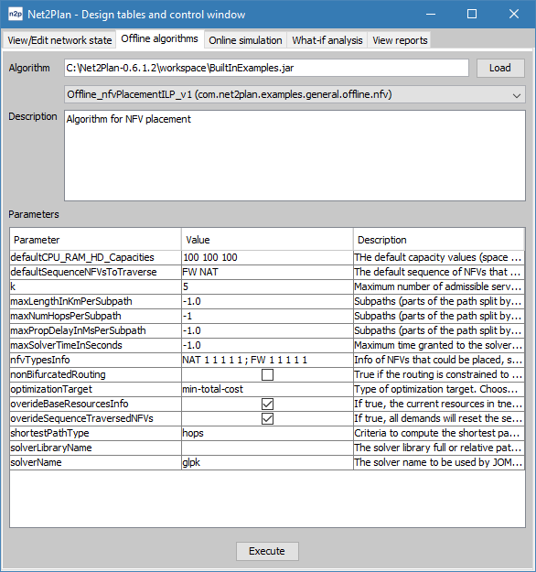
Methodology for techno-economic analysis. Workflow example
IP BOM
Cost model
Multi-hour tests
Capacity Planning alg.
Reference Topology & Traffic
DC BOM
Energy model
Multi-period tests
WDM BOM
JOINT capacity planning of IT & network resources
  Different algs from different partners for different problem variants / approaches
ML algorithms in resource allocation in dynamic traffic environments
Code reuse: Algorithms can leverage on proven routines or other algorithms
RUN
Notes:
Important message: cap planning in MH targets JOINTLY designing the IT requirements and IP & WDM requirements. Why? Where you put VNFs shapes the traffic => IT dimensioning cannot be made independently of IP/WDM dimensioning.
Algorithms (from multiple partners, for different variants) for this are developed in Net2Plan. Thanks to NIW library they are much easier to do.
Code reuse: Algorithms can leverage on proven routines or other algorithms:
VNF placement
RWAs
Multiple algorithms of different partners / collaborations:
For different optical equipment available (ROADM / filterless) in different parts of the network
For different types of User Plane Function location (at MCENs / AMENs) for each service. If in AMENs, caching can occur also there.
Algorithms based on machine learning are proposed in MH in dynamic resource allocation cases (good to mention ML). However, this particular example is for capacity planning.
The output is a n2p flie (exportable to Excel) with the IP flows allocated, lightpaths created, VNFs instantiated etc. From that, we can count how many of everything is needed to allocate all.

Slide 19
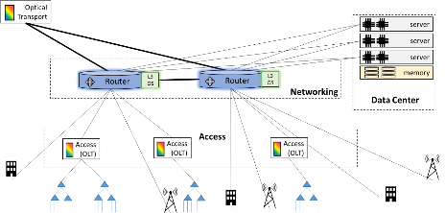
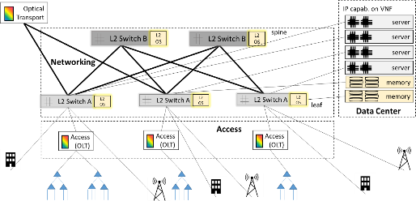
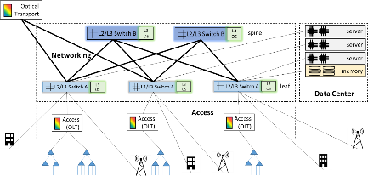
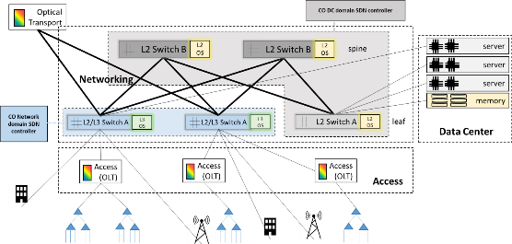
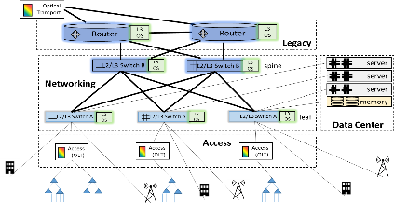
Methodology for techno-economic analysis . Workflow example
IP BOM
Cost model
Multi-hour tests
Capacity Planning alg.
Reference Topology & Traffic
DC BOM
Energy model
Multi-period tests
WDM BOM
Automatic scripts creating Bill-of-Materials reports
IT: BOMs for different DC architectures
IP & WDM: BOMs for different capabilities of optical equipment
Notes:
We are developing different Net2Plan algorithms that work as scripts:
Take the allocation of IP flows, lightpaths, VNF instances (previous step)
From there compute the IT, IP, WDM equipment requirements (BOM)
2.1) For DC BOM: TIM/TID/UPCT we are collaborating on creating Net2Plan reports for, given the network produced by the algorithm, count number of cards, switches, routing, servers required in all the AMENs/MCENs, and make a report (HTML/Excel/N2P). The numbers depend on the DC architecture (leaf/spine, flat etc). Numbers will be produced for the DC architectures highlighted in the deliverable
2.2) The same for WDM equipment. Different options here (ROADM / filterless / different equipment flavours).
Once the BOM-reports are there, can be applied for any network from any reference topology, produced by any algorithm.

Slide 20
Methodology for techno-economic analysis . Workflow example
IP BOM
Cost model
Multi-hour tests
Capacity Planning alg.
Reference Topology & Traffic
DC BOM
Energy model
Multi-period tests
WDM BOM
Datacenter Components
 | Description (text)
Compute Nodes | Examples: HP Proliant DL 360, Huawei 1288-v5 or 2288H-V5, Dell R740 or R940
Small | Intel Xeon Gold 6134 with 8 cores, 64 GB RAM, 600GB HDD
Medium | Intel Xeon Gold 6140 with 16 cores, 128 GB RAM, 1.2TB HDD
Large | Intel Xeon Platinum 8160 with 2 CPUs x 24 cores, 128 GB RAM, 3.6 TB HDD
ExtraLarge | Intel Xeon Platinum 8160 with 4 CPUs x 24 cores, 192 GB RAM, 3.6 TB HDD
Storage | Examples: Samsung SSD, iXSystems TrueNAS X10 2U, HPE Nimble Storage HF40/60, Dell EMC Unity 300
SSD Small | 4 TB
SSD Large | 8 TB
NAS Small | 20 TB
NAS Medium | 60 TB
NAS Large | 120 TB
NAS ExtraLarge | 400 TB
Other specialized hardware
BRAS
HW Firewall | eg Fortinet FortiGate 3000D
Load Balancer | eg HPE OpenCall Load Balancer, Radware Alteon. F5Big-IP, etc
MH Cost model & energy consumption model
A cost model is being produced, updating and expanding efforts in previous Eus
Cost model includes energy consumption figures
Automatic reports are being developped to produce cost & energy figures from the BOMs & networks.
Notes:
The consortium is collaborating to provide a complete cost model that can be combined with the pre-calculated BOMs to translate “number of” to cost and energy => create relevant cost/energy reports to show these figures. The figure shows a table with some components included in the MH cost model
TID-UC3M is coordinating this, mostly engaging all the vendors and carriers.

Slide 21
Methodology for techno-economic analysis . Workflow example
IP BOM
Cost model
Multi-hour tests
Capacity Planning alg.
Reference Topology & Traffic
DC BOM
Energy model
Multi-period tests
WDM BOM
Different tests are being conducted. Scripts for bulk definition of the multiple tests can be also shared.
Multi-hour: Exploit knowledge of well known traffic profile variation along day.
Multi-period: Studies considering traffic growth. Future-proof network evolution.
Relevant results already obtained, described later in this talk
Notes:
Multiple tests will be conducted, with this methodology. Multi-hour & multi-period tests are of course considered. Multi-hour considers the well known traffic tidal patterns for different services.
Multi-period, year by year growths, to make long term technoec analysis
Scripts defining the tests (e.g. launching 100s of tests for different traffics, equipment types…) can be reused. E.g. then can be applied with other algorithm and/or other topology. Also, external people can repeat and validate our studies.
You may say some words about the question to answer, that you raised in BCN, and will be addressed for EUCNC invited: how dynamic capabilities of MH control plane can save CAPEX? For this, we will consider the multi-hour scenario with different tidal variations, and compare: i) not dynamic allocation possible => VNFs & IT dimensioned for the per-service day peak traffic. Ii) dynamix allocation possible => dimension is for the peak of the aggregated traffic along the day. Since different service peak at different times according to D2.3. data (business vs residential traffic), I expect non-negligible savings here. Results will tell.

Slide 22
Static traffic matrices
Traffic model proposal based on three main categories
Residential and Business «mass market». Three types:
  (10%) Peer-to-peer (audio and video call and other services between user terminals) – Symmetrical (Upstream 100% of Downstream)
    User ↔ MCEN BB (5G Core handling IP packets) ↔ User
  (30%) No cached traffic from remote DC (in Metro Core BB sites or outside) - no caching in metro network assumed – Asymmetrical (Upstream 30% of Downstream)
    User↔MCEN BB (where application DCs are, or going to the core)
  (60%) Cached video traffic on remote or local DC Hugely asymmetrical (Upstream 10% of Downstream)
    User↔AMEN Cache
    User↔Closest MCEN Cache
    User↔MCEN BB (Cache / go to backbone)
Traffic intensities: short, medium and long term traffic (2019, 2022, 2025), reflecting also expected 5G penetration

Slide 23
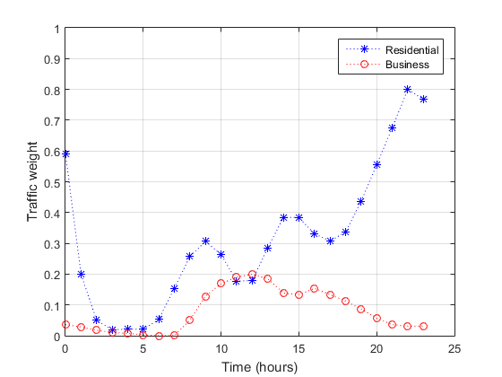
Daily Traffic Profile
Residential and business have different daily patterns
  For all the traffic types:
  80% residential nature
  20% business nature
Note that residential traffic flows peak at night, and business traffic flows peak in the afternoon

Slide 24
Static vs Dynamic Control & Data Planes
Static case:
  Traffic flows of residential and business traffic separated
  No reconfiguration possible:
    IP flows are statically assigned resources for peak load.
    Lightpaths are statically placed, never changed, but shared between residential and business traffic
Dynamic case. MetroHaul agile control and data plane permits:
    Make the most of Physical NFs → VNFs
    Redimension the IT resources assigned in the DCs to each VNF
      IT resources used in the morning for NFs of business traffic, can be reused in the evening for NFs handling residential traffic.
    Lightpaths are set up and down dynamically on demand to adapt to traffic variations
      Transponders INSIDE a node are reusable: A transponder in node A can be used in the morning for a lightpath A↔B, and later in a lightpath A↔C.

Slide 25
Technoeconomics Outcomes in Topology Dense
Having a dynamic & agile control & data plane helps to reduce CAPEX?
TOPOLOGY 1 | Tp1 | TP2 | TPOther
Static | 0 | 466 | 756
Dynamic | 16 | 386 | 630
20-27% reduction in # transponders needed, both in filterless and full ROADM cases
TOPOLOGY 2 | Tp1 | TP2 | TPOther
Static | 0 | 5500 | 468
Dynamic | 71 | 4588 | 370
(Transponders - TP1 – 10G, TP2 25G, TPOther 100G)
TOPOLOGY 1 | Server (T1) | Cache (T2) | UPF (All)
Static | 20.5 | 34.7 | 65.7
Dynamic | 17 | 28.9 | 54.6
17%-20% reduction in IT resources CAPEX estimated as the amount of Tbps of traffic to be processed by the VNFs thanks to their dynamic resizing
TOPOLOGY 2 | Server (T1) | Cache (T2) | UPF (All)
Static | 29.6 | 50.1 | 94.9
Dynamic | 25 | 41.6 | 78.8
Notes:
Dynamicity produces CAPEX reductions in # of transponders, and IT resources. IT resources occupation is estimated to be proportional to the amount of traffic that has to traverse each VNF in each node. How this translates into CPU/RAM/HD depends on the VNF nature, but since we are interested in relative numbers, for comparison can be enough.
Numbers here apply to BOTH ROADM and filterless cases

Slide 26
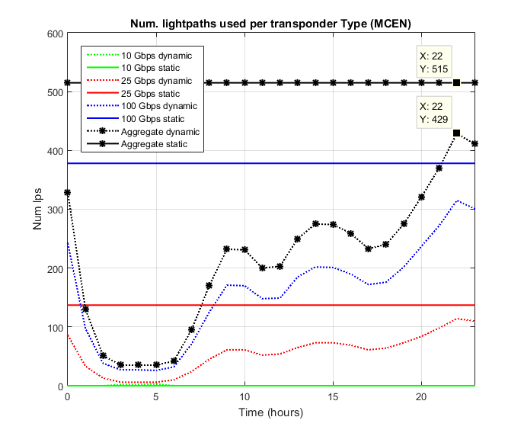
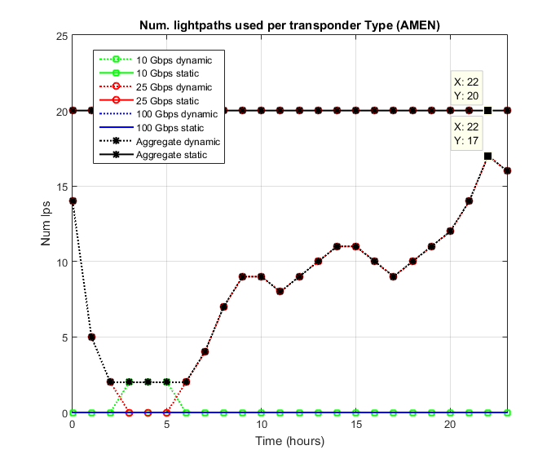
Transponders used in MCEN and AMEN Nodes (Static & Dynamic)
Dynamic case also helps in energy consumption OPEX
(# active lightpaths used)
Notes:
Dynamicity also brings energy savings, since permits setting down lighptaths not used. These graphs illustrate how the number of lightpaths changes with time, and 1) is always smaller than in the static case, 2) uses the valley times to switch off things

Slide 27
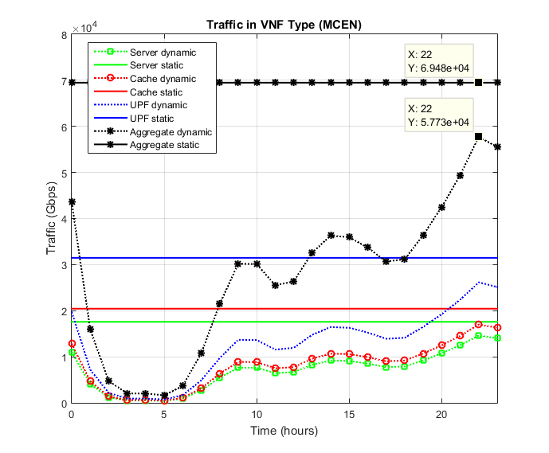
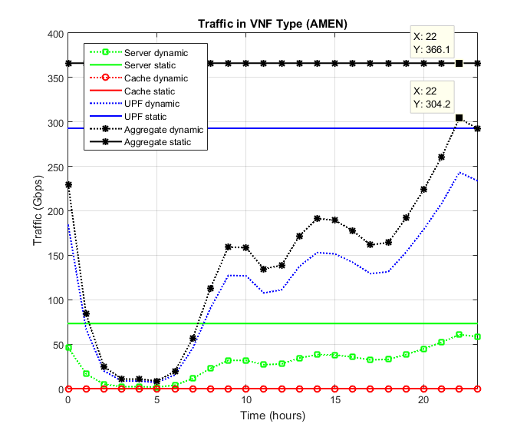
Traffic per VNF Type in MCEN and AMEN Nodes (Static & Dynamic). Dense
Dynamic case also helps in energy consumption OPEX
(reserved (even if idle) capacity in IT resources)

Slide 28
SUMMARY

Slide 29
Summary
Very successful, though challenging, first 2 years of WP2 activities
  M2.1 & D2.1 very important input to all WPs and activities in Metro-Haul
  M2.2 & D2.2 brought together all the initial work done in WP2, WP3, WP4, and WP5
    Huge effort from many partners from within and outside WP2
    Some partners without planned effort in WP2 made significant and important contributions
  T2.3 is a very complex and critical activity cleverly and efficiently led by Infinera
    D2.3 laid the Foundations (Tools & Methodology) of how to evaluate the Metro-Haul architecture & different solution options
  D2.4 will show some of the Key Results of Metro-Haul Assessment & Evaluation
Use of resources
  Activities have exceeded what had been planned in the proposal (e.g. development of Traffic Generating Tools)
  Higher complexity that anticipated (e.g. analysing the Use Cases)
  Some partners have made much larger contributions than anticipated (e.g. UPC/UPCT)
NEXT STEPS
  Deliver D2.4
  WP2 planned to stop activities by end of November 2019

Slide 30
Conclusions & Next Steps
Very important inputs to all WPs and activities in Metro-Haul
Bringing together all the initial work done in WP2, WP3, WP4, and WP5
Edge-to-edge fully disaggregated Metro-Haul architecture finalised assimilating physical and control plane aspects
Laid the Foundations (Tools & Methodology) to enable evaluation of the Metro-Haul architecture & different solution options
Techno-economic analysis with well-defined use-cases assessing the physical layer solutions already showing benefits
NEXT STEPS
  Deliver D2.4
  WP2 planned to stop activities by end of November 2019

Slide 31

Questions or Clarifications?
THANK YOU
http://metro-haul.eu

