Slide 1
Metro-Haul Project Second Review
WP4
Ramon Casellas ramon.casellas@cttc.es
Brussels, October 2nd , 2019

Slide 2
Presentation Outline
WP4 Overview, description and tasks
Recommendations from First Period review
Second Period main achievements
Milestones and Deliverables
WP4 Objective Assessment
  Objective 1 [control plane requirements and related KPIs].
  Objective 2 [network control and management architecture].
  Objective 3 [information and data models, covering from devices to systems].
  Objective 4 [control plane prototype]
    Control, Orchestration and Management (COM)
WP4 impact
Second Period Summary and conclusions
Next Steps and ongoing work

Slide 3
WP4 Overview, descriptions and tasks.
The design and implementation of a scalable, flexible and modular control plane for a cost-efficient optical metro network targeting 5G backhauling,
  with WP2 related to architectural aspects
  with WP3 in order to define abstracted devices, nodes and network models
  To be demonstrated in integrated scenarios within WP5.
The defined control and management architecture shall enable the dynamic deployment of 5G services.
  WP4 will consider service life-cycle aspects, with inherent support for multi-tenancy and network virtualization and slicing.
Structured into tasks
  Task T4.1: Control and Management Architecture [M1-M20] (CTTC)
  Task T4.2: Metro Network infrastructure and resource control [M3-M36] (UPC)
  Task T4.3: End-to-end Service orchestration [M6-M36] (UNIVBRIS)

Slide 4
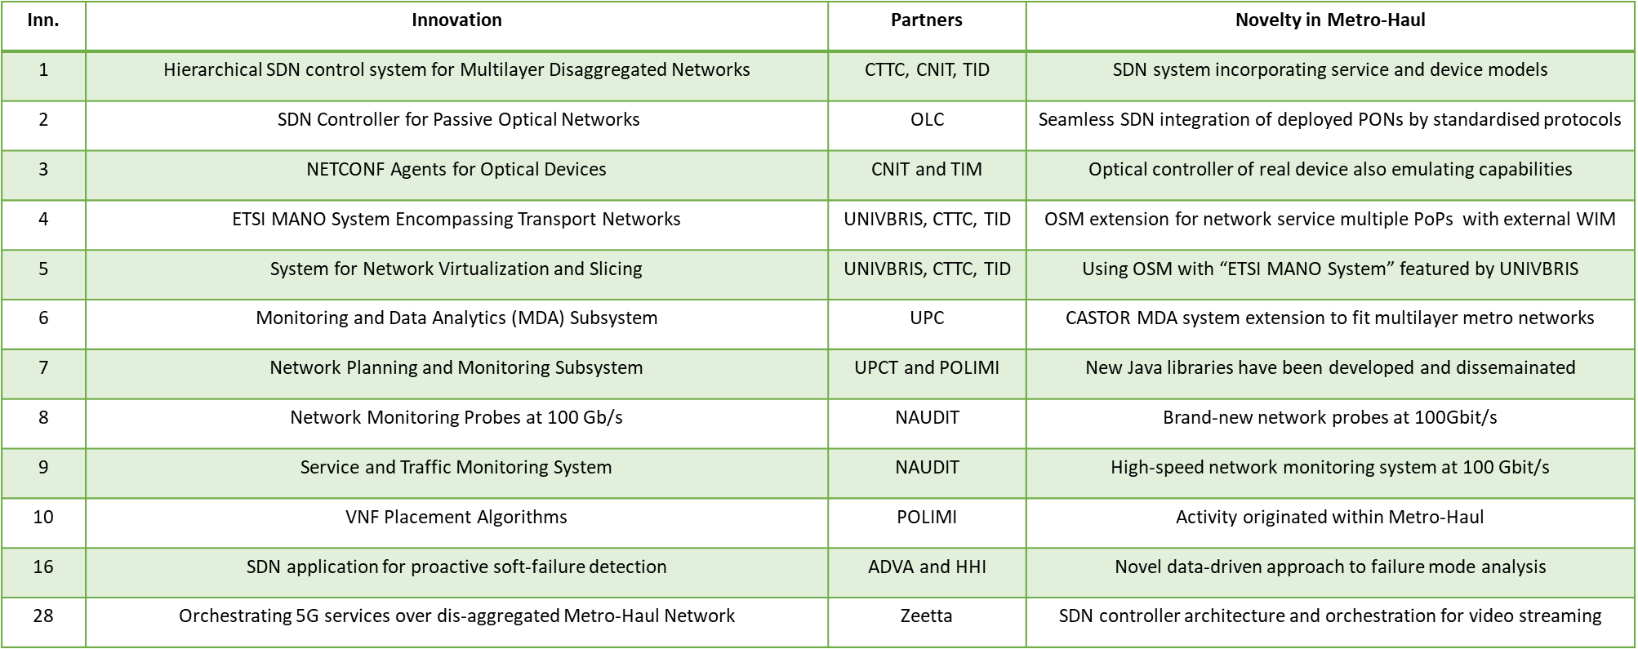
Recommendations from First Period Review
A clear indication (…) which technologies are being developed by the consortium, which were brought by partners and are being enhanced as part of the work and which are solutions existing already (…)
  WP4 components have been listed in D4.1. We identify the contributions from Metro-Haul, see also Innovation in the Y2 periodic report
In all future deliverables the Executive Summary should be short (one page) and comprehensive highlighting the main findings and conclusions of each section.
  Applied the recommendation to D4.2
The scope of current R&D activities especially in WP3 is very wide, the technological choices should be stabilized to make sure that the project objectives will be achieved.
  D4.1 (Y1) explored different architectures and technological solutions. D4.2 (Y2) consolidated and focused on the development and integration of components.
  Open and Standard interfaces have been used in preference to favor interoperability.
  Y2 objectives have been fully achieved.

Slide 5
Second Period Main Achievements (1/2)
Completed Metro-Haul architecture of Control Plane → Control, Orchestration and Management (COM)
Development of a COM prototype
  Specified in terms of Components, that communicate via Protocol Interfaces – D4.2
  Functional, Regression and Integration testing, successful EUCNC demo (June 2019), D5.3
    1) the Parent Controller; 2) the Optical SDN Controller; 3) the OLS controller; 4) the SDN for Passive Optical Networks; 5) the service orchestrator; 6) the system for network virtualization and slicing; 7) the Monitoring and Data Analytics (MDA) subsystem; and 8) the Network Planner.
Algorithmic aspects (algorithms implemented in MDA, Network Planner or External Applications)
  Completion of resource allocation algorithms, for VNF placement and traffic prediction/optimization algorithms.
  Completion of IT and network resource allocation in metro networks for service chains.
  Completion of spectrum defragmentation algorithm for L0.
External applications (that use the COM services)
  Machine learning architectures for fault management in optical Networks, including work on how to combine the METRO network architecture with machine learning platforms,
  A defragmentation application, including the comparison of different defragmentation strategies: keeping the path of optical connections and changing the path of optical connections.

Slide 6
Second Period Main Achievements (2/2)
Service and Traffic Monitoring
  Composed by active and passive probes to monitor the system at packet layer.
  Active network probes for 100 Gbps networks (FPGA card and associated software), together with the definition of a management architecture, including the designed a packet train measurement that works at 100 Gbps in the VCU118 FPGA card and in a Xilinx Ultrascale FPGA card, providing capacity, delay and loss measurements.
Adoption of Machine Learning in Optical Networks
  Leverage on the telemetry innovations of Metro-Haul for Machine Learning applications.
  Traffic matrix generation for network topologies and application of machine learning algorithms to forecast data traffic and optimize the resource allocation of optical WDM networks; Fault detection, etc.
Successful demonstrations to deploy Network Services and Network Slicing over a disaggregated optical network.
  Service orchestration including the selection of functions, of computing and storage resources and the provisioning of connectivity interconnecting such functions to provide the infrastructure of top of which the service runs.
  Integration of the ETSI NFV architecture with SDN Control of the Metro-Haul infrastructure.
  ECOC2018, OFC2019, EUCNC, ONF Connect, ECOC2019
Dissemination activities and Liaisons with Open Source projects

Slide 7
Milestones and Deliverables
MS4.3, “First (alpha) release of METRO-HAUL Control Framework Prototypes” – [COMPLETE]
  List the main components delivered by WP4 to implement the Metro-Haul Control, Orchestration and Management (COM) system as part of the first alpha (internal) release. For each component, a brief description is provided, as well as a list of currently implemented main features and status.
MS4.4, “Second (beta) release of METRO-HAUL Control Framework Prototypes” – [COMPLETE, Sept 2019]
  By agreement, based on the COM components used in the EUCNC demo.
  The milestone has been delayed with regards to the proposed date for two reasons:
    a) due to the delay of D4.2 which listed the different components and evaluated their performance and
    b) EUCNC -- control plane demo (reported in D5.3) – took place in June 2019
D4.2, “Report on Implementations for METRO-HAUL Control for Resource and Service Management” [Deliv. 2019-06-18]
  Reports the final architecture of the METRO-HAUL COM, after successive refinements driven by feedback gathered after implementation and integration activities.
  Reports the status and assessment of the implementation of METRO-HAUL functional components, including control plane validation of relevant performance indicators and tests.
  Each functional component in the COM includes the list of subcomponents and their status and tests.
  Specific key performance indicators (KPIs) in which the component is involved are defined and measured.
  The interfaces connecting functional components of the COM are defined in terms of functions with regard to requirements in D4.1 and new functions
  Delay due to: OFC conference, plenary meeting in Barcelona, longer than expected implementations and the need to report KPIs of each component.

Slide 8
WP4 Objective Assessment (1/3)
Objective 1 | To identify control plane requirements and related KPIs from a set of functional and requirements, starting from a set of targeted METRO-HAUL services and use cases.
Status: Complete (First Period) | Covered in Task 4.1 Link with WP2 services and use cases Defined System-specific KPIs for the control plane (on a per component basis, see D4.1) Cover the dynamic provisioning of targeted Metro-Haul services
Objective 2 | To define the network control and management architecture for an abstracted METRO-HAUL network and infrastructure, including service management aspects as well as network and system monitoring.
Status: Complete | Covered in Task 4.1 and Task 4.3, reported in D4.2 Conceived to enable the dynamic deployment of services For the Metro-Haul data plane infrastructure (focus on Optical Interfaces) with a generic node with compute, storage and networking resources. Main traits Layered architecture (Network and Resource Control, Service Orchestration, Slicing) Extending and Integrating SDN (ONF) and NFV MANO (ETSI) architectures

Slide 9
WP4 Objective Assessment (2/3)
Objective 3 | To define information and data models, covering from devices to systems (nodes), and to provide as inputs to standards defining organizations (SDO) in cooperation with WP6.
Status: Target Complete, Ongoing Extensions | Covered in Task 4.2 Adoption and Extension of relevant models for the systematic modeling of Metro-Haul optical devices. Year 2 has been focusing on, mainly, OpenConfig Terminal Devices and OpenROADM devices. TAPI Connectivity and Topology services IETF Layer 2 Service Model (L2SM) Collaboration with ONF ODTN, TAPI Systematic use of Monitoring and Data Analytics Interfaces Contributions to OpenROADM, OpenConfig, IETF (cfr. WP6) Open Source Contributions

Slide 10
WP4 Objective Assessment (3/3)
Objective 4 | To develop a control plane prototype apt for integrated demonstration with node and network prototypes as implemented within other work-packages, apt for integrated demonstration within WP5, including prototype an enhanced SDN controller with a monitoring framework, ETSI/MANO stack and a multi-tenancy/slicing layer
Status: Ongoing | Relies on Architecture and Interfaces defined in Task 4.1, effort Covered in Task 4.2 and Task 4.3 At the end of the second period, COM components meet the targeted requirements and usable, have been demonstrated in key events (e.g. ECOC2018, OFC2019, EUCNC, ECOC2019) and are continuously improved on. Code has already been contributed to Upstream Open Source Projects. Evaluation and Integration Deliverable D4.2 reports the Implementation of the components ONGOING WORK (Y3) Integration and development in support of WP5 Field trials and demos. Further work on aspects related to network virtualization and slicing.

Slide 11
COM Target: Support deploying functions across Metro-Haul nodes
VNF
VM
NFVI-PoP
VNF
VM
VM
NFVI-PoP
Layer 2 / Layer 3
Switching (OpenFlow)
Disaggregated Optical Transport Network (Optical Domain)

Slide 12
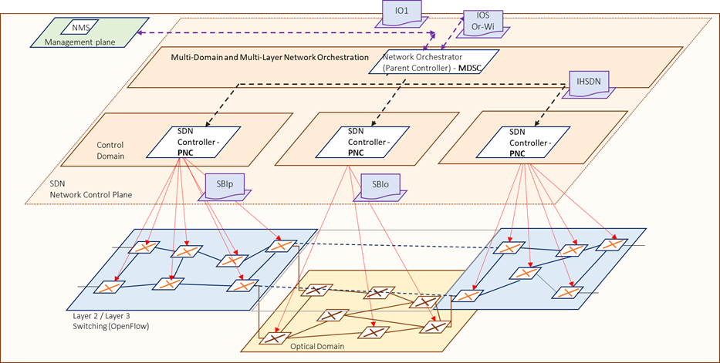
COM: Metro-Haul Service Platform (Integrated)
The Network Function Virtualization (NFV) Orchestrator (NFVO) that performs Service Orchestration (involving the functional split of the service into/amongst different VNFs and their logical interconnection) and Resource Orchestration dealing with the allocation of resources to support the VNFs and the logical links.
  Used to provision Network Services (NS) that usually entail VNFs deployed in multiple Metro-Haul nodes;
The WAN Infrastructure Manager (WIM) and Hierarchical SDN
  Responsible for provisioning of connectivity paths between VNFs.
  The WIM architecture is hierarchical and consists of a Software Defined Networking (SDN) controller for every technology domain.
The Monitoring and Data Analytics (MDA),
  Responsible for implementing autonomic networking.
  Capability to do measurements on the data plane and for generating data records that are collected and analysed by the MDA subsystem to discover patterns (knowledge) from the data.
The Network Planner,
  Responsible for optimizing the resource allocation in the optical metro network to effectively provision services featured by heterogeneous requirements.
  This task comprises the provisioning of VNF in specific METRO-HAUL nodes and the allocation of network resources.
NFVI-PoP

Slide 13
Component List
Components | Lead Partner | Comments
Parent SDN Controller | TID | Interfaces with OSM and SDN
ONOS Optical Controller | CTTC | Optical Control for OpenConfig terminal devices and OpenROADMs nodes
ONOS TAPI 2.1 SBI Driver | TID | Used by the Parent controller to request services by the optical controller.
ONOS OC Driver | CTTC+CNIT | Driver implemented in ONOS as an SBI , using generic NETCONF Subsystem
ONOS OpenROADM Driver | CTTC+CNIT | Driver implemented in ONOS as an SBI , using generic NETCONF Subsystem
Open Line System Controller | ADVA | Optical Control for proprietary domains
Generic OpenConfig Agent | CNIT, CTTC | OpenConfig emulated driver, based on ConfD agent software
Generic OpenROADM Agent | TIM, CTTC | OpenROADM emulated driver, based on Net2peerm ConfD agent software
SDN Control of PON | OLC | SDN Control of PON networks with std. interfaces
Service and Network monitoring | NAUDIT | Active and Passive Probes at 100 Gbps.
OSM with WIM Plugin | Bristol +TID | Used for the interaction OSM / parent controller
MDA Controller | UPC | Retrieves data from agents and reacts accordingly.
MDA Agent | UPC | Emulated at the OpenConfig Devices
Front-end Net2Plan interfaces | UPCT | Net2plan for VNF instantiation and flow provision
Machine-learning algorithmic sub-module (Back-end) | PoliMi | Use machine-learning and net2plan for network resource allocation
Machine-learning algorithmic sub-module (Back-end) | UC3M | Use machine-learning and net2plan for network resource allocation
Seetec Application Orchestrator | Seetec | Triggers the workflow by requesting a service composed of interconnected VNFs.
Fault Management application | ADVA | Use Machine Learning for Fault mgmt. over ONOS.
Defragmentation application | Nokia IT | Algorithms for defragmentation

Slide 14
Metro-Haul Key Innovations
SDN Control of disaggregated optical networks
  Supporting partial or full disaggregation
Deploying 5G services and Virtualized Network Functions across multi-layer disaggregated networks
  Including advanced algorithms for placement that take into account the status of the optical resources
Extension to Open Source Mano (OSM) to integrate WIM (transport networks)
  Beyond intra-datacenter deployments
Machine Learning applications for Control of Optical Networks

Slide 15
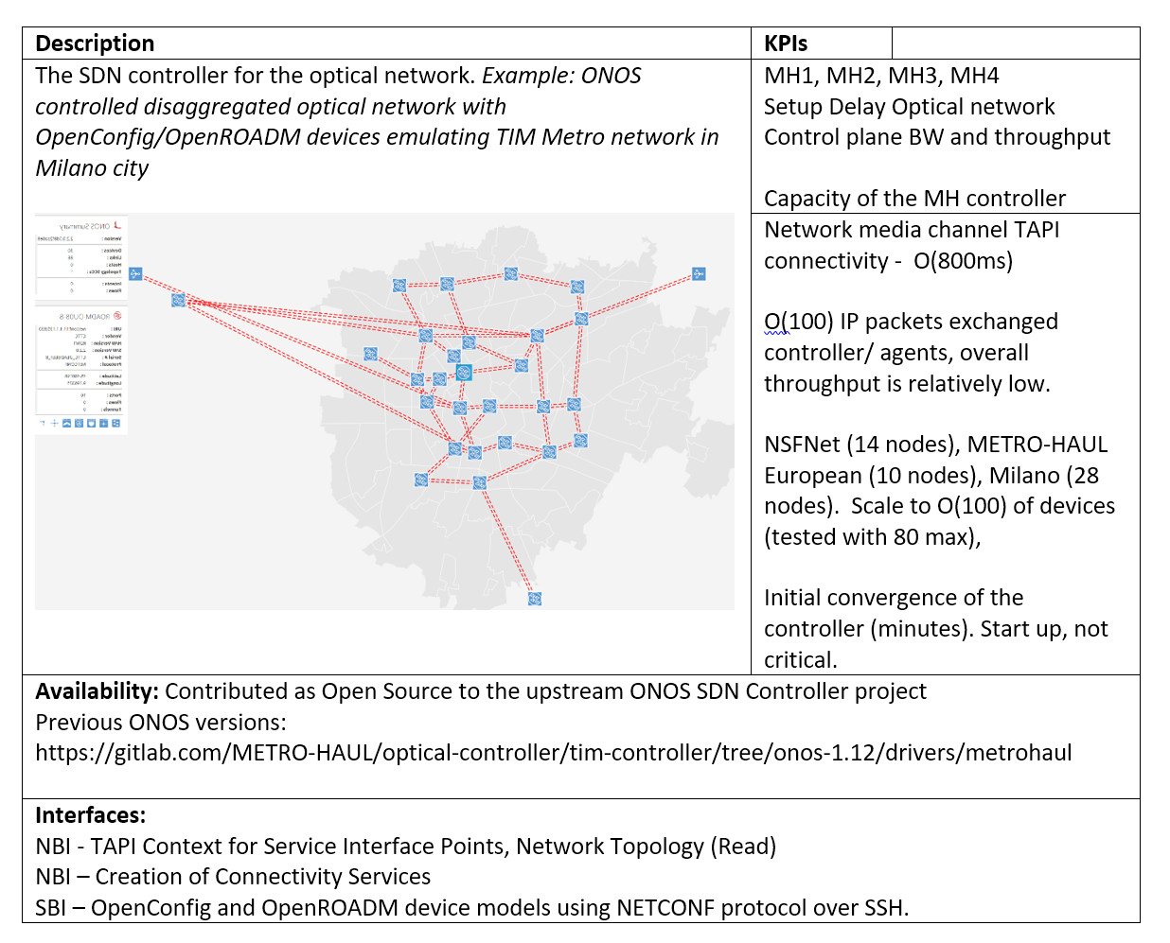
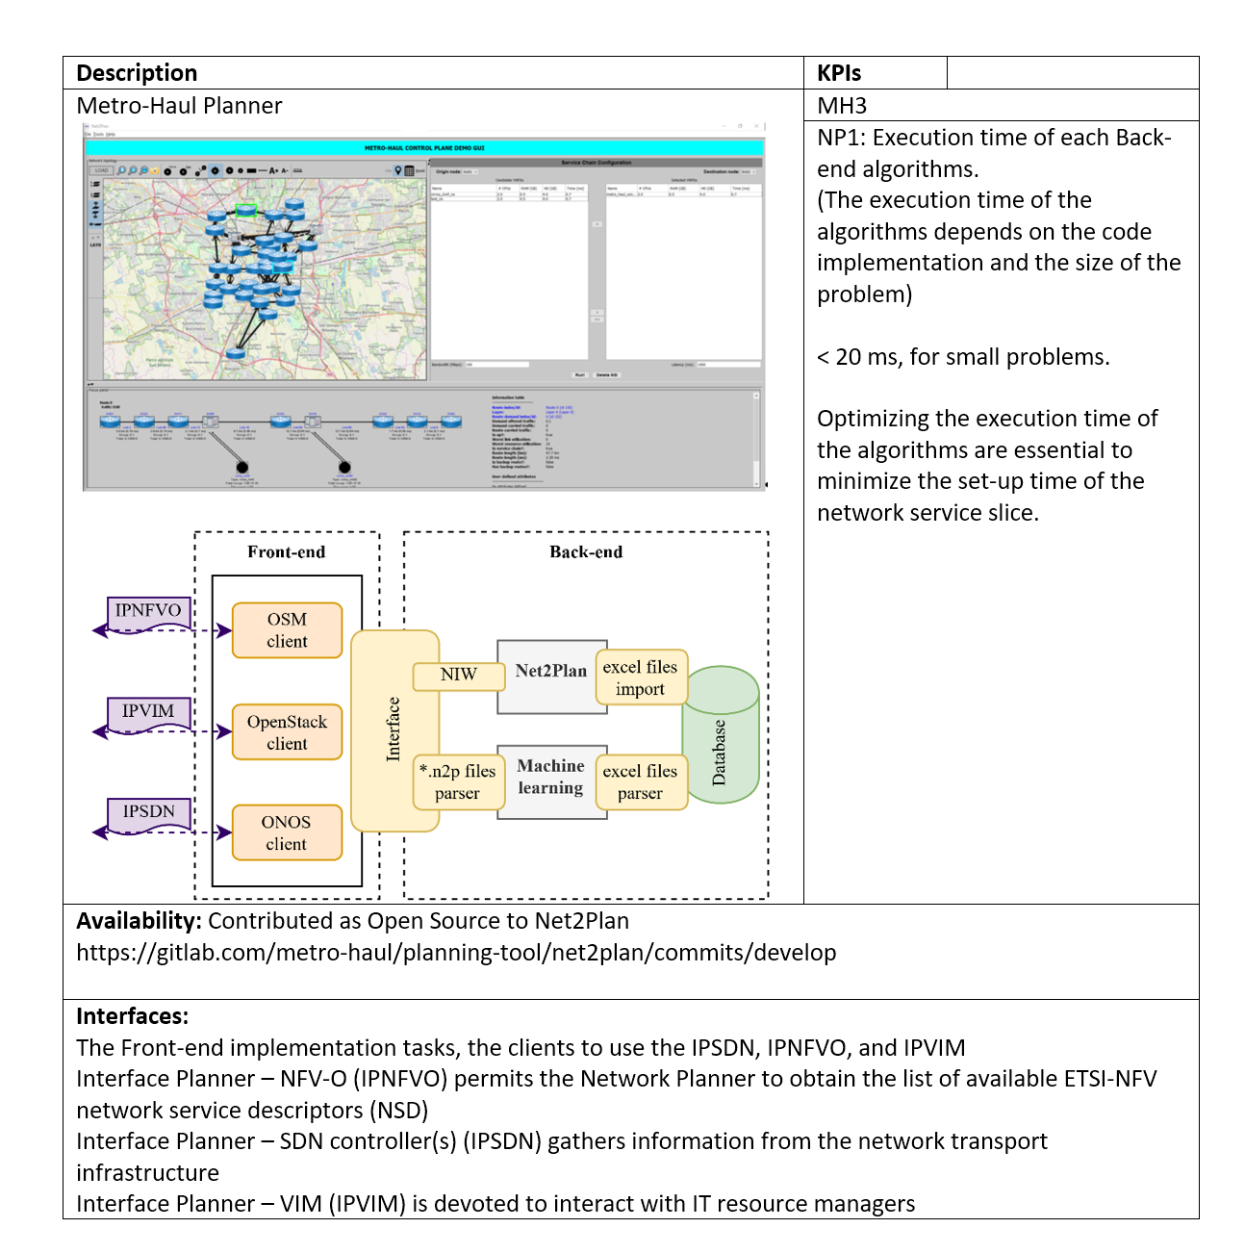
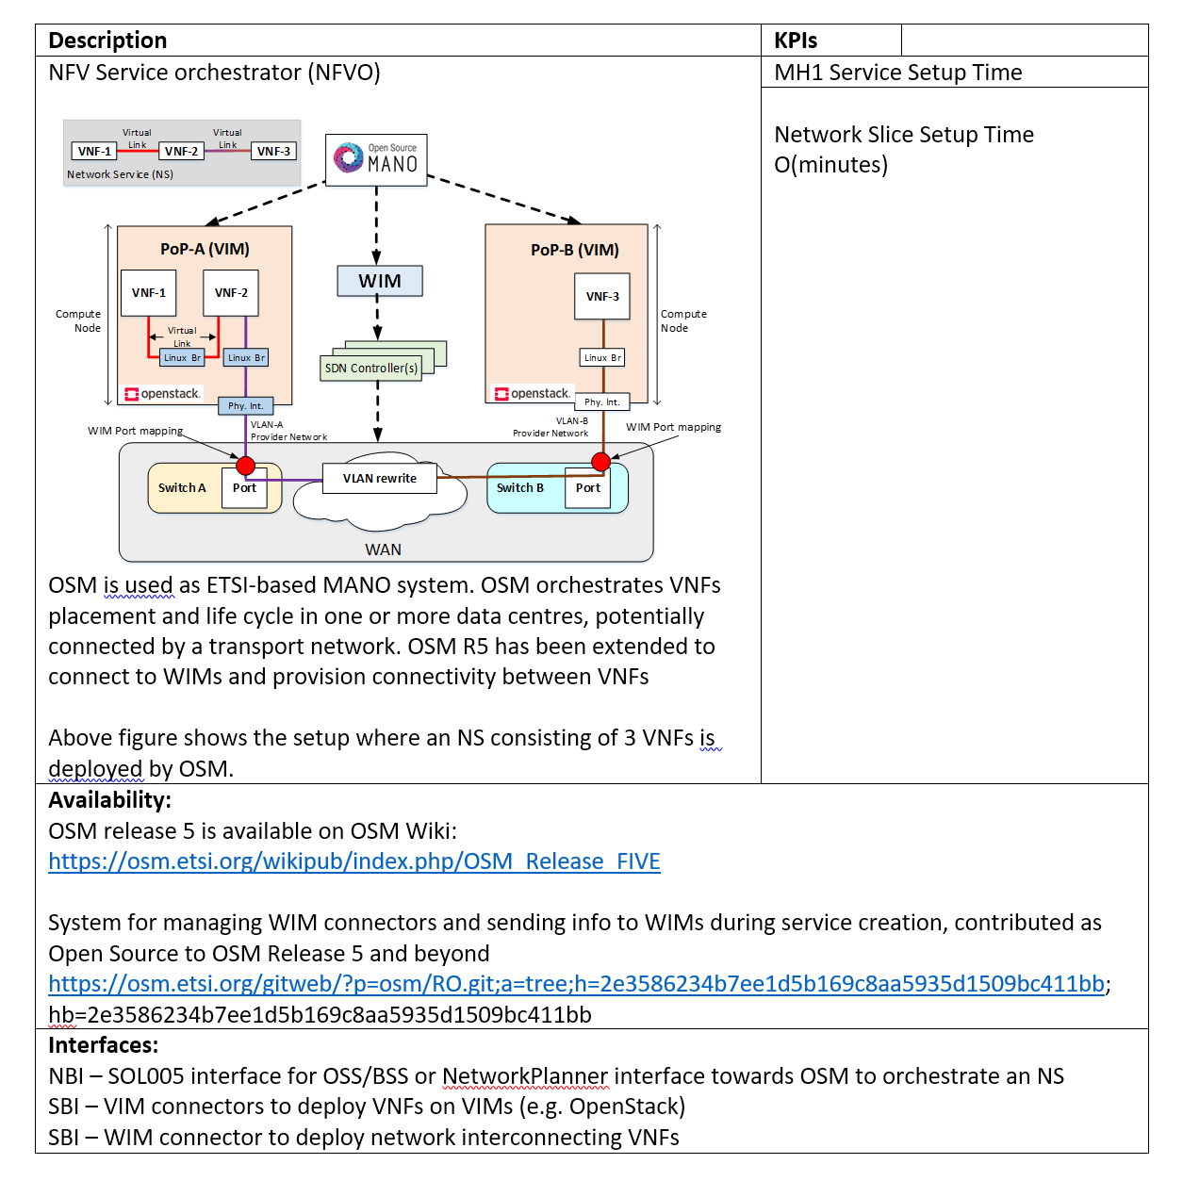
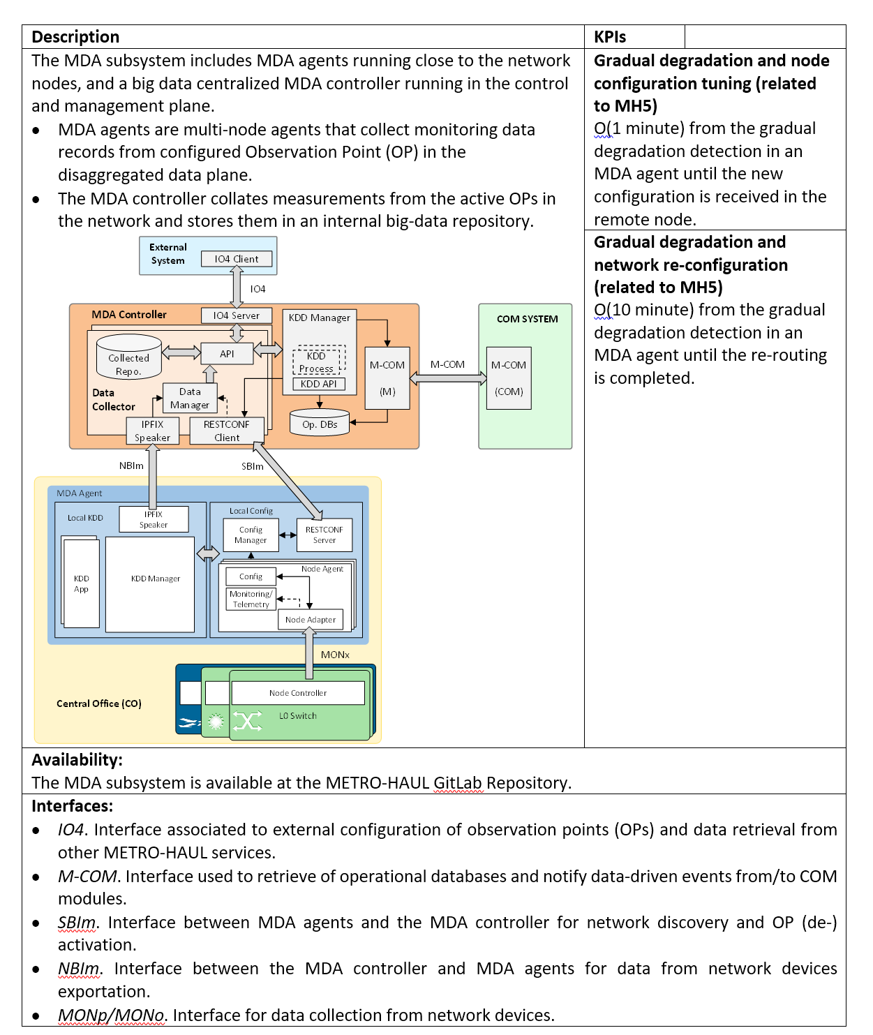
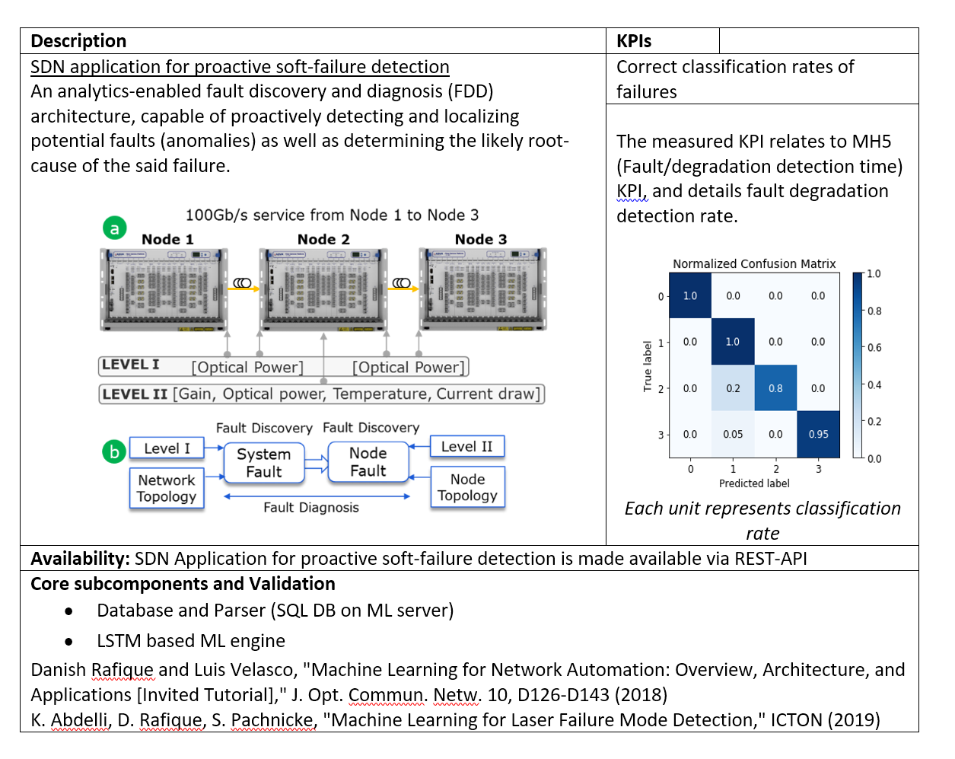
Component(s) : see D4.2

Slide 16
Control Plane demo: Integration and validation (see WP5)

Slide 17
WP4 Impact

Slide 18
WP4 impact: Scientific papers and demonstrations
Large number of peer-reviewed conference papers (cfr. WP6)
  [invited] Giorgetti, A., Casellas, R., Morro, R., et al., “ONOS-controlled Disaggregated Optical Networks”, in Proceedings of the Optical Networking and Communication Conference & Exhibition (OFC), 3-7 March 2019, San Diego, CA (USA). 2019
EUCNC2019 Papers, Valencia, Spain, June 2019
  Sebastian Troia et al., “Machine Learning-assisted Planning and Provisioning for SDN/NFV-enabled Metropolitan Networks”, joint collaboration with key results from the Planner Task force
  Miquel Garrich, et al., “Network Optimization as a Service with Net2Plan”
Journal papers (selected, based on relevance and/or involving multiple partners)
  Journal of Lightwave Technology, “Control, management, and orchestration of optical networks: Evolution, trends, and challenges”
  Journal of Lightwave Technology, “Multi-layer service provisioning over resilient Software-Defined partially disaggregated networks”
  IEEE Network, “Monitoring and Data Analytics for Optical Networking: Benefits, Architectures, and Use Cases”
  Photonic Network Communications Journal, “A control and management architecture supporting autonomic NFV services”
  Elsevier Optical Switching and Networking, “The Dichotomy of Distributed and Centralized Control: METRO-HAUL, when control planes collide for 5G networks”
  IEEE Trans. Network and Service Management, “Machine Learning-Based Routing and Wavelength Assignment in Software-Defined Optical Networks”
  Contribution to the "'Cloud-Native and Verticals’ services'" white paper published by the 5G-PPP Working group on Software Networks officially released on Sept 3rd, with Metro-Haul use cases and key technologies highlighted, including Video Security for Smart Cities: Real-time low-latency object tracking and Crowdsourced video broadcasts.

Slide 19
WP4 impact: dissemination and demonstrations
Selected Key Demonstrations
  ECOC2018, R. Morro et al., “Automated End to End Carrier Ethernet Provisioning over a Disaggregated WDM Metro Network with a Hierarchical SDN Control and Monitoring Platform”.
  OFC2019, A. Campanella et al., “ODTN: Open Disaggregated Transport Network. Discovery and control of a disaggregated optical network through open source software and open APIs”.
  OFC2019, P. R. Esmenats et al., “Autonomic NFV Network Services on Top of Disaggregated Optical Metro Networks”
  OFC2019,S. Troia et al “Dynamic Virtual Network Function Placement over a Software-Defined Optical Network”
  ECOC2019 Invited ODTN/Metro-Haul demo
EUCNC 2019 demonstrations:
  METRO-HAUL Main control plane demo, “Leveraging multi-layer network slicing for improving public safety”,
  Joint 5G-Picture and METRO-HAUL, “Active Optical Metro Transport solution”

Slide 20
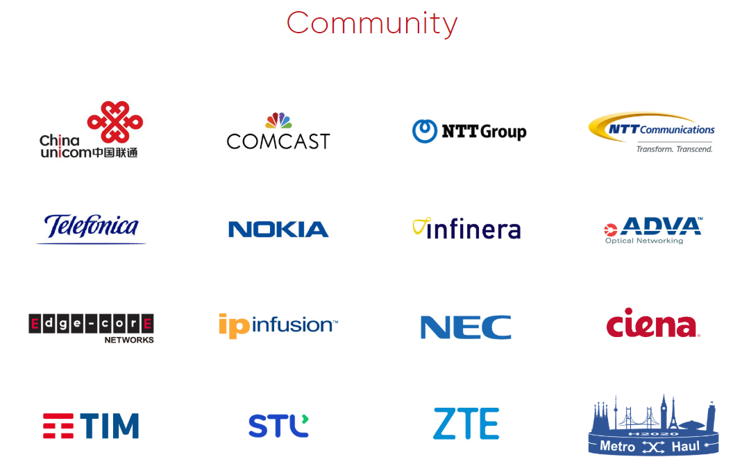
WP4 Impact: Liaisons with Other Projects (ODTN)
Metro-Haul partners are co-founding and participant members of the Open Networking Foundation (ONF) Open Disaggregated Transport Networks (ODTN) project,
  Participation in Use Case, Testing and Software developments teams.
  Joint demonstrations ODTN / Metro-Haul in uttermost important events such as OFC 2019, ECOC 2019 or ONF Connect 2019
  Optical vendors adopting ODTN/Metro-Haul solutions
  Wider reach and impact.
Metro-Haul has provided applications and drivers, which are now part of the ONOS official Open Source software distribution.
  Parts of the ODTN application.
  OpenROADM v2.2, Lumentum devices and OpenConfig transceivers device drivers.
  Extensions to NBI Interfaces.
  Integrated Coriant/Groove drivers into the optical network controller [ ECOC Demo ].
  Geo-referenced metro network [ control plane demo at EUCNC ].
  Map of an Italian city and a new icon for ROADM devices.
ONF recognized Metro-Haul contributions to ODTN
Metro-Haul members have participated in ONF Connect as ODTN Track Co-lead (TPC)
  https://www.opennetworking.org/onf-connect-2019/

Slide 21
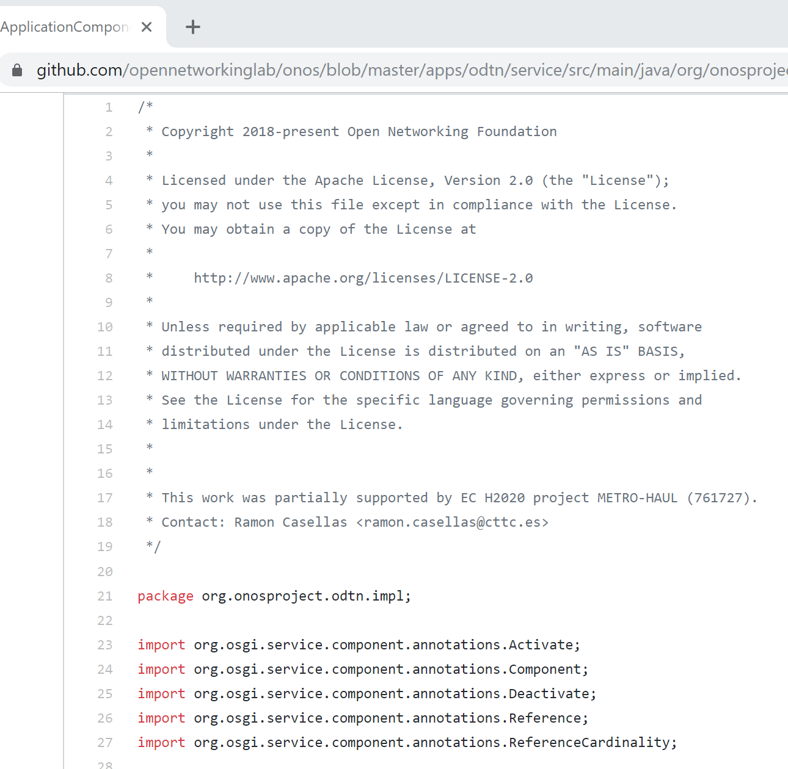
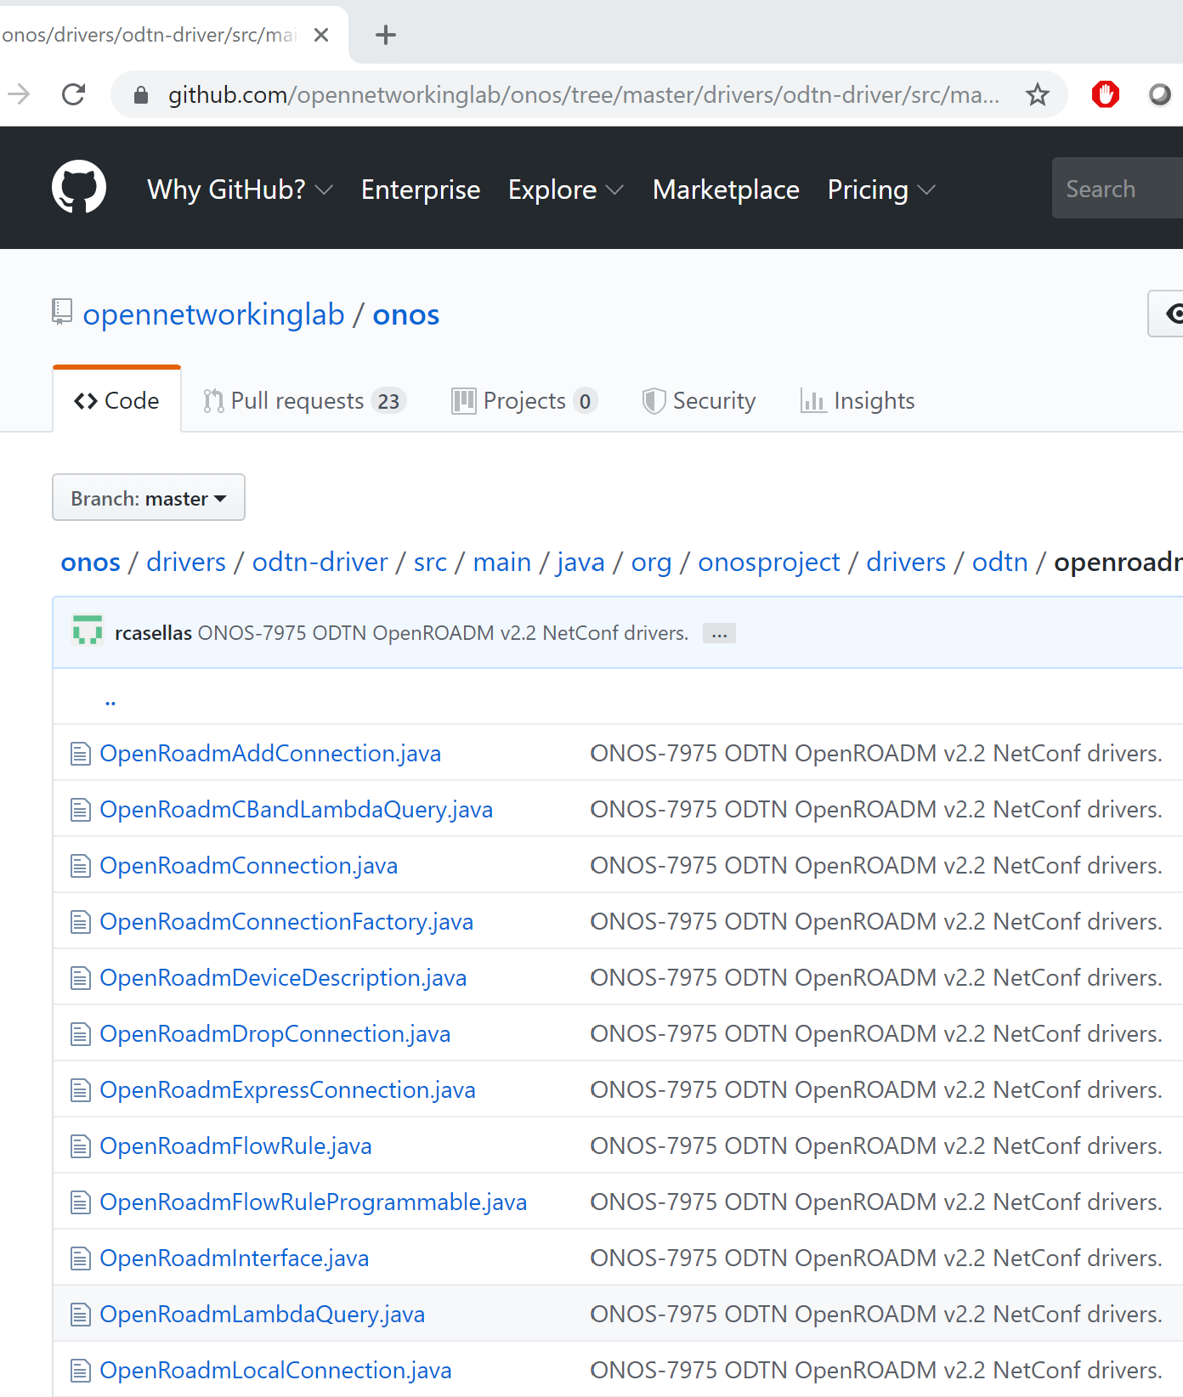
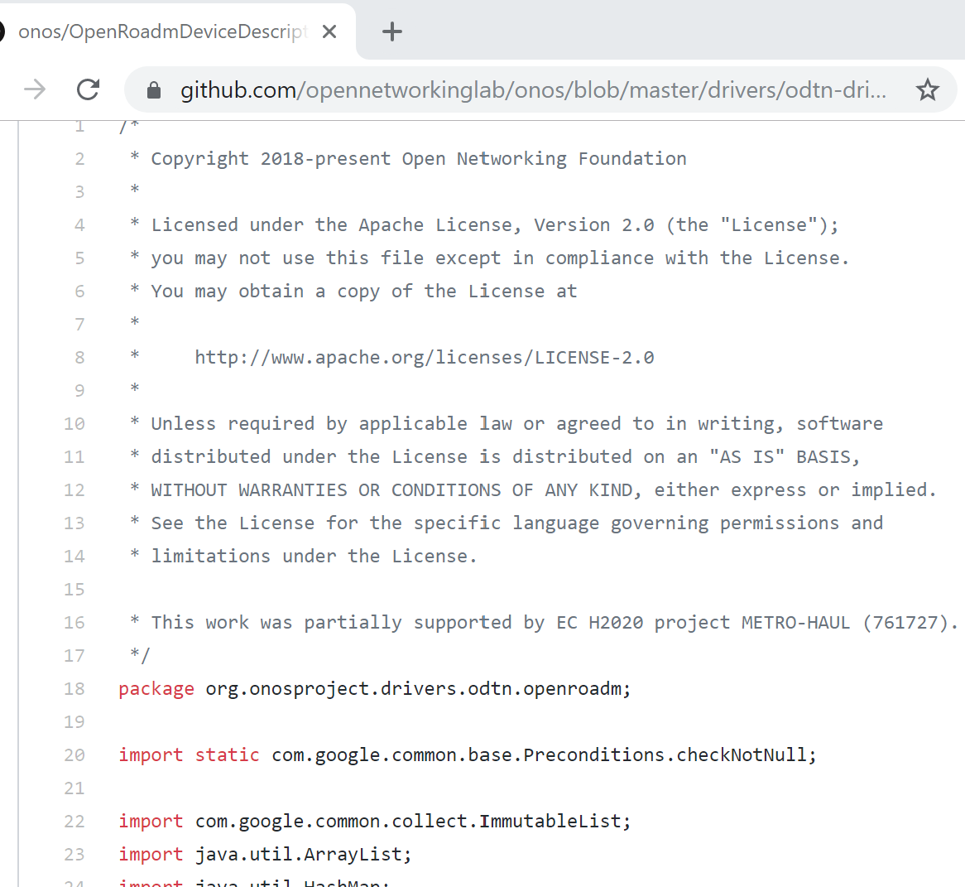
WP4 Impact: Liaisons with Other Projects (ODTN)

Slide 22
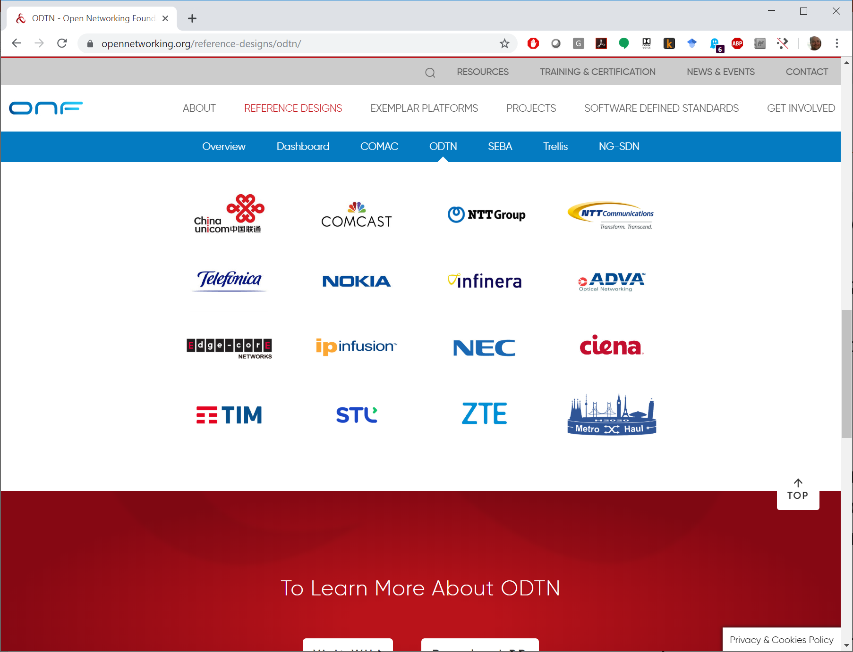
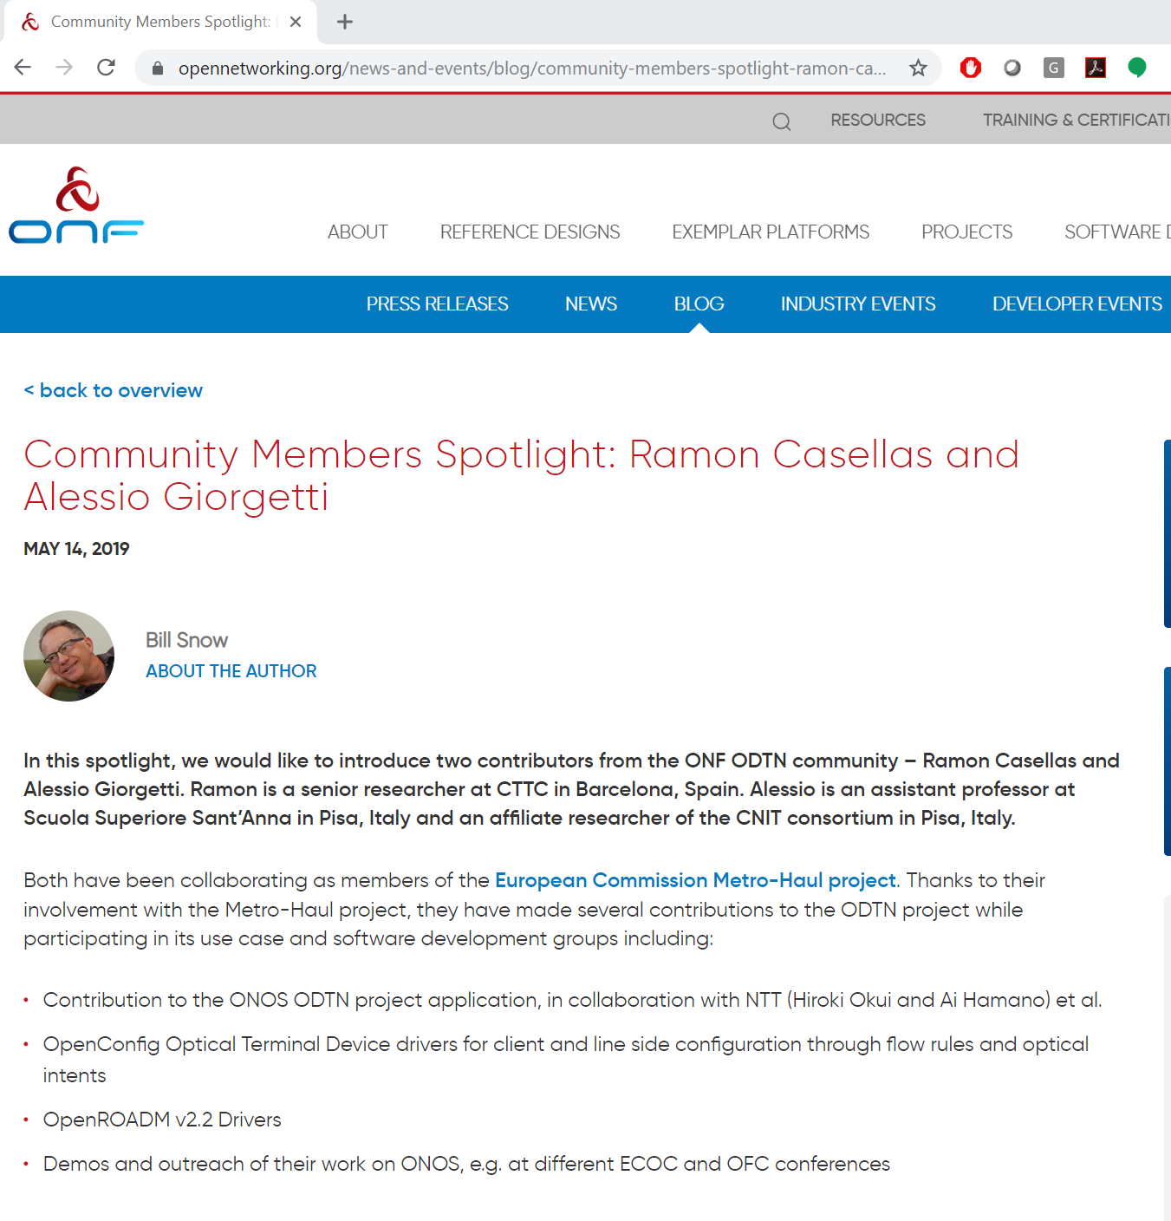
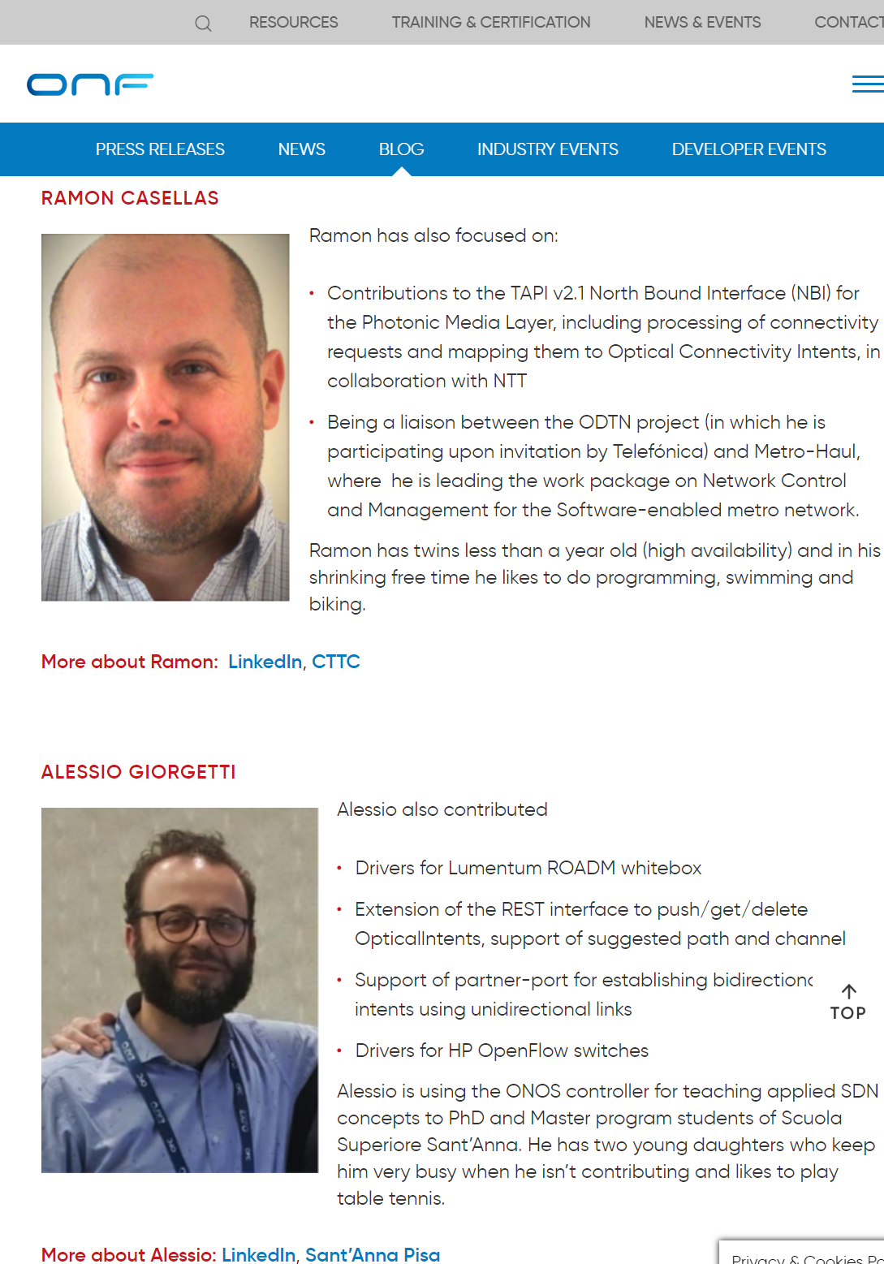
WP4 Impact: Liaisons with Other Projects (ODTN)
https://www.opennetworking.org/news-and-events/blog/community-members-spotlight-ramon-casellas-and-alessio-giorgetti/

Slide 23
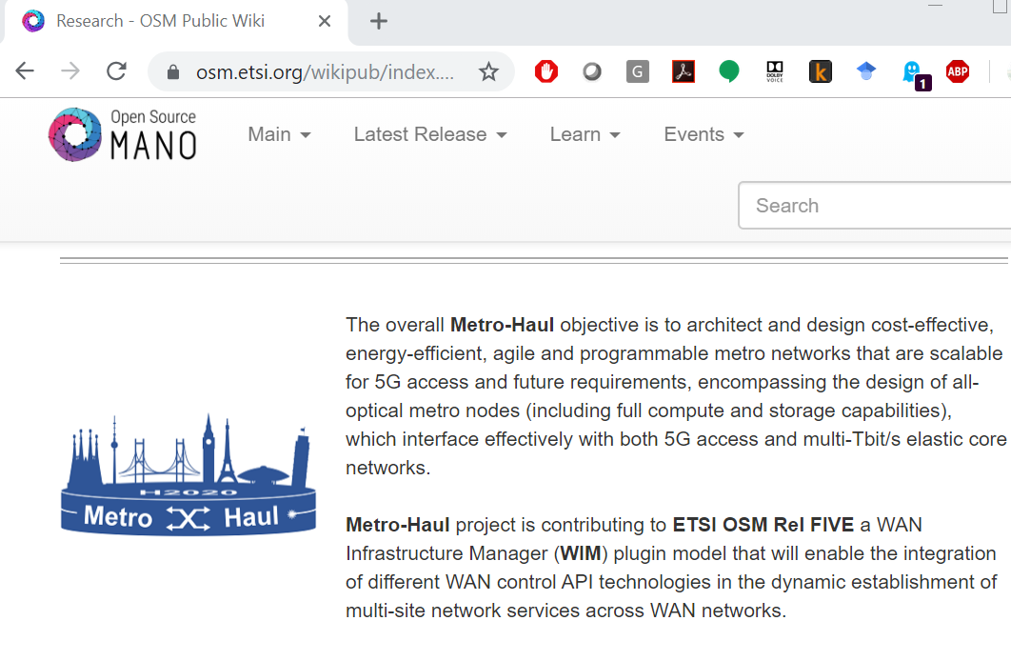
WP4 Impact: Liaisons with Other Projects (OSM)
Cooperation with the Open Source Mano (OSM) project community.
  OSM Hackfest in CTTC, Barcelona, Spain,
    February 2019
  Metro-Haul presented during OSM 5G Day
OSM Open Source Contributions:
  Members of the project submitted features that have been included in OSM release 5 (WIM)
  Implementation of the WIM connector for OSM
    Layer 2 Service Model (L2SM) WIM Connector for OSM

Slide 24
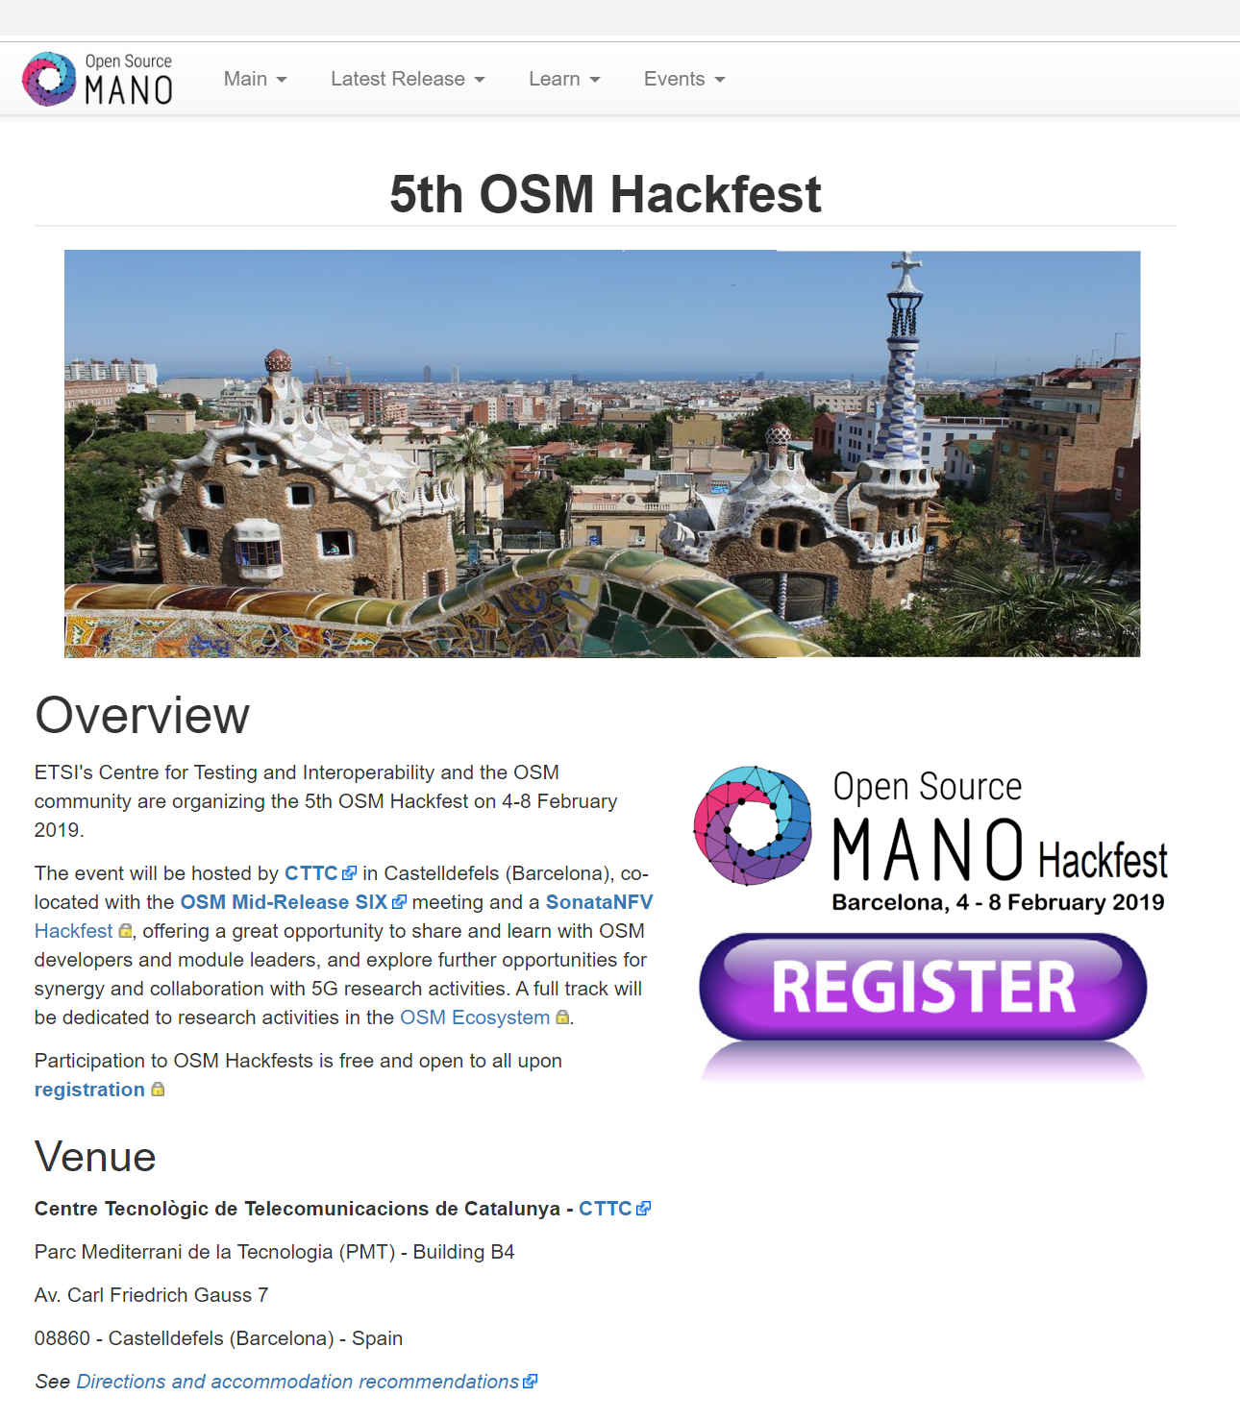
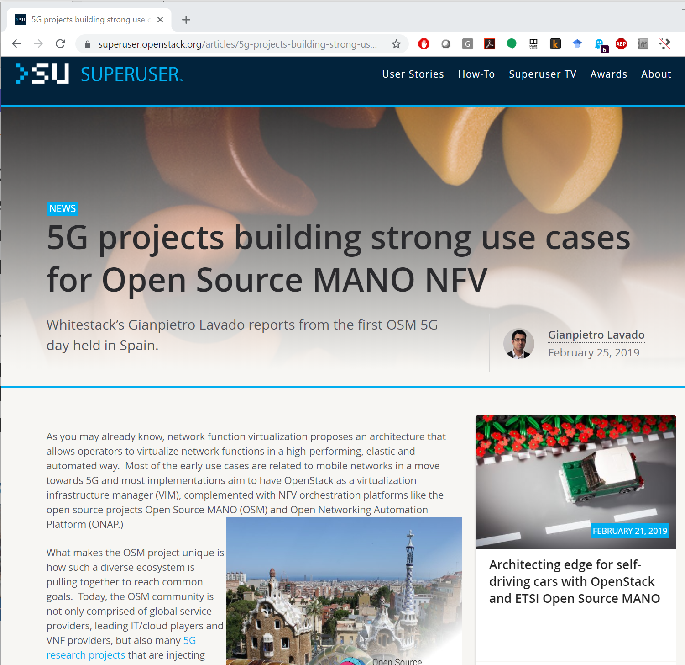
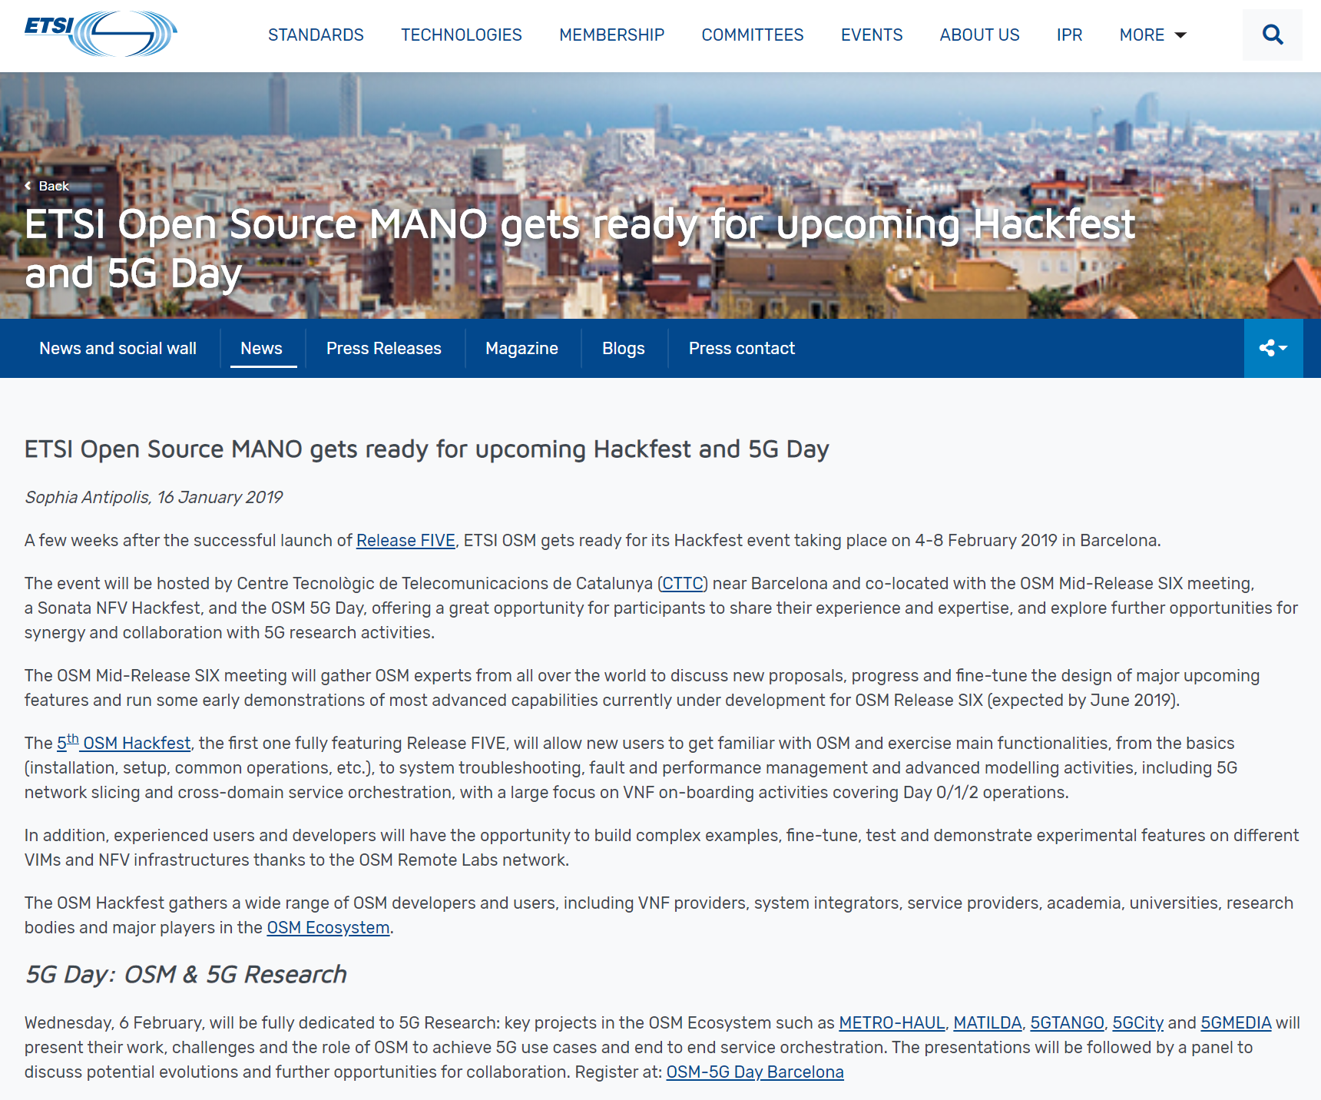
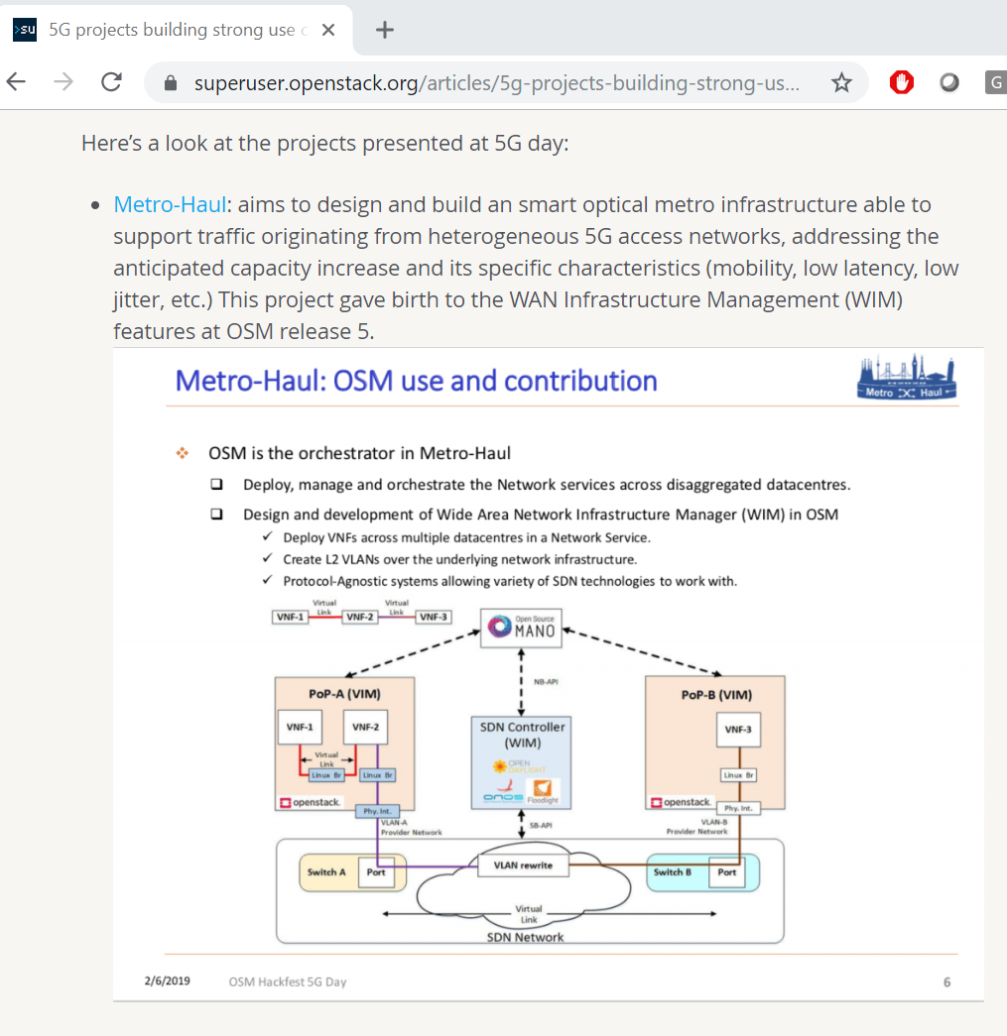
WP4 Impact: Liaisons with Other Projects (OSM)

Slide 25
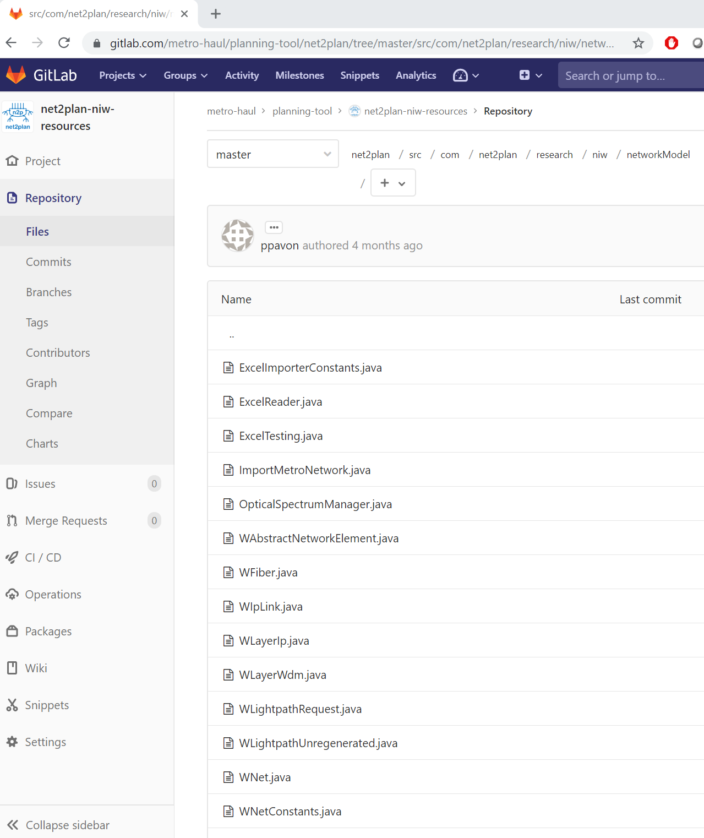
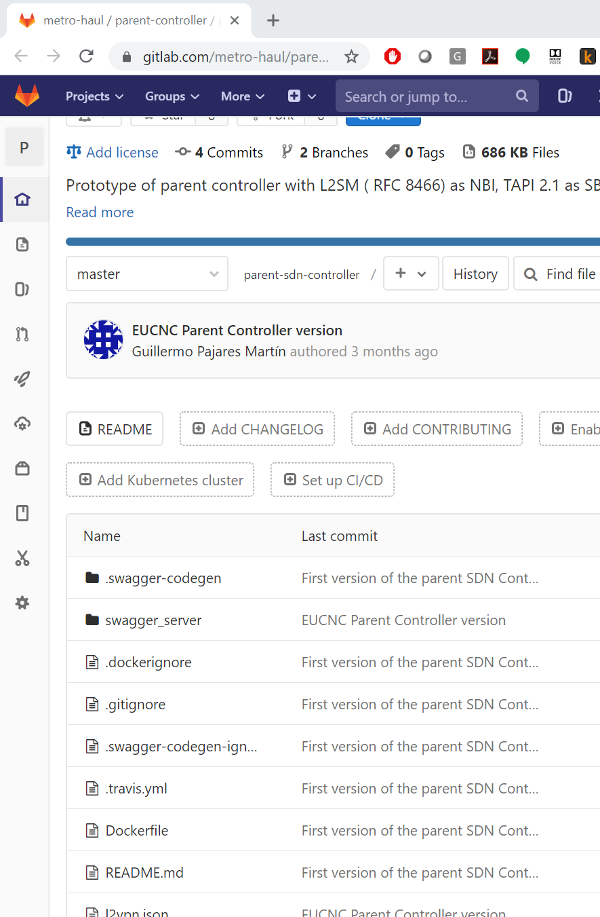
WP4 Impact: Open Source Contributions
Internal Gitlab Repository
Component | License | Lead Partner | Open Source Project | Further information | Release | Models and SDOs
WIM OSM | Apache 2.0 | Univ. Bristol | osm.etsi.org | D4.1, D4.2 | OSM Rel. 5 | ETSI NFV
ONOS ODTN | Apache 2.0 | CTTC, CNIT | https://wiki.onosproject.org/display/ODTN/ODTN | D4.1, D4.2 | 2.0 master | OpenConfig OpenROADM ONF TAPI
NET2PLAN | LGPLv3 | UPCT | https://github.com/girtel/Net2Plan/releases | http://www.net2plan.com/ | master | Several
IETF L2SM WIM Connector for OSM | Apache 2.0 | TID | osm.etsi.org | D4.2 | master | IETF L2SM Yang model
Contributions to Upstream OSS projects
Notes:
https://osm.etsi.org/gitweb/?p=osm/RO.git;a=blob_plain;f=osm_ro/wim/wimconn_ietfl2vpn.py;hb=73ce6ce177937bac038f892e75dfe5a95dc8feeb

Slide 26
WP4 Conclusions and Take away messages
Big picture: WP4 built a Control, Orchestration and Management (COM) system,
  Extending ONOS SDN Controller for disaggregated optical networks, OSM for NFV across transport networks,
  Leveraging on Monitoring, Data Analytics, and Machine Learning,
  Enabling state of art algorithms for function placement, Service Function Chaining, …
  Implemented, Integrated and Demonstrated
WP4 tasks are progressing as planned
  Macroscopically, there are no deviations in terms of time, no corrective actions are needed.
  Slight overspending (~ 120%)
Second year project objectives have been met successfully.
  Implementation, evaluation and Integration of components.
  Strong impact in terms of publications, demos, collaborations,…

Slide 27
Next Steps and ongoing work. Y3 Will cover
Further development of WP4 components in support of WP5 demonstrations
  Integration tests between key components
  Integration with available hardware components
    Hardware specific issues and limitations.
    Preliminary tests have passed.
    Need to focus on WP5 actual demo scenarios
Further work Network virtualization and network slicing
  Year 1 – 2 has covered network slicing over the Metro-Haul infrastructure supported as Network Services (VNF-FGs)
  Year 3 addresses, in addition to VNF-FGs, transport network virtualization, sharing and partitioning
Plenary meeting in Pisa (Oct 2019) to close scope and targets.

Slide 28

Thank you. Questions?
Metro-Haul Second Period Report Review - WP4 Status
http://metro-haul.eu

Slide 29
Backup and Supporting Slides

Slide 30
Current Control, Orch. & Mgmt (COM) targeted services ~ NBI
SDN services (IO1)
  Connectivity provisioning between MAC endpoints
  Connectivity provisioning between IP addresses (ex. VXLAN VTEP at each data center node)
  Connectivity provisioning between Optical Layer ports (media channels)
  Configuration of PON
  SDN as WIM
VIM services (IO2) – Direct OpenStack API
  Selected multi-VIM option (one dedicated VIM per Metro-Haul node)
  Instantiation of Virtual Machines (VMs) and VNFs in specific Metro-Haul nodes; ability to configure VMs and attach virtual NICs to soft switches.
    OpenStack selected as main VIM for development and testbeds (not excluding e.g. OpenVIM, etc.)
    OpenStack → Keystone, Glance, Nova, Neutron (ML2) by default
ETSI/NFV Network Service Provisioning – Slicing (IO3)
  Slicing considered as a set of interconnected VNFs as first step.
  Connectivity provisioning between Virtual Machines / Virtualized Network Functions
  Admits a Network Service Descriptor (NSD) to be deployed.
  Extend Architecture to include PNFs and VNFs (ex. PNFs are physically attached to packet switches in Metro-Haul nodes)
Monitoring and Data analytics (IO4)
  Monitoring Services
Notes:
Having a single centralized VIM could raise issues on scalability, and delays / latencies in service deployments, for example, when having to transfer large volumes of data.

Slide 31
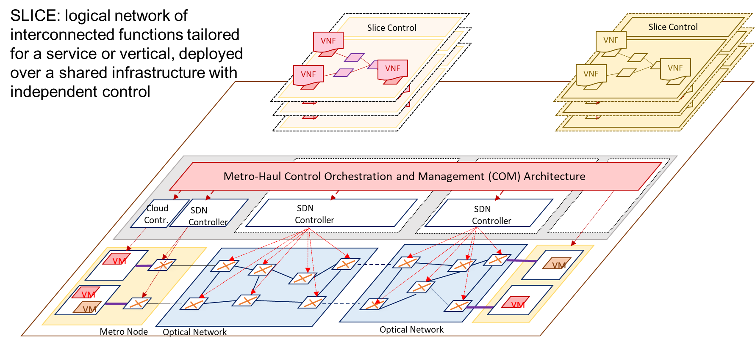
Supporting Slicing and Multitenancy

Slide 32
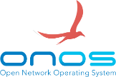
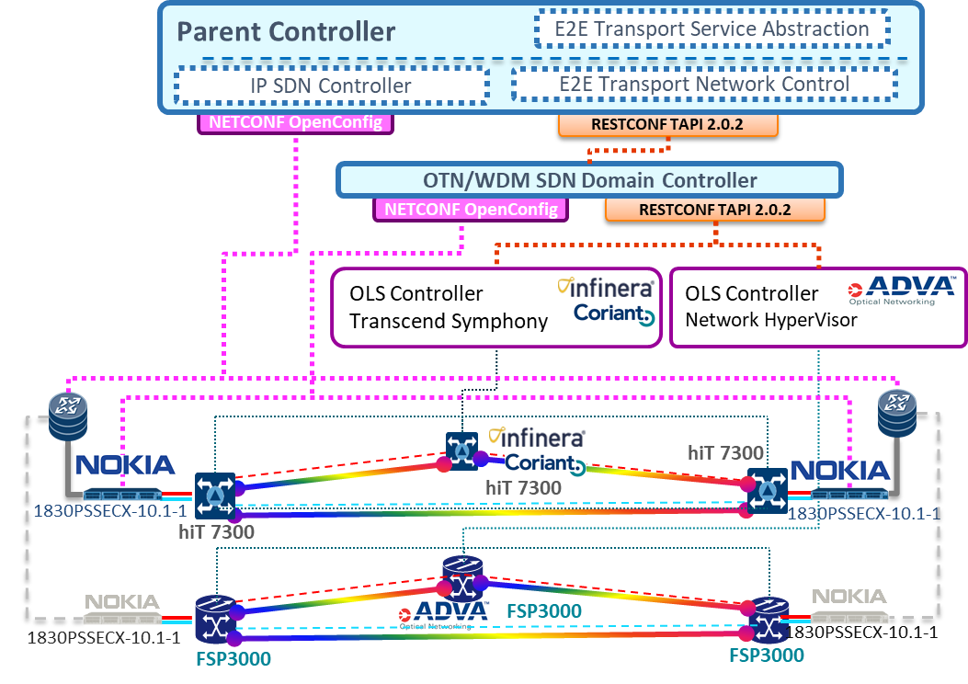
Network Orchestration: packet over optical SDN
Network orchestrator handles E2E network provisioning across L0-3 between the local DC endpoints
Also orchestrates sub-domain controllers for packet/optical
Optical network controller to manage OpenConfig / OpenROADM devices
Also control other devices with
registered YANG models
Packet controller leveraging existing solutions (e.g., control of OpenFlow switches)
Can be extended to abstracted devices (e.g. PON as a switch)

Slide 33
Metro-Haul Service Platform: Extending ETSI NFV MANO
Deploy VNFs across distributed DCs, and generate underlying L2 connectivity
Use network service descriptors to instantiate the chains through OSM
Slicing demonstrated by provisioning and abstracting independent service chains over the same infrastructure
Central NFVO based on OSM to orchestrate VIM/WIM for joint IT/Network service provisioning
Metro-Haul is an active contributor to standardizing the NFVO-WIM interface (particularly for optical network aspects not covered in L2/L3 management)
Dedicated VIM per compute node (OpenStack)
NFVI-PoP

Slide 34
Metro-Haul Service Platform: MDA and Planner
Planner subsystem based on open-source Net2Plan framework
Integration with WIM/OSM for topology and service data retrieval
Implements NFV-over-IP-over-WDM library for resource optimization in deployment of network services
Optimized placement of distributed VNFs
Traffic-prediction based setup of lightpaths
Centralized MANO, to promote better integration with monitoring/planning activities
MDA controller implements interfaces to WIM/OSM for anomaly/degradation detection, as well as planning/reconfiguration actions
  Anomaly/degradation detection for preventive reconfiguration (e.g. modulation format adjusment, traffic re-routing)
  Traffic-monitoring based data analytics for predictive optimization of resources

